Slide 1
Taking One for the Team: Trading Overhead and Blocking for Optimal Critical-Section Granularity with a Shared GPU
Motivation
Access Model
Optimal Algorithm
Evaluation
Future Work
Tanya Amert |  | Catherine E. Nemitz
Carleton College |  | Davidson College

Slide 2
Taking One for the Team: Trading Overhead and Blocking for Optimal Critical-Section Granularity with a Shared GPU
Motivation
Access Model
Optimal Algorithm
Evaluation
Future Work

Slide 3
GPU Sharing
Motivation
Access Model
Optimal Algorithm
Evaluation
Future Work
Taking One for the Team: Trading Overhead and Blocking for Optimal Critical-Section Granularity with a Shared GPU
An autonomous vehicle may utilize multiple GPU-using tasks that all share one GPU.
Lane Detection
Turtle Detection
Rabbit Tracking

Slide 4
Synchronization
Motivation
Access Model
Optimal Algorithm
Evaluation
Future Work
Taking One for the Team: Trading Overhead and Blocking for Optimal Critical-Section Granularity with a Shared GPU
Consider a simple Turtle Detection algorithm:
We can minimize interference on the GPU by locking it.
Conventional wisdom says the lock should be held as briefly as possible.
Copy in image
Copy out results
A
B
C
D
E
Turtle Detection
But could a task hold it longer?

Slide 5
Synchronization
Motivation
Access Model
Optimal Algorithm
Evaluation
Future Work
Taking One for the Team: Trading Overhead and Blocking for Optimal Critical-Section Granularity with a Shared GPU
Consider a simple Turtle Detection algorithm:
We can minimize interference on the GPU by locking it.
Conventional wisdom says the lock should be held as briefly as possible.
Copy in image
Copy out results
A
B
C
D
E
Turtle Detection
But could a task hold it longer?

Slide 6
Synchronization
Motivation
Access Model
Optimal Algorithm
Evaluation
Future Work
Taking One for the Team: Trading Overhead and Blocking for Optimal Critical-Section Granularity with a Shared GPU
Let’s look deeper at the Turtle Detection algorithm:
B
C
D
E
Copy out
Copy in
A
B
C
D
E
Copy out
A
B
C
D
E
Copy out

Slide 7
Synchronization
Motivation
Access Model
Optimal Algorithm
Evaluation
Future Work
Taking One for the Team: Trading Overhead and Blocking for Optimal Critical-Section Granularity with a Shared GPU
Let’s look deeper at the Turtle Detection algorithm:
B
C
D
E
Copy out
Copy in
A
B
C
D
E
Copy out
A
B
C
D
E
Copy out

Slide 8
Overhead
Motivation
Access Model
Optimal Algorithm
Evaluation
Future Work
Taking One for the Team: Trading Overhead and Blocking for Optimal Critical-Section Granularity with a Shared GPU
Let’s look deeper at the Turtle Detection algorithm:
B
C
D
E
Copy out
Execution times, measured on the CPU (in $μ$s)
Copy in
A
B
C
D
E
Copy out
Grouping | A | B | C | D | E
A
B
C
D
E
Copy out

Slide 9
Overhead
Motivation
Access Model
Optimal Algorithm
Evaluation
Future Work
Taking One for the Team: Trading Overhead and Blocking for Optimal Critical-Section Granularity with a Shared GPU
Let’s look deeper at the Turtle Detection algorithm:
B
C
D
E
Copy out
Execution times, measured on the CPU (in $μ$s)
Copy in
A
B
C
D
E
Copy out
Grouping | A | B | C | D | E
None | 150 | 152 | 191 | 150 | 182
A
B
C
D
E
Copy out
B
C
D
E
Copy out
Copy in
A
B
C
D
E
Copy out
A
B
C
D
E
Copy out

Slide 10
Overhead
Motivation
Access Model
Optimal Algorithm
Evaluation
Future Work
Taking One for the Team: Trading Overhead and Blocking for Optimal Critical-Section Granularity with a Shared GPU
Let’s look deeper at the Turtle Detection algorithm:
B
C
D
E
Copy out
Execution times, measured on the CPU (in $μ$s)
Copy in
A
B
C
D
E
Copy out
Grouping | A | B | C | D | E
None | 150 | 152 | 191 | 150 | 182
All | 153 | 150 | 90 | 48 | 76
A
B
C
D
E
Copy out
B
C
D
E
Copy out
Copy in
A
B
C
D
E
Copy out
A
B
C
D
E
Copy out

Slide 11
Overhead vs. Blocking
Motivation
Access Model
Optimal Algorithm
Evaluation
Future Work
Taking One for the Team: Trading Overhead and Blocking for Optimal Critical-Section Granularity with a Shared GPU
Critical-section granularity impacts both overhead and blocking.
Copy in image
Copy out results
A
B
C
D
E
Copy in image
Copy out results
A
B
C
D
E

Slide 12
Overview
Motivation
Access Model
Optimal Algorithm
Evaluation
Future Work
Motivation
Access Model
Optimally Grouping Accesses into Critical Sections
Evaluation
Next Steps

Slide 13
Assumptions
Motivation
Access Model
Optimal Algorithm
Evaluation
Future Work
Fixed-priority uniprocessor scheduling
One shared resource (e.g., a GPU)
Resource accesses arbitrated by Priority Inheritance Protocol
Constant synchronization-related overhead
Resource accesses are identical across any conditional branches

Slide 14
Task Model
Motivation
Access Model
Optimal Algorithm
Evaluation
Future Work
lock request
unprotected section
unlock request
critical section
Task $τ_{i}$

Slide 15
Task Model
Motivation
Access Model
Optimal Algorithm
Evaluation
Future Work
lock request
unprotected section
unlock request
critical section
Task $τ_{i}$
Under fixed-priority scheduling and the PIP, may block at most one higher-priority task

Slide 16
Task Model
Motivation
Access Model
Optimal Algorithm
Evaluation
Future Work
access segment
lock request
unprotected section
non-access segment
unlock request
critical section
Task $τ_{i}$
First critical section of task $τ_{i}$

Slide 17
Task Model
Motivation
Access Model
Optimal Algorithm
Evaluation
Future Work
Each task $τ_{i}$ is characterized by:
period $T_{i}$
worst-case execution time $C_{i}$
unprotected section
critical section
lock request
unlock request
Task $τ_{i}$

Slide 18
Task Model
Motivation
Access Model
Optimal Algorithm
Evaluation
Future Work
Each task $τ_{i}$ is characterized by:
period $T_{i}$
worst-case execution time $C_{i}$
access segment
Task $τ_{i}$
non-access segment

Slide 19
Extended Task Model
Motivation
Access Model
Optimal Algorithm
Evaluation
Future Work
Each task $τ_{i}$ is characterized by:
period $T_{i}$
worst-case execution time $C_{i}$
access segment
Task $τ_{i}$
non-access segment

Slide 20
Extended Task Model
Motivation
Access Model
Optimal Algorithm
Evaluation
Future Work
Each task $τ_{i}$ is characterized by:
period $T_{i}$
list $Γ_{i}$ of durations of non-access segments
list $Α_{i}$ of durations of access segments
Each task $τ_{i}$ is characterized by:
period $T_{i}$
worst-case execution time $C_{i}$
$$γ_{i}^{0}$$
$$γ_{i}^{1}$$
$$γ_{i}^{2}$$
$$γ_{i}^{3}$$
access segment
Task $τ_{i}$
non-access segment
$$α_{i}^{1}$$
$$α_{i}^{2}$$
$$α_{i}^{3}$$

Slide 21
Extended Task Model
Motivation
Access Model
Optimal Algorithm
Evaluation
Future Work
Example:
$$τ_{i}=\left(25, \left[2,1,2,2\right], [1,1,1]\right)$$
$$2$$
$$1$$
$$2$$
$$2$$
access segment
Task $τ_{i}$
non-access segment
$$1$$
$$1$$
$$1$$

Slide 22
Extended Task Model
Motivation
Access Model
Optimal Algorithm
Evaluation
Future Work
Example:
$$τ_{1}=\left(14, \left[3,3\right], [1]\right) \\ τ_{2}=\left(25, \left[2,1,2,2\right], [1,1,1]\right)$$
Task $τ_{1}$
access segment
Task $τ_{2}$
non-access segment

Slide 23
Critical-Section Granularity
Motivation
Access Model
Optimal Algorithm
Evaluation
Future Work
unprotected section
lock request
access segment
critical section
unlock request
non-access segment
Task $τ_{1}$
Task $τ_{2}$

Slide 24
Critical-Section Granularity
Motivation
Access Model
Optimal Algorithm
Evaluation
Future Work
unprotected section
lock request
access segment
critical section
unlock request
non-access segment
Task $τ_{1}$
Task $τ_{2}$

Slide 25
Critical-Section Granularity and Overhead
Motivation
Access Model
Optimal Algorithm
Evaluation
Future Work
unprotected section
lock request
access segment
critical section
unlock request
non-access segment
Task $τ_{1}$
Task $τ_{2}$
overhead

Slide 26
Overview
Motivation
Access Model
Optimal Algorithm
Evaluation
Future Work
Motivation
Access Model
Optimally Grouping Accesses into Critical Sections
Evaluation
Next Steps

Slide 27
Grouping Accesses into Critical Sections
Motivation
Access Model
Optimal Algorithm
Evaluation
Future Work
1. For each task $τ_{i}$, in decreasing-priority order:
2. Compute bound $Q_{i}$ on critical-section duration
If the $τ_{i}$ accesses the resource:
group accesses into critical section(s)
update WCET $C_{i}$
Compute blocking tolerance $β_{i}$

Slide 28
Grouping Accesses into Critical Sections
Motivation
Access Model
Optimal Algorithm
Evaluation
Future Work
Consider the following tasks:
Task $τ_{1}$
Task $τ_{2}$
Task $τ_{3}$
Task $τ_{4}$
Task $τ_{5}$
Notes:
accessesPerTask = [[], [4, 4, 4, 4], [], [6, 6, 6], []]
nonaccessesPerTask = [[5], [4, 2, 2, 2, 4], [20], [5, 2, 2, 5], [5]]

Slide 29
Grouping Accesses into Critical Sections
Motivation
Access Model
Optimal Algorithm
Evaluation
Future Work
bound
tolerance
$$D_{i}$$
$$Q_{i}$$
$$C_{i}$$
$$β_{i}$$
Consider the following tasks:
Task $τ_{1}$
$$40$$
$$∞$$
$$5$$
$$n/a$$
Task $τ_{2}$
Task $τ_{3}$
Task $τ_{4}$
Task $τ_{5}$
Notes:
accessesPerTask = [[], [4, 4, 4, 4], [], [6, 6, 6], []]
nonaccessesPerTask = [[5], [4, 2, 2, 2, 4], [20], [5, 2, 2, 5], [5]]

Slide 30
Grouping Accesses into Critical Sections
Motivation
Access Model
Optimal Algorithm
Evaluation
Future Work
bound
tolerance
$$D_{i}$$
$$Q_{i}$$
$$C_{i}$$
$$β_{i}$$
Consider the following tasks:
Task $τ_{1}$
$$40$$
$$∞$$
$$5$$
$$n/a$$
Task $τ_{2}$
$$80$$
$$∞$$
$$31$$
$$39$$
Task $τ_{3}$
$$4$$
$$4$$
$$2$$
$$4$$
$$2$$
$$4$$
$$2$$
$$4$$
$$4$$
Task $τ_{4}$
Task $τ_{5}$
Notes:
accessesPerTask = [[], [4, 4, 4, 4], [], [6, 6, 6], []]
nonaccessesPerTask = [[5], [4, 2, 2, 2, 4], [20], [5, 2, 2, 5], [5]]

Slide 31
Grouping Accesses into Critical Sections
Motivation
Access Model
Optimal Algorithm
Evaluation
Future Work
bound
tolerance
$$D_{i}$$
$$Q_{i}$$
$$C_{i}$$
$$β_{i}$$
Consider the following tasks:
Task $τ_{1}$
$$40$$
$$∞$$
$$5$$
$$n/a$$
Task $τ_{2}$
$$80$$
$$∞$$
$$31$$
$$39$$
Task $τ_{3}$
Task $τ_{4}$
Task $τ_{5}$
Notes:
accessesPerTask = [[], [4, 4, 4, 4], [], [6, 6, 6], []]
nonaccessesPerTask = [[5], [4, 2, 2, 2, 4], [20], [5, 2, 2, 5], [5]]

Slide 32
Grouping Accesses into Critical Sections
Motivation
Access Model
Optimal Algorithm
Evaluation
Future Work
bound
tolerance
$$D_{i}$$
$$Q_{i}$$
$$C_{i}$$
$$β_{i}$$
Consider the following tasks:
Task $τ_{1}$
$$40$$
$$∞$$
$$5$$
$$n/a$$
Task $τ_{2}$
$$80$$
$$∞$$
$$31$$
$$39$$
Task $τ_{3}$
$$100$$
$$39$$
$$20$$
$$19$$
Task $τ_{4}$
Task $τ_{5}$
Notes:
accessesPerTask = [[], [4, 4, 4, 4], [], [6, 6, 6], []]
nonaccessesPerTask = [[5], [4, 2, 2, 2, 4], [20], [5, 2, 2, 5], [5]]

Slide 33
Grouping Accesses into Critical Sections
Motivation
Access Model
Optimal Algorithm
Evaluation
Future Work
bound
tolerance
$$D_{i}$$
$$Q_{i}$$
$$C_{i}$$
$$β_{i}$$
Consider the following tasks:
Task $τ_{1}$
$$40$$
$$∞$$
$$5$$
$$n/a$$
Task $τ_{2}$
$$80$$
$$∞$$
$$31$$
$$39$$
Task $τ_{3}$
$$100$$
$$39$$
$$20$$
$$19$$
Task $τ_{4}$
$$200$$
$$19$$
Task $τ_{5}$
Notes:
accessesPerTask = [[], [4, 4, 4, 4], [], [6, 6, 6], []]
nonaccessesPerTask = [[5], [4, 2, 2, 2, 4], [20], [5, 2, 2, 5], [5]]

Slide 34
Grouping Accesses into Critical Sections
Motivation
Access Model
Optimal Algorithm
Evaluation
Future Work
bound
tolerance
$$D_{i}$$
$$Q_{i}$$
$$C_{i}$$
$$β_{i}$$
Consider the following tasks:
Task $τ_{1}$
$$40$$
$$5$$
$$∞$$
$$n/a$$
$$5$$
$$6$$
$$2$$
$$6$$
$$2$$
$$6$$
$$5$$
Task $τ_{2}$
$$80$$
$$31$$
$$∞$$
$$39$$
Task $τ_{3}$
$$100$$
$$20$$
$$39$$
$$19$$
Task $τ_{4}$
$$200$$
$$19$$
$$34$$
$$8$$
Task $τ_{5}$
Notes:
accessesPerTask = [[], [4, 4, 4, 4], [], [6, 6, 6], []]
nonaccessesPerTask = [[5], [4, 2, 2, 2, 4], [20], [5, 2, 2, 5], [5]]

Slide 35
Grouping Accesses into Critical Sections
Motivation
Access Model
Optimal Algorithm
Evaluation
Future Work
bound
tolerance
$$D_{i}$$
$$Q_{i}$$
$$C_{i}$$
$$β_{i}$$
Consider the following tasks:
Task $τ_{1}$
$$40$$
$$∞$$
$$5$$
$$n/a$$
Task $τ_{2}$
$$80$$
$$∞$$
$$31$$
$$39$$
Task $τ_{3}$
$$100$$
$$39$$
$$20$$
$$19$$
Task $τ_{4}$
$$200$$
$$19$$
$$34$$
$$8$$
Task $τ_{5}$
Notes:
accessesPerTask = [[], [4, 4, 4, 4], [], [6, 6, 6], []]
nonaccessesPerTask = [[5], [4, 2, 2, 2, 4], [20], [5, 2, 2, 5], [5]]

Slide 36
Grouping Accesses into Critical Sections
Motivation
Access Model
Optimal Algorithm
Evaluation
Future Work
bound
tolerance
$$D_{i}$$
$$Q_{i}$$
$$C_{i}$$
$$β_{i}$$
Consider the following tasks:
Task $τ_{1}$
$$40$$
$$∞$$
$$5$$
$$n/a$$
Task $τ_{2}$
$$80$$
$$∞$$
$$31$$
$$39$$
Task $τ_{3}$
$$100$$
$$39$$
$$20$$
$$19$$
Task $τ_{4}$
$$200$$
$$19$$
$$34$$
$$8$$
Task $τ_{5}$
$$240$$
$$∞$$
$$5$$
$$n/a$$
Notes:
accessesPerTask = [[], [4, 4, 4, 4], [], [6, 6, 6], []]
nonaccessesPerTask = [[5], [4, 2, 2, 2, 4], [20], [5, 2, 2, 5], [5]]

Slide 37
Optimality
Motivation
Access Model
Optimal Algorithm
Evaluation
Future Work
(this minimizes the WCETs)
In this context, optimality means minimizing the number of critical sections such that no critical-section duration exceeds $Q_{i}$.
For one resource under uniprocessor scheduling and the PIP, greedily assigning accesses to critical sections is optimal.
See the paper for the proof!

Slide 38
Overview
Motivation
Access Model
Optimal Algorithm
Evaluation
Future Work
Motivation
Access Model
Optimally Grouping Accesses into Critical Sections
Evaluation
Next Steps

Slide 39
Experiment Setup
Motivation
Access Model
Optimal Algorithm
Evaluation
Future Work
We used SchedCAT to generate 100 task systems for each system utilization in $\left\{0.1, 0.15,…, 0.9\right\}.$
Per-task utilization: light (0.001 to 0.1) or medium (0.1 to 0.4)
Periods: short (3ms-33ms) or moderate (10ms to 100ms)
Deadlines: $0.4⋅T_{i}$ to $0.6⋅T_{i}$
Overhead: short (3$μ$s) or GPU-inspired (100$μ$s)
Access durations: short (1$μ$s to 15$μ$s) or GPU (10$μ$s to 200$μ$s)
Fraction of resource-accessing tasks: 0.6, 0.8, or 1.0
Target access count: 4 or 10

Slide 40
Evaluation: Low overhead
Motivation
Access Model
Optimal Algorithm
Evaluation
Future Work
Moderate periods: 10ms to 100ms
Short accesses: 1$μ$s to 15$μ$s
Low overhead: 3$μ$s
Target access count: 4
For low-overhead configurations, the grouping of accesses into critical sections has minimal impact on schedulability.

Slide 41
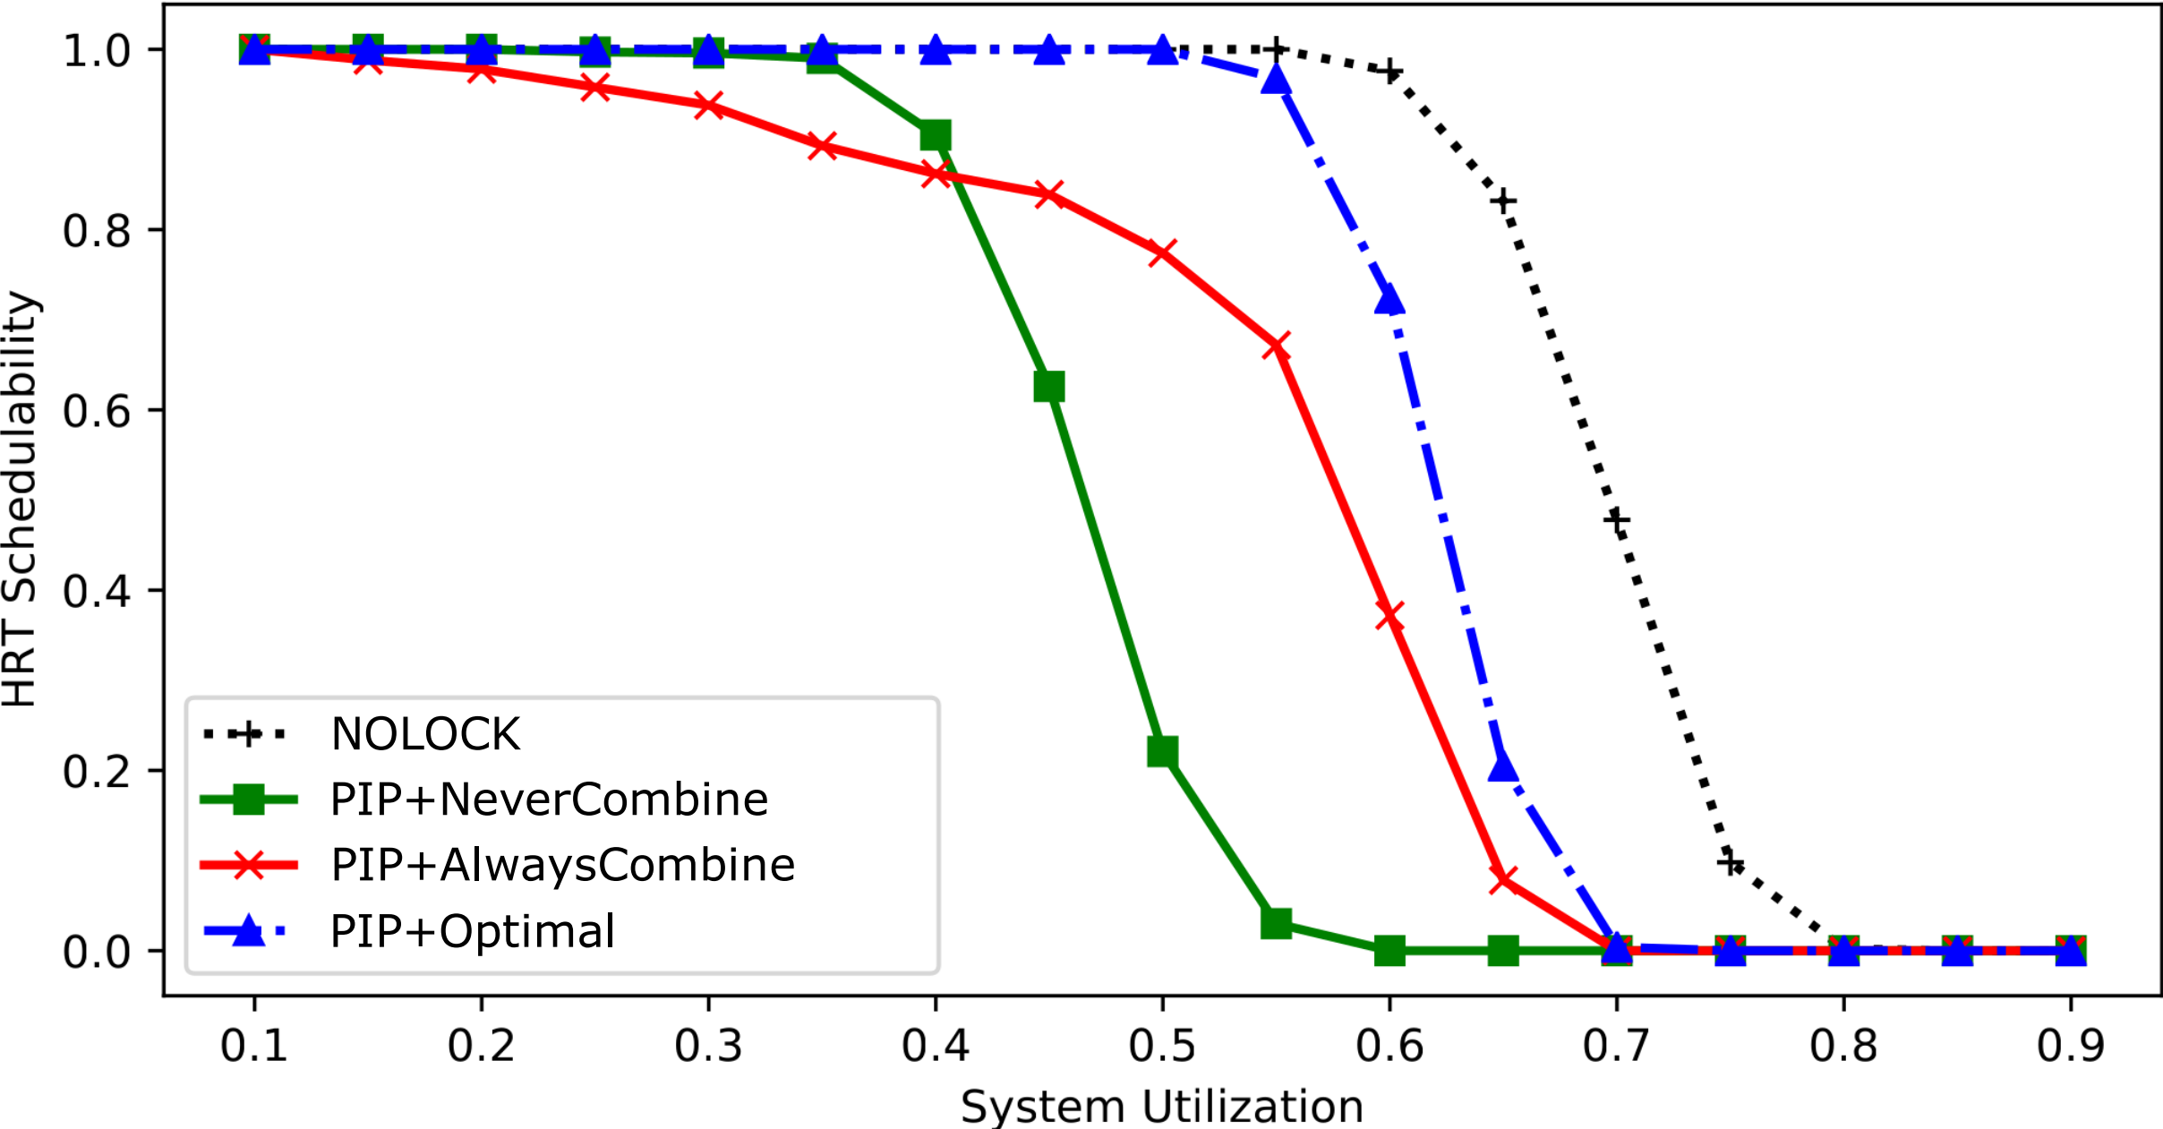
Evaluation: GPU-inspired tasks
Motivation
Access Model
Optimal Algorithm
Evaluation
Future Work
Short periods: 3ms to 33ms
GPU-inspired accesses: 1$μ$s to 15$μ$s
GPU-inspired overhead: 100$μ$s
Target access count: 10
For some GPU-inspired configurations, neither extreme dominates.

Slide 42
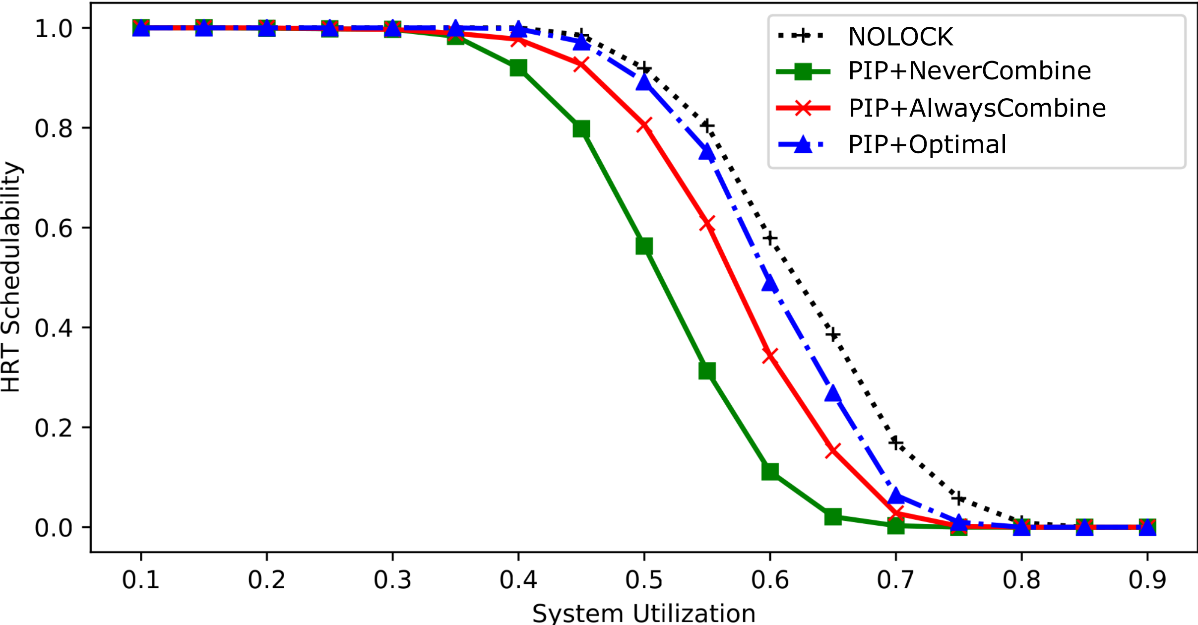
Evaluation: GPU-inspired tasks
Motivation
Access Model
Optimal Algorithm
Evaluation
Future Work
Our optimal algorithm performs at least as well as either always or never grouping accesses.
Short periods: 3ms to 33ms
GPU-inspired accesses: 1$μ$s to 15$μ$s
GPU-inspired overhead: 100$μ$s
Target access count: 10

Slide 43
Overview
Motivation
Access Model
Optimal Algorithm
Evaluation
Future Work
Motivation
Access Model
Optimally Grouping Accesses into Critical Sections
Evaluation
Next Steps

Slide 44
Future work: real workloads
Motivation
Access Model
Optimal Algorithm
Evaluation
Future Work
We have done an initial exploration into GPU-using workloads.
What we need is a model for how GPUs are currently used, especially in deep-learning-driven computer vision.

Slide 45
Future work: question our assumptions
Motivation
Access Model
Optimal Algorithm
Evaluation
Future Work
See our talk at OPERA 2024!
Fixed-priority uniprocessor scheduling
One shared resource (e.g., a GPU)
Resource accesses arbitrated by Priority Inheritance Protocol
Constant synchronization-related overhead
Resource accesses are identical across any conditional branches

Slide 46
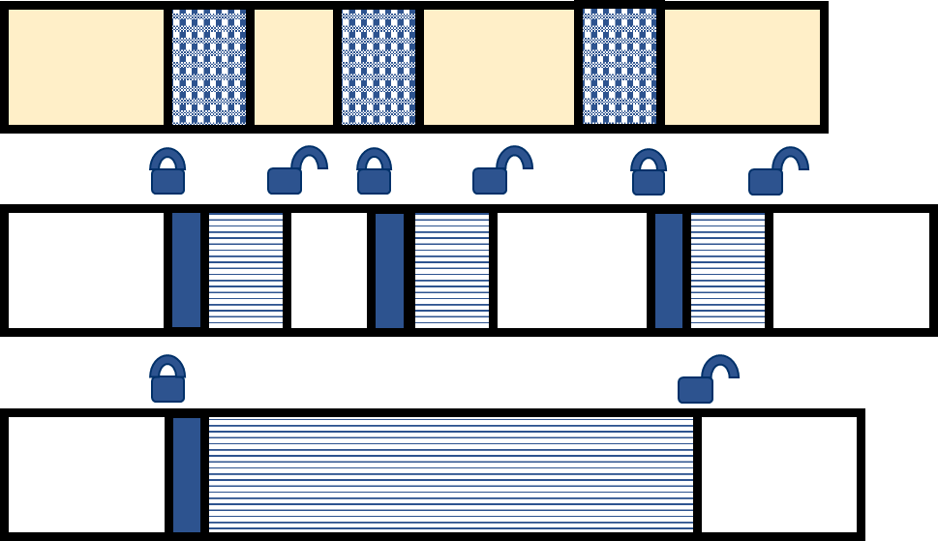
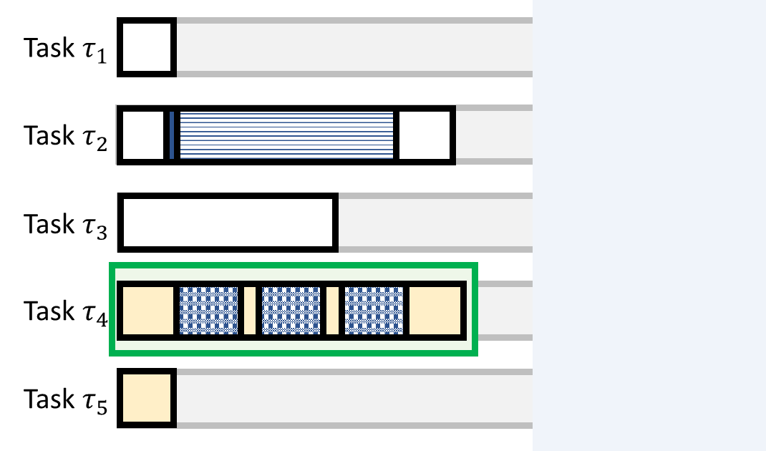
Summary
Motivation
Motivation
Optimal Algorithm
Optimal Algorithm
Evaluation
Evaluation
Future Work
Access Model
Future Work
Access Model
Questions?
We expose a lower level of shared-resource accesses in our task model.
Grouping impacts both overhead and blocking.
The greedy algorithm to group accesses is actually optimal!
Our algorithm outperforms either access-grouping extreme.

