Slide 1
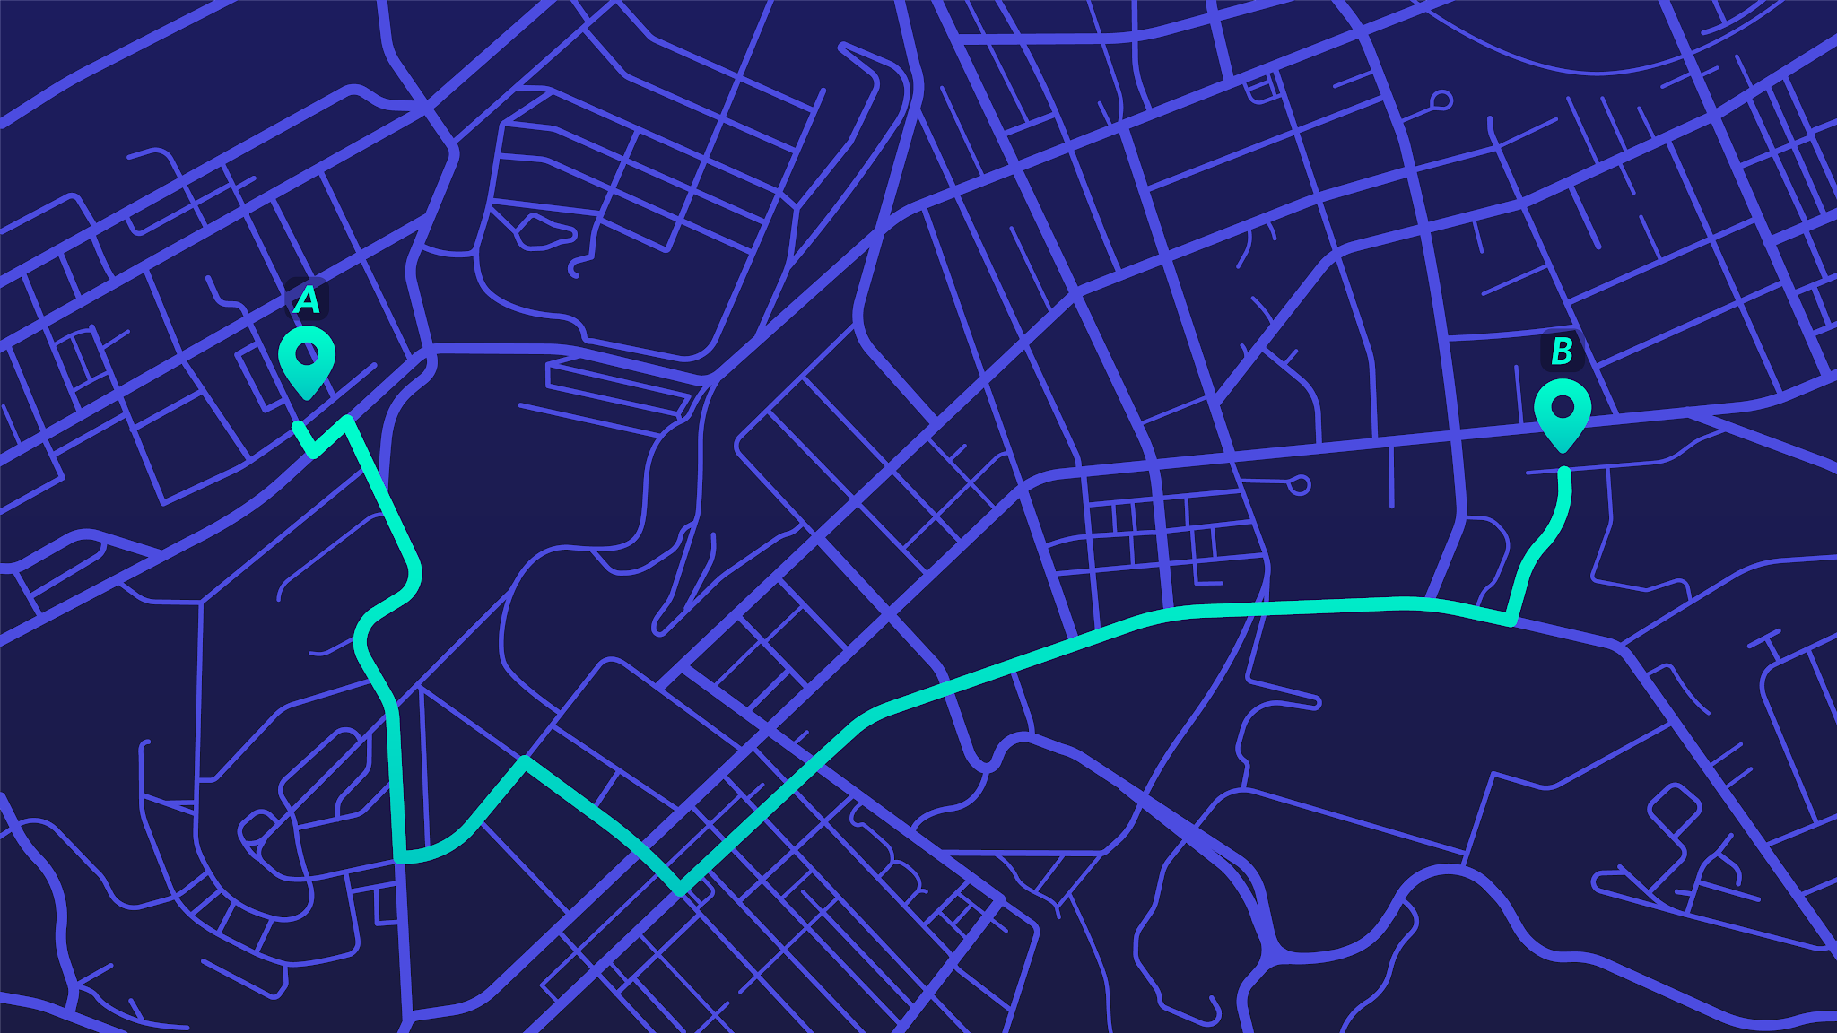

Adam Nik, Molly Kammann,
Jack Rybarczyk, & Sue He
Notes:
Zoom link

Slide 2
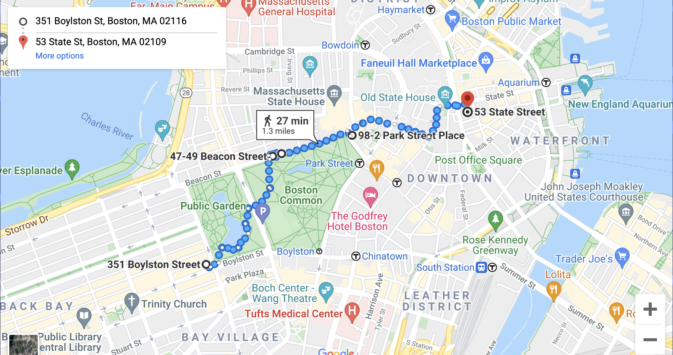
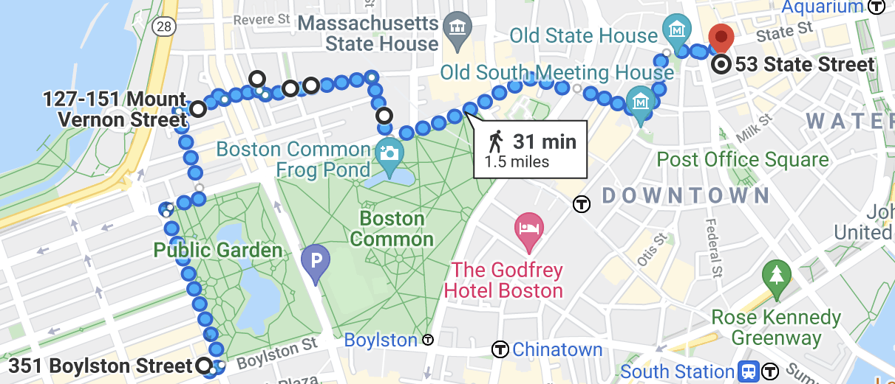
Example Routes Through Boston
Natural Scenery
Urban Scenery
Notes:
Compare to the original route given by Google?

Slide 3
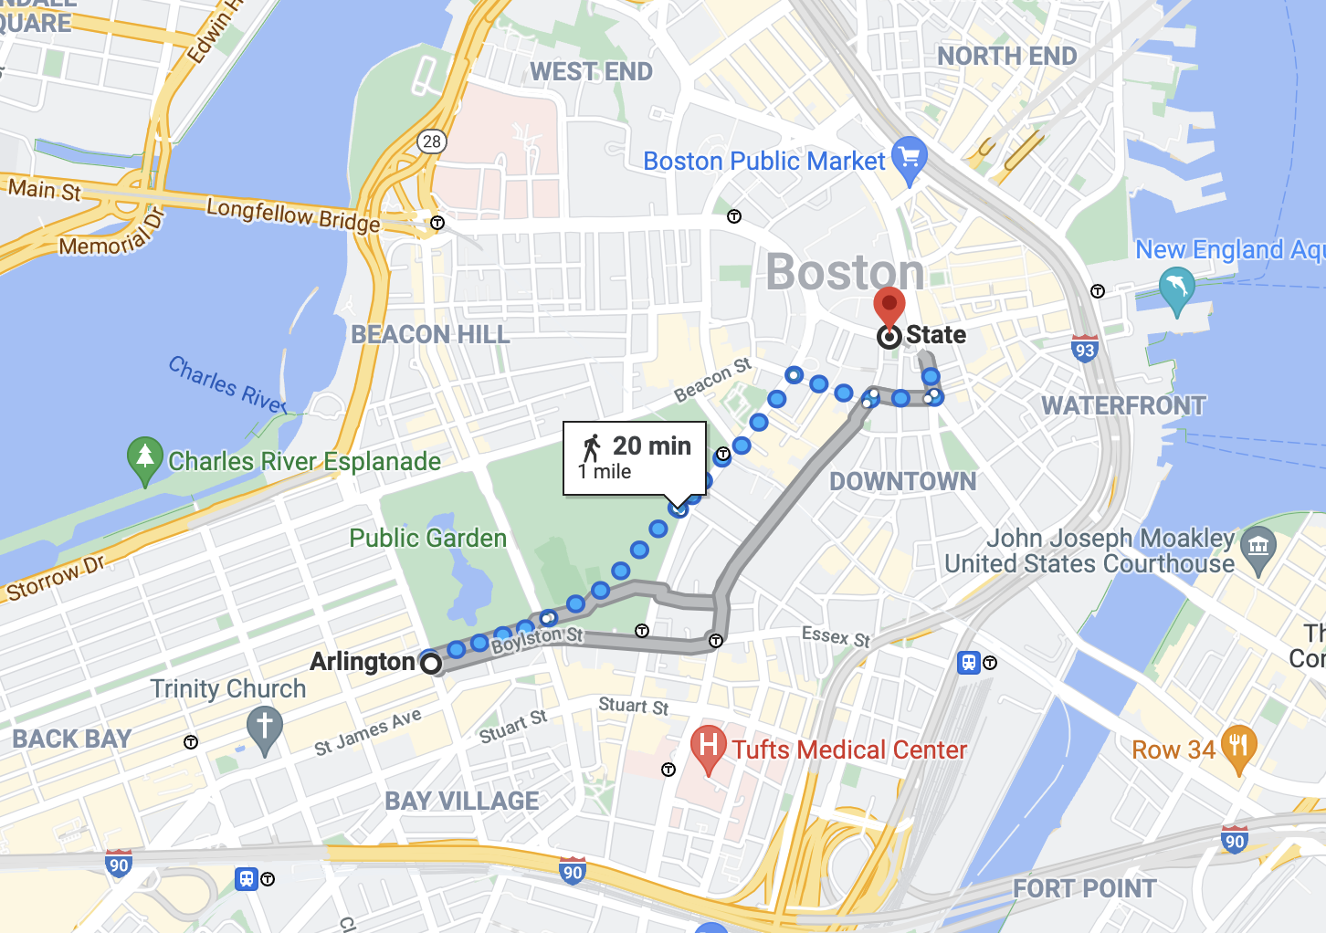
Current Navigation Systems
Google Maps: fastest & shortest route
What if you aren’t concerned with the speed & length of your route?
Notes:
Go over the project from a user perspective

Slide 4
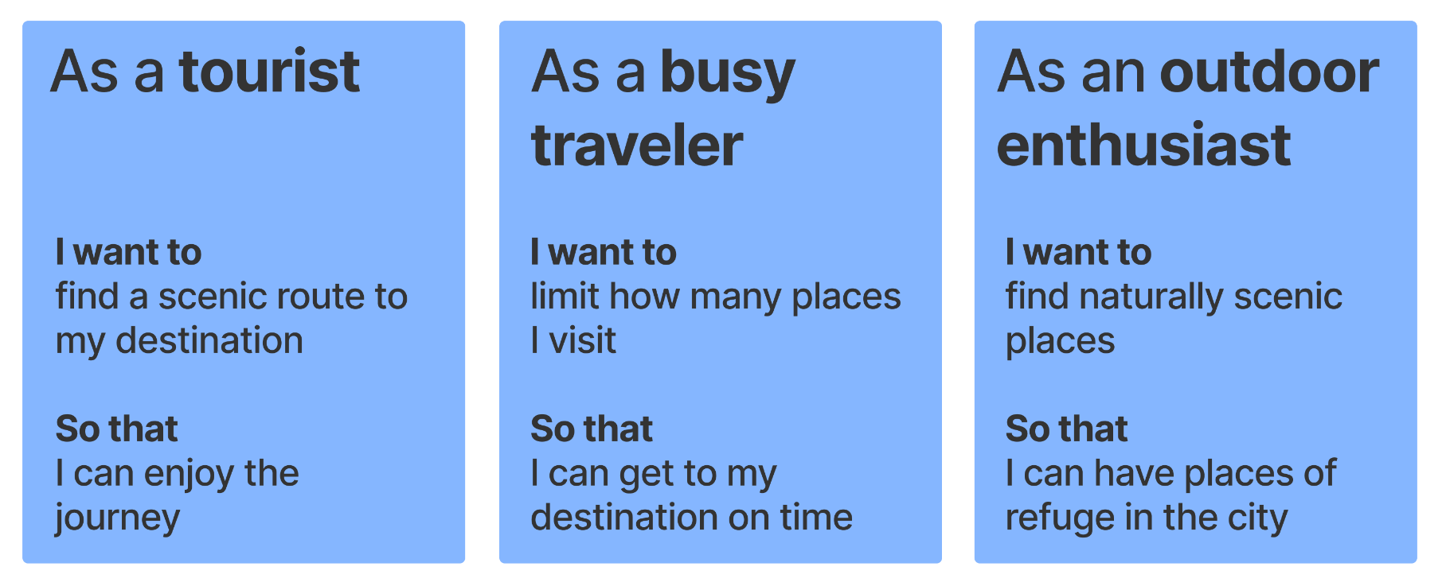
User Stories
Notes:
bigger

Slide 5
What features does our product have?
Optimize the scenery of a walking route instead of it’s length or speed
User can choose between natural and urban scenery
User can indicate maximum number of stops
Notes:
include figure that is how we implemented features.
“Scenic value”?

Slide 6

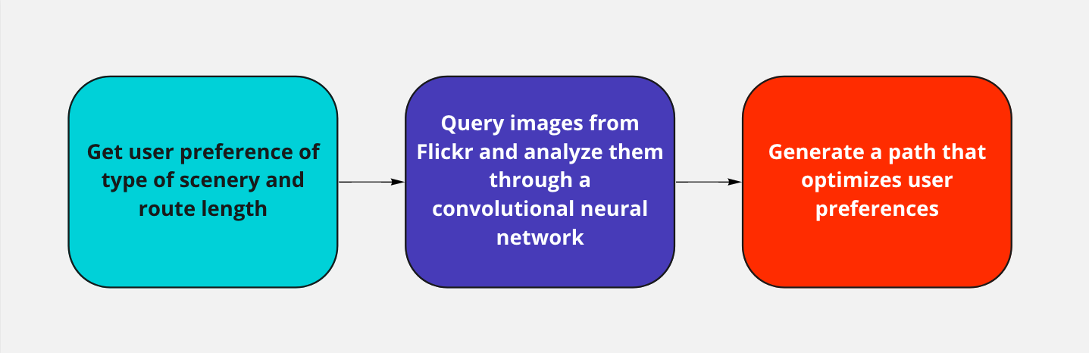
How to implement these features?
Data Source: ’s geotagged images
Data Analysis: Place categorization using machine learning

Slide 7
Similar Past Project
No more Autobahn! Scenic Route Generation Using Googles Street View (2016)
Initial groundwork for our project
Provided framework of neural network
Runge, N., Samsonov, P., Degraen, D., & Schöning, J. (2016). No more Autobahn! Scenic Route Generation Using Googles Street View. Proceedings of the 21st International Conference on Intelligent User Interfaces. https://doi.org/10.1145/2856767.2856804

Slide 8

How we made this project our own
Flickr vs. Google Street View Images
Flickr photos are dependent on user
Walking paths instead of Driving
Notes:
Popularity via views

Slide 9


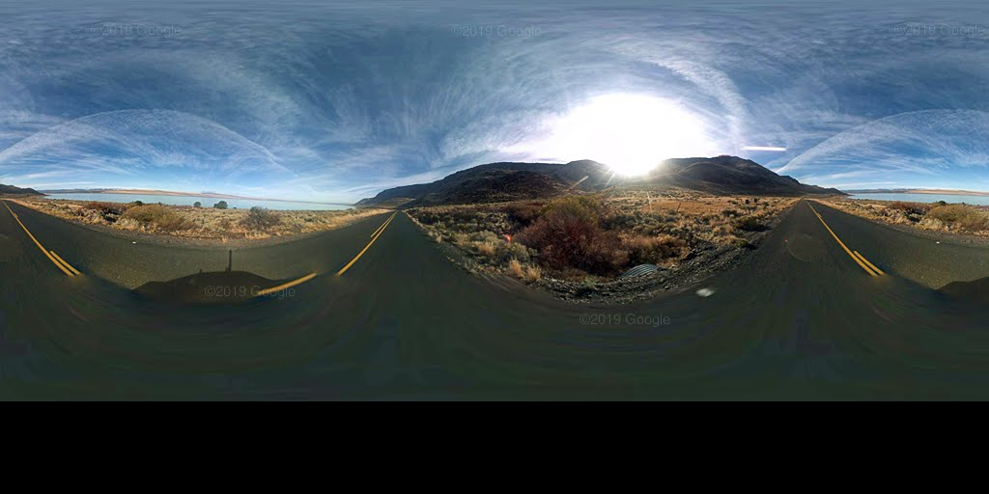
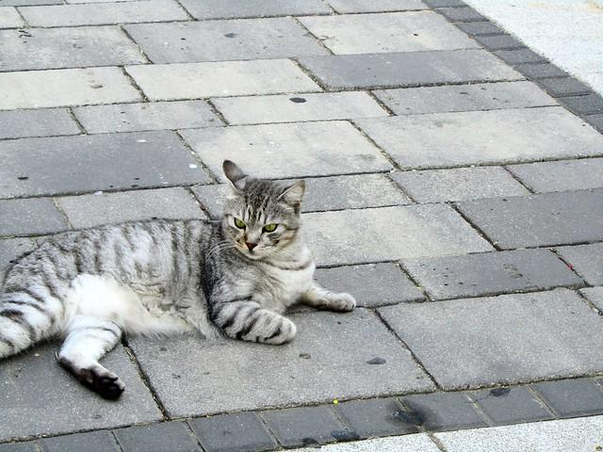
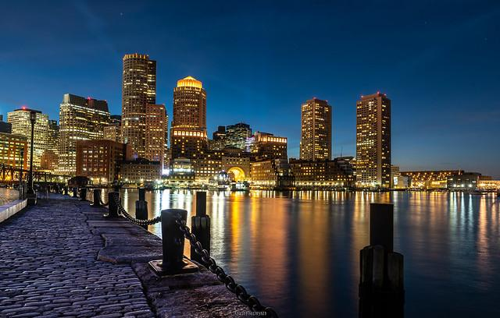
How we made this project our own
Google Street View
Flickr Additional information about photos
Popularity via views and comments
Density of images in a specified area
Notes:
Popularity via views

Slide 10
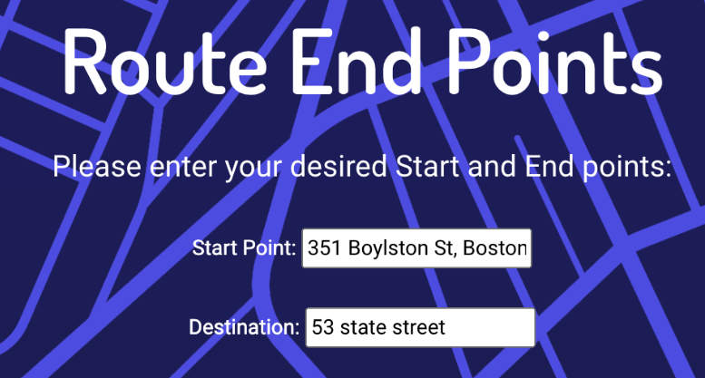
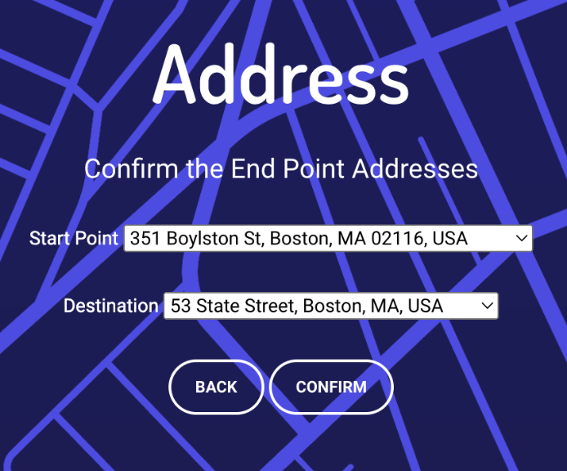
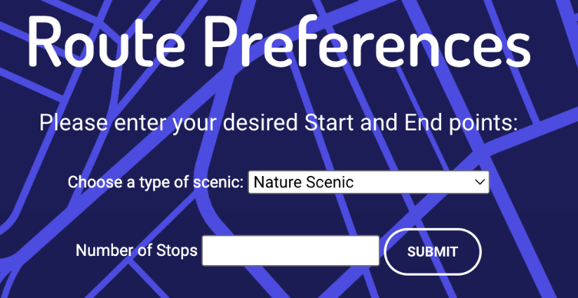
User Input & Google Places API
User Input
Google Places API
Start & End Points
Recommendation
Webapp
Return the lists of autocomplete start & end addresses
User Input
Confirmation
Webapp
Store the address & lat/long of the start & end points
Store the preferences
Backend
User Input
Preferences

Slide 11
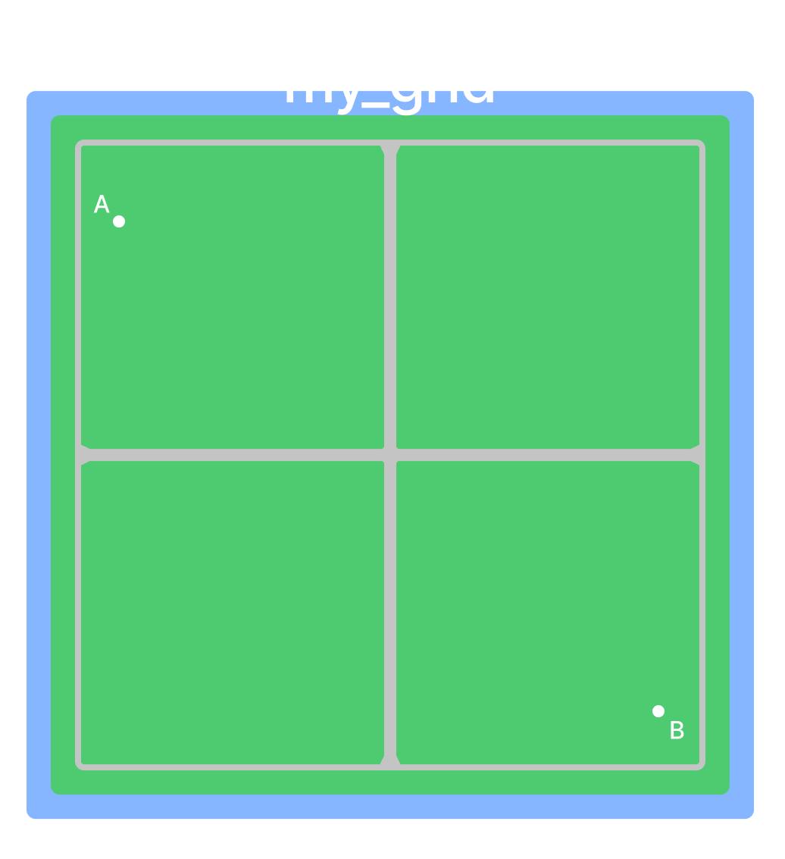
Backend Data Structure
Grid is 2D array that holds cells
Cells are 100m x 100m
Allows for quick access to adjacent cells
Useful for traversal algorithms
[ [cell 1, cell 2],
[cell 3, cell 4] ]
Notes:
Bigger font?

Slide 12
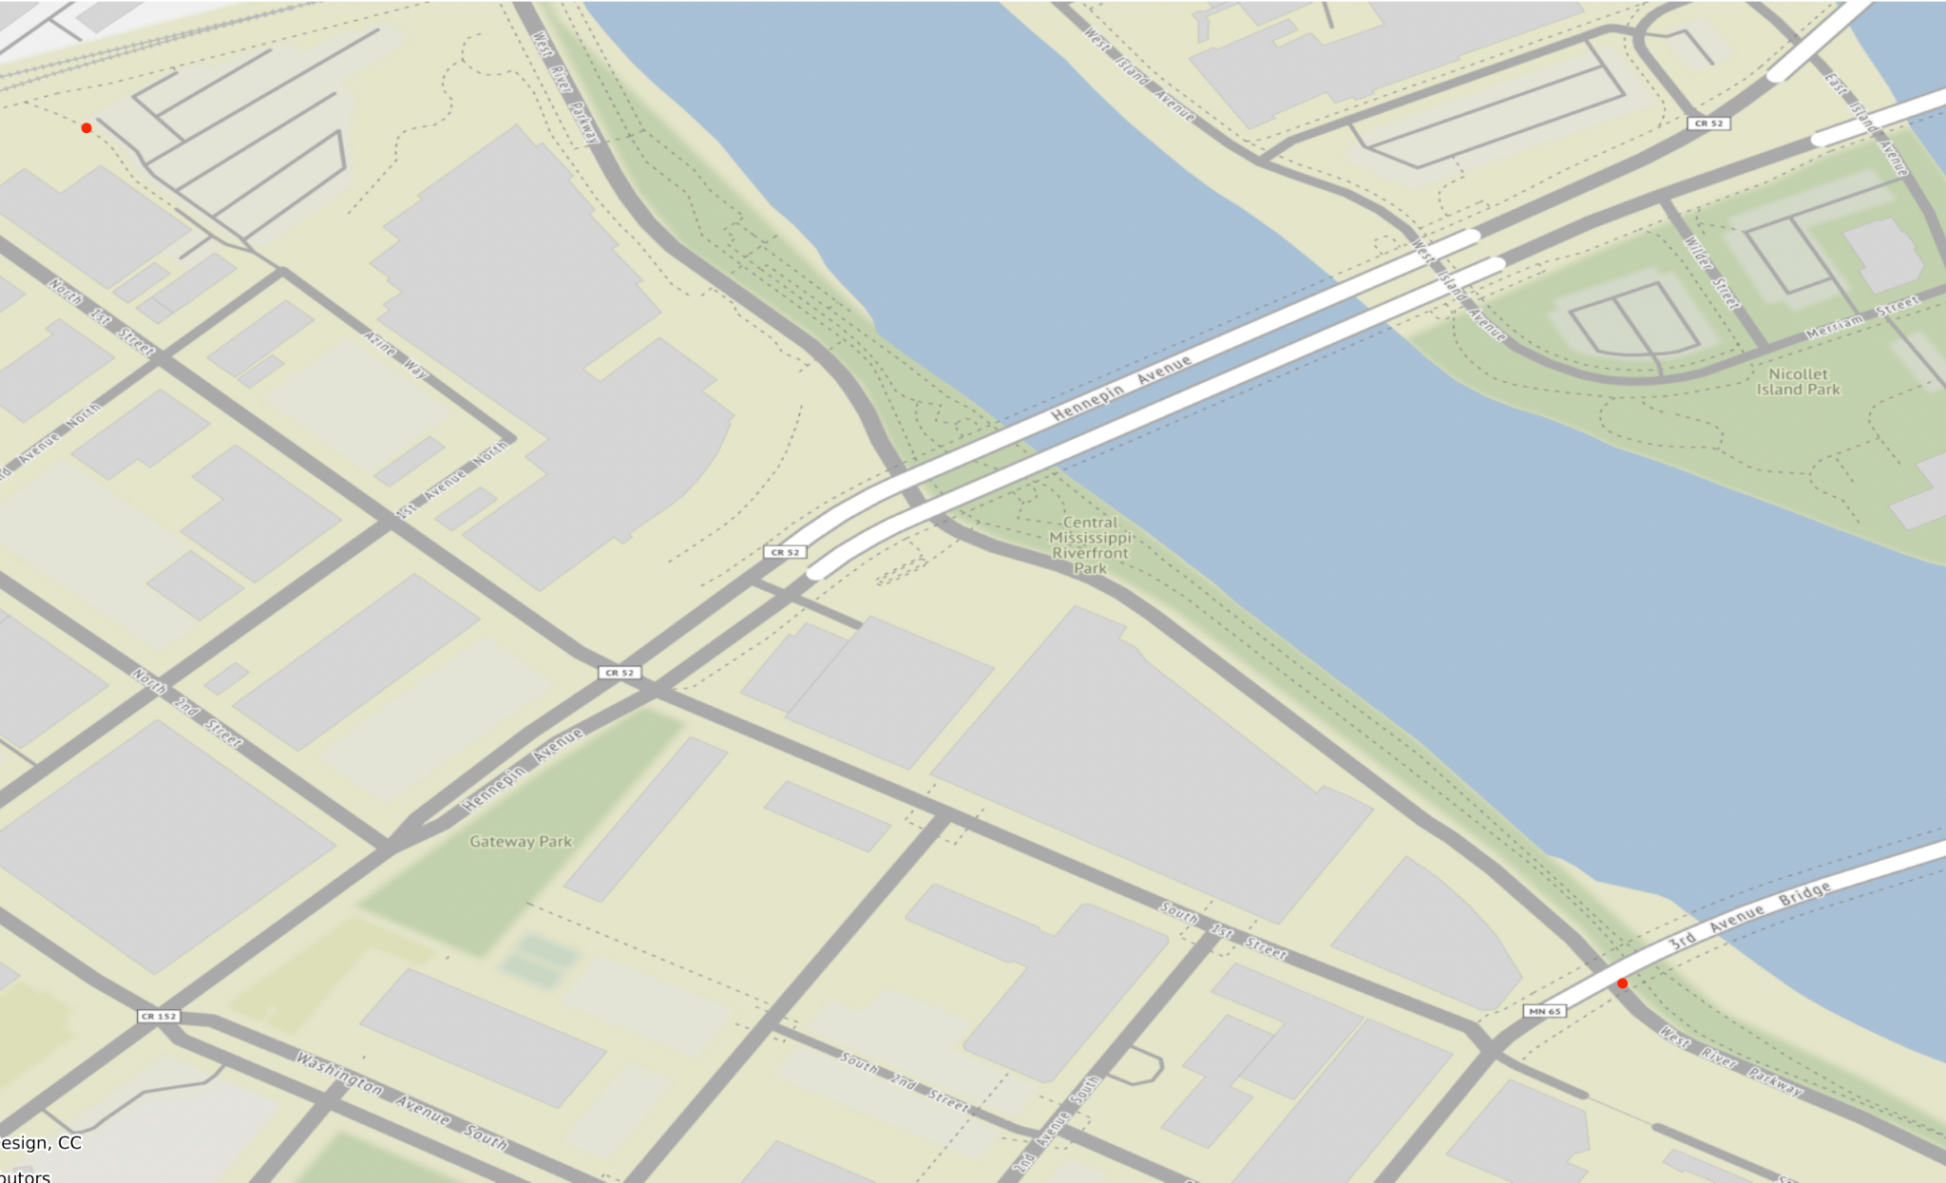
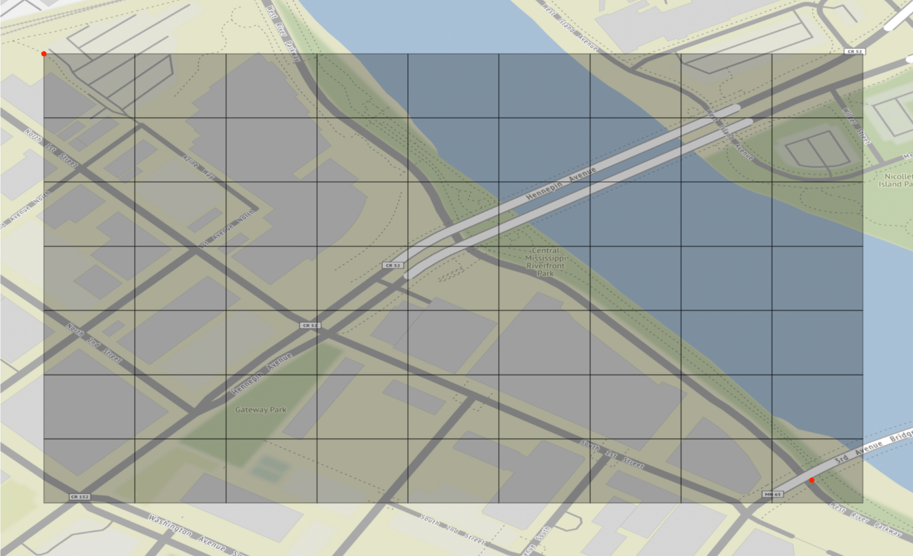
Generating a grid

Slide 13
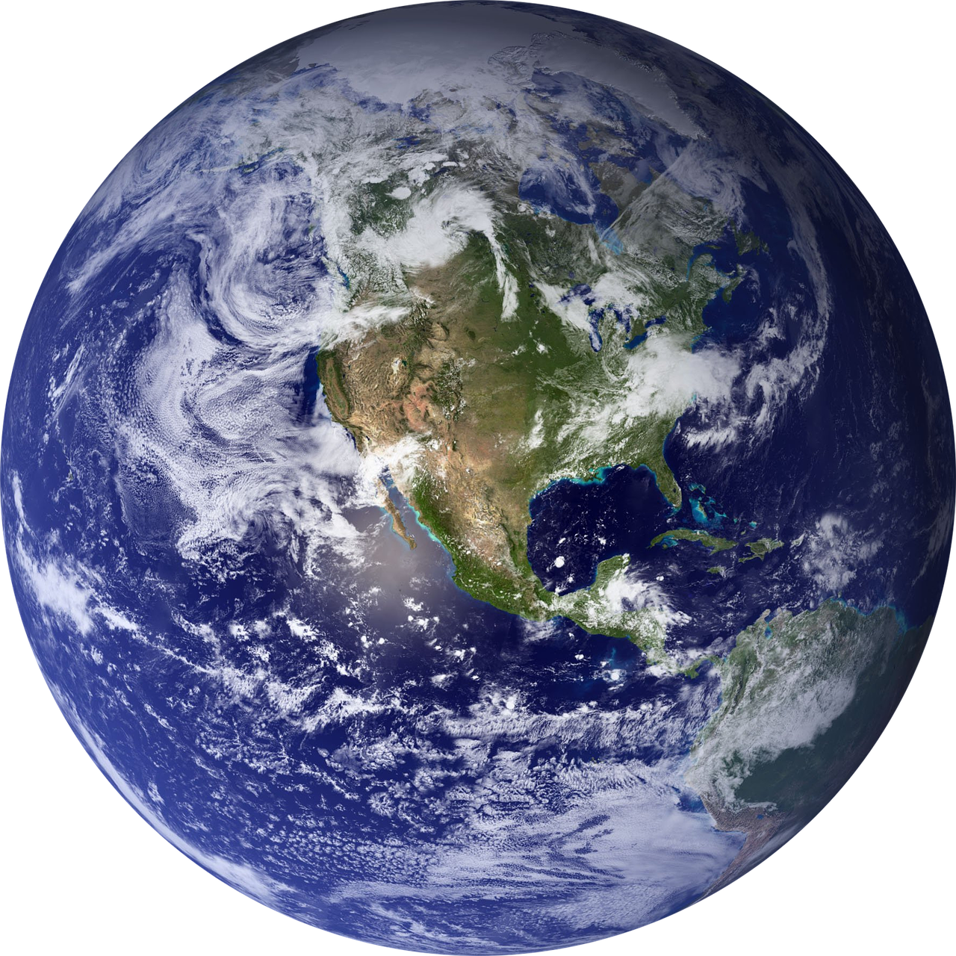
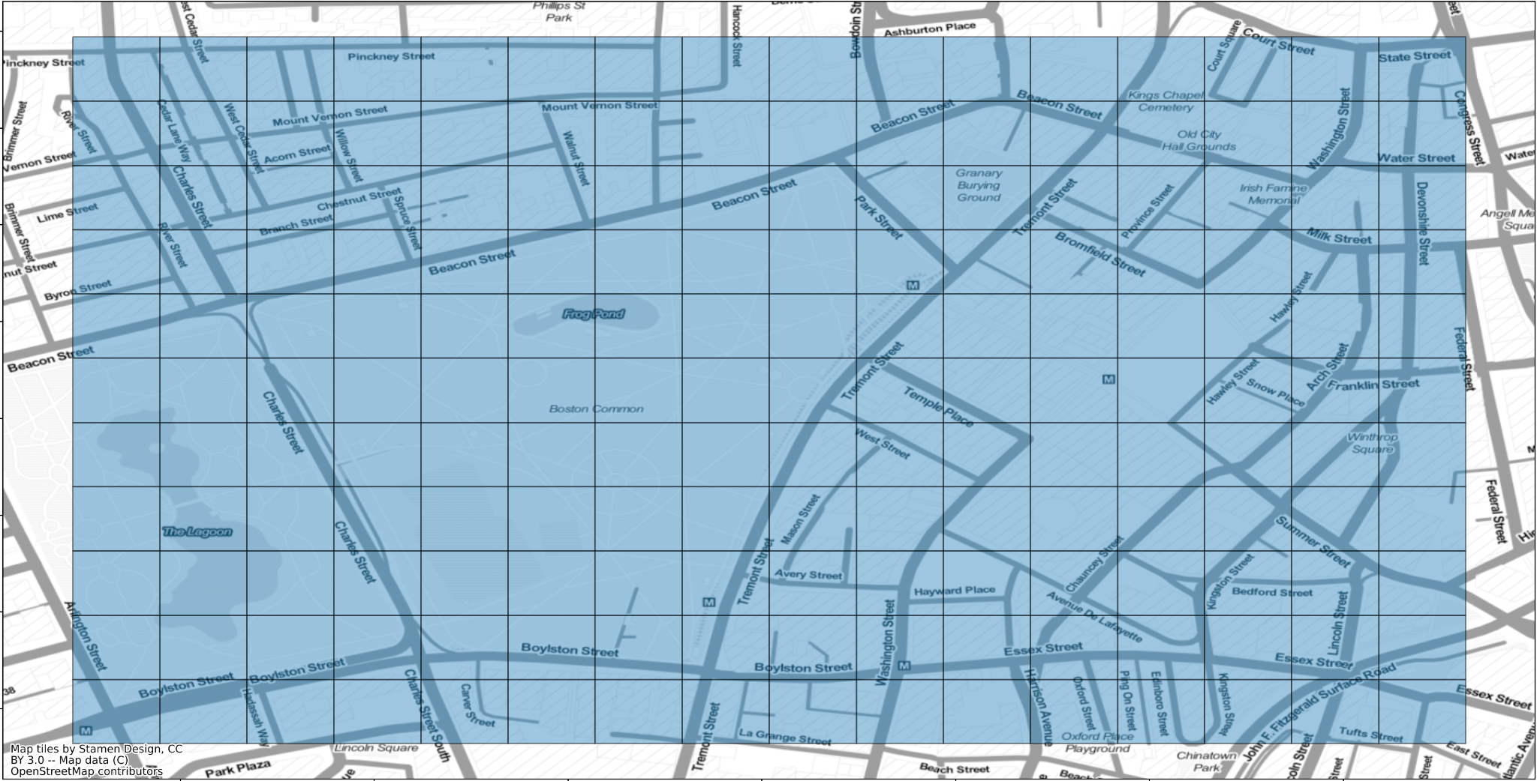
How to Implement our Grid
Mercator Projection
Our grid
Earth (inconveniently for us, not flat)

Slide 14
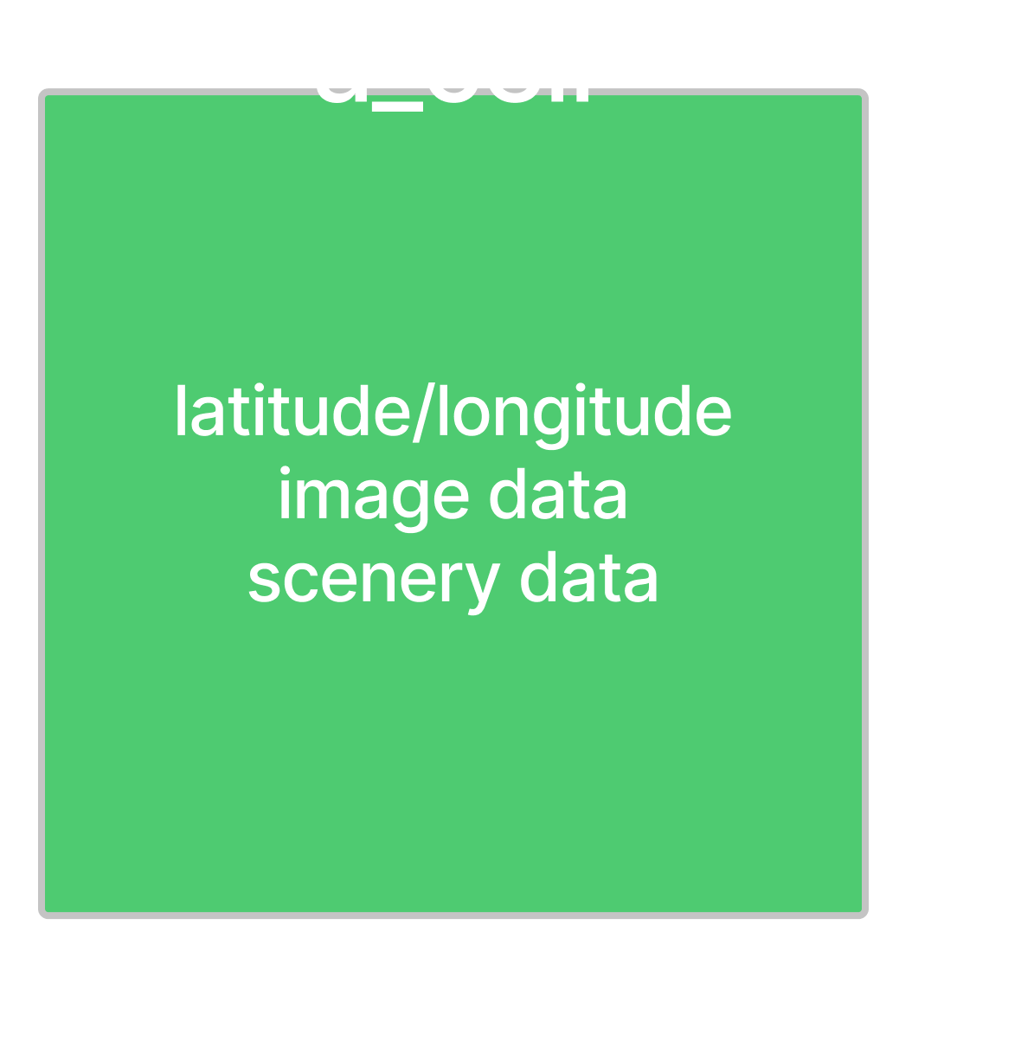
Most Data Lives in Cell Objects
Grid contains cells at each latitude and longitude
At runtime, we hold data in cells
✔
Notes:
we increased the resolution of our cells

Slide 15
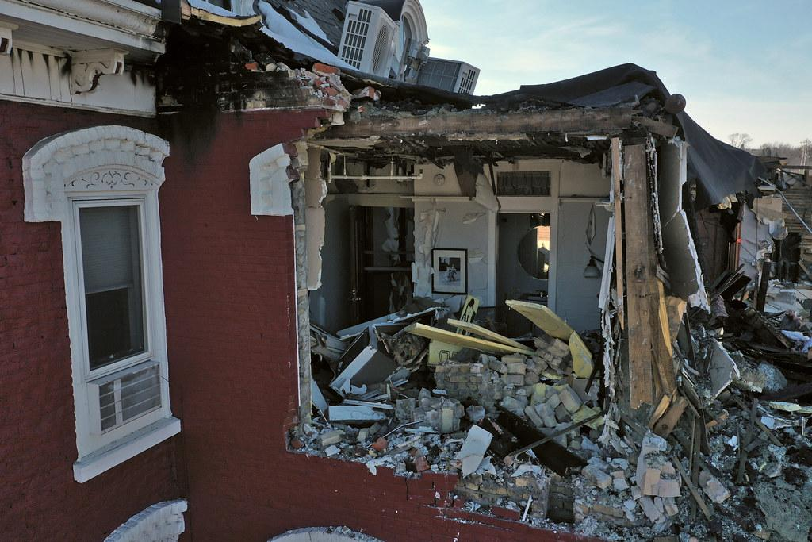

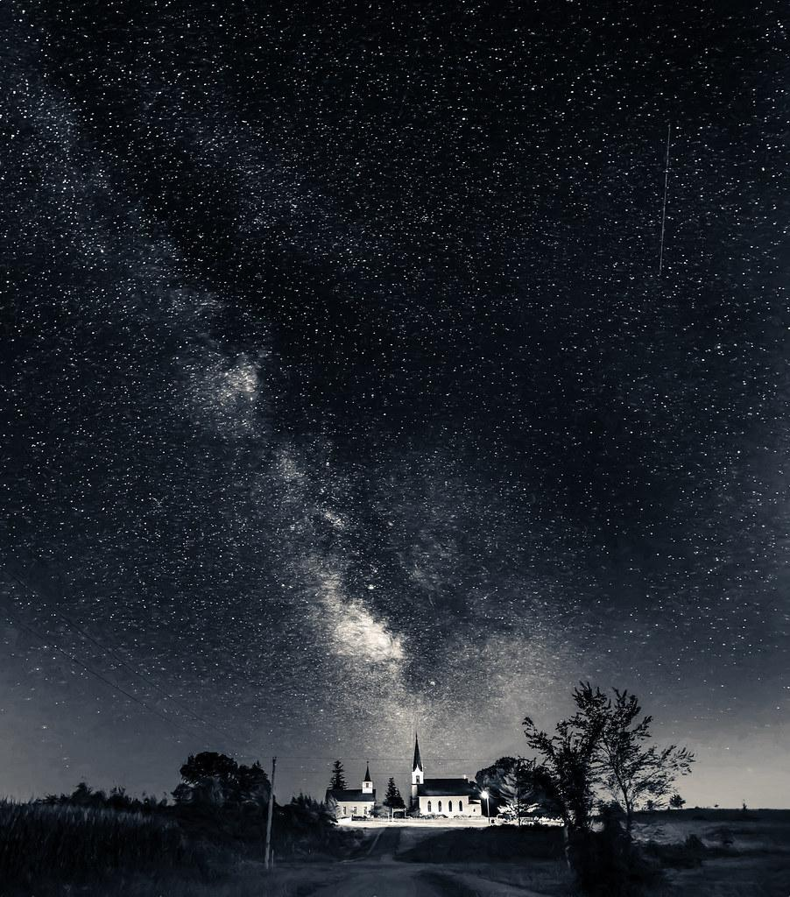
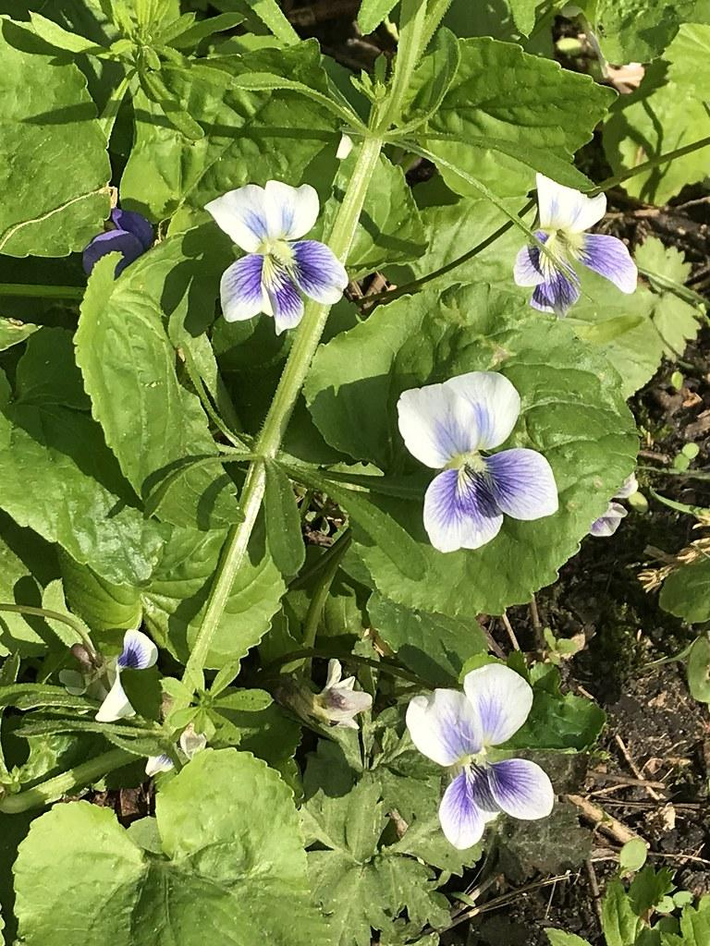


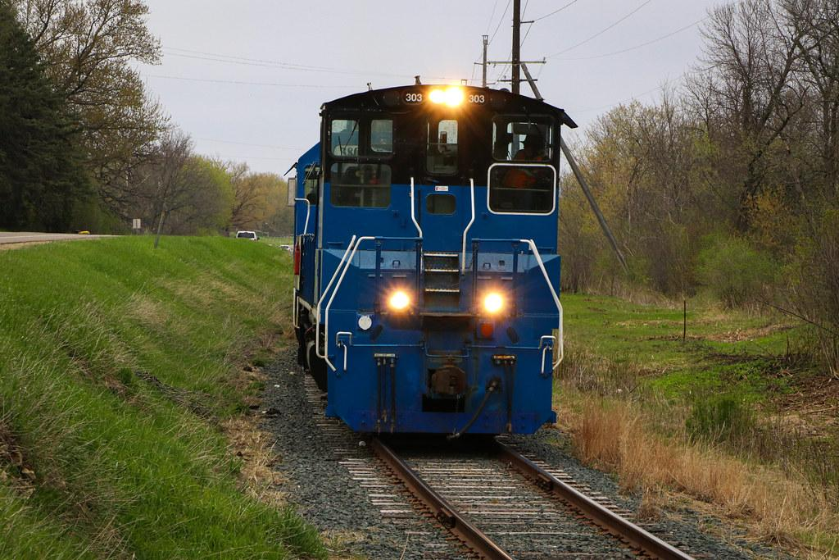
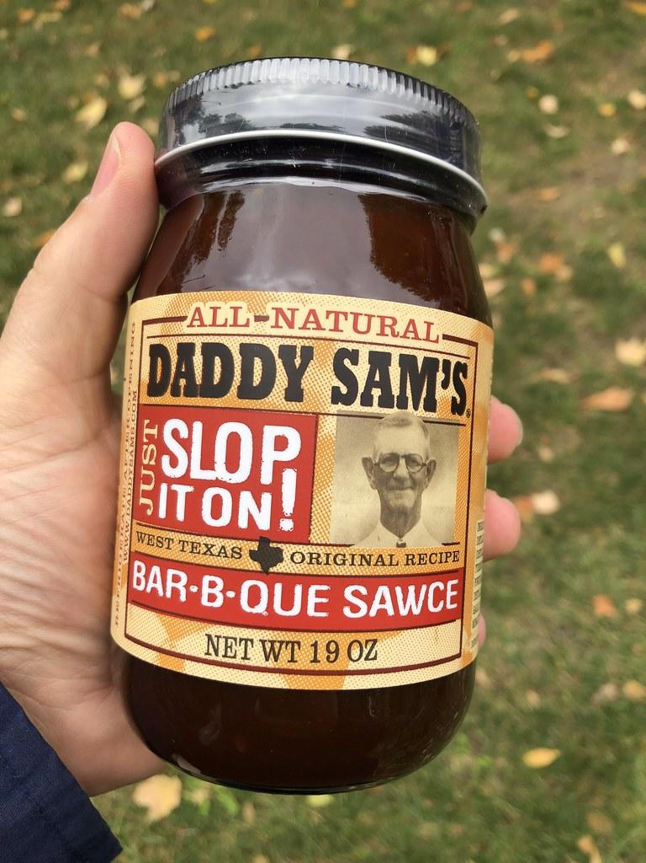
Flickr Queries
Outdoor
Sort by views
Lat/long box
NW
SE
Notes:
uncollage
flickr has metadata and we can filter using that
“top 5% of most viewed images”

Slide 16
Using the Neural Network
Places205 CNN
Pre-trained on scenic-centric images from Places Database
Places Database scenic-centric image database
CNN image recognition
Zhou, B., Lapedriza, A., Xiao, J., Torralba, A., Oliva, A. (2014). Learning Deep Features for Scene Recognition using Places Database. Advances in Neural Information Processing Systems. https://dspace.mit.edu/handle/1721.1/96941
Notes:
is places205 a set of data or a CNN
Display screenshot bigger or own slides
did not train CNN

Slide 17
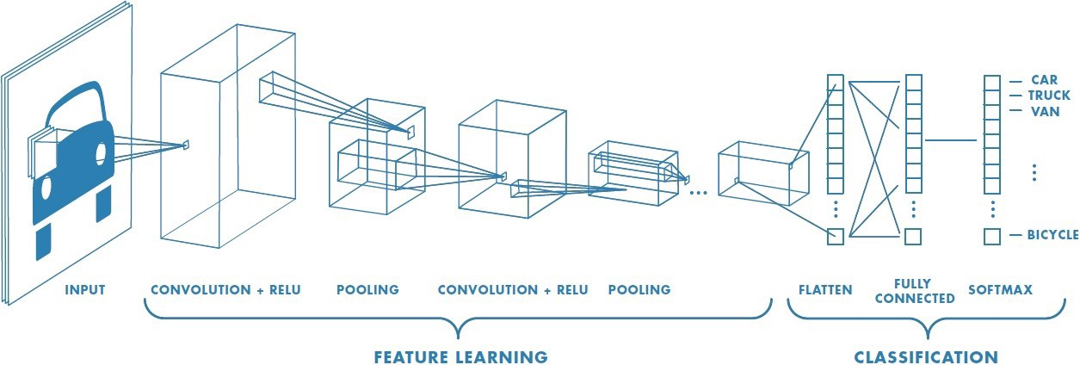
Using the Neural Network
https://towardsdatascience.com/a-comprehensive-guide-to-convolutional-neural-networks-the-eli5-way-3bd2b1164a53
Notes:
is places205 a set of data or a CNN
Display screenshot bigger or own slides
did not train CNN

Slide 18
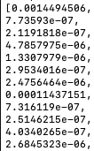
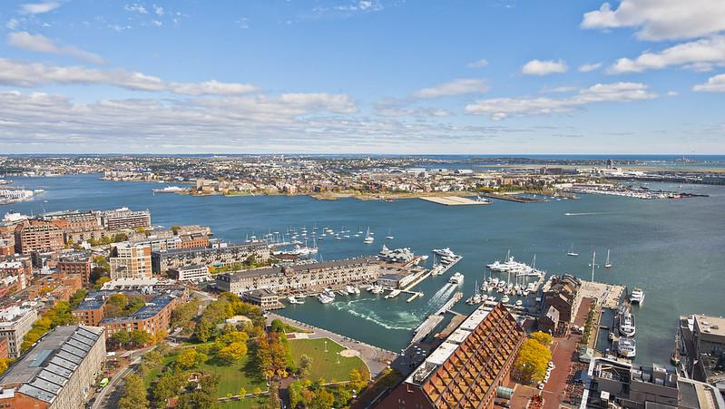
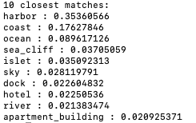
Using the Neural Network
205 categories
.
.
.
> 0.1 confidence threshold indicates good match
Notes:
-talk about 0 < val < 1 range
-0.1 confidence threshold

Slide 19

How can we save time?
cell
Downloading and processing images is slow
We need an efficient way to store data: Database!
database
Notes:
https://www.researchgate.net/publication/261718817_How_much_of_the_world's_land_has_been_urbanized_really_A_hierarchical_framework_for_avoiding_confusion
Earth is 510 million km^2
29.2% is land, and of that only about 3% is urban, leaving an estimate
4.5 million km^2
Times by 100 to get in hectares
450,000,000 cells

Slide 20

What information is stored in database?
We only need to remember the CNN output and the URL
2.9% of the Earth’s land is urban, requiring 450 billion cells
Only ~1 terabytes to store all cities of the world!
Notes:
Each cell stores at most 20 images
20 image ids (8 bytes each) = 160 bytes
255 real for all category (4 bytes each) = 1020 bytes per image
= (20 * 8) + (20 * 1020)
= 2560 bytes per cell
1.152 terrabytes for the whole world

Slide 21
Database saves time
Images in database
Only need to download these cells

Slide 22
Edge case: incomplete database
New grid
in database

Slide 23
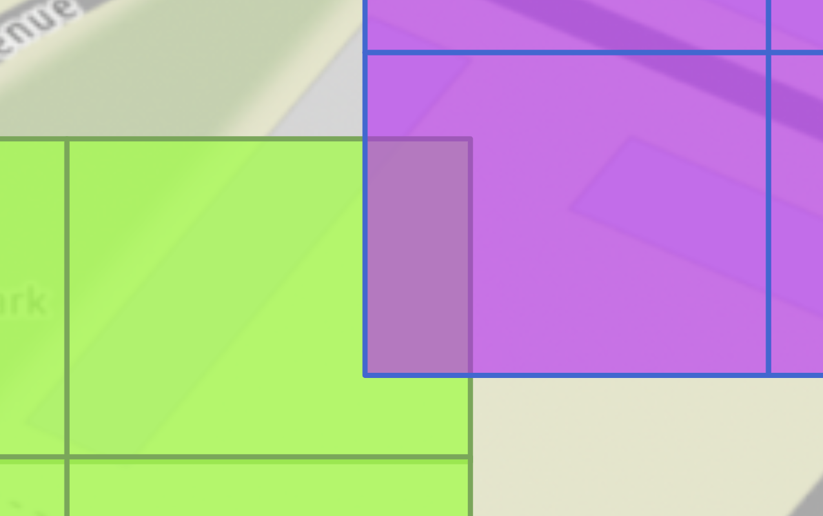
Edge case: incomplete database
Stored in database

Slide 24
Solution: Fixed grid offset
Snap cells to existing universal grid
New grid
in database

Slide 25
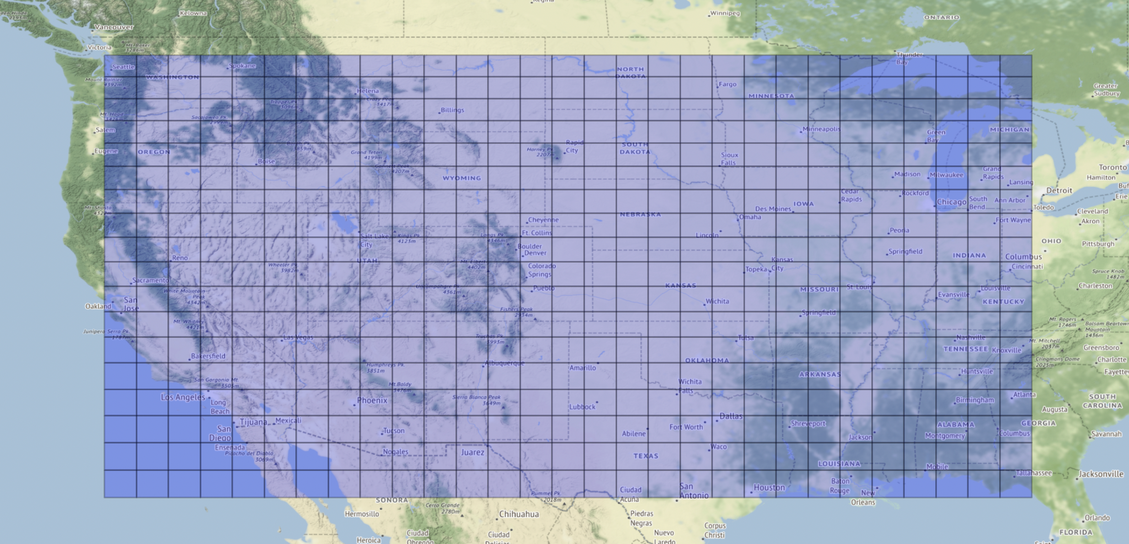
Solution: Fixed grid offset
Snap cells to existing universal grid
Cells not to scale

Slide 26
Run CNN
CNN Output
shortcut!
? ? ? ? ?
Database
Scenic Route
Notes:
less weird path

Slide 27

How do we quantify scenicness?
There’s a lot of information about every cell

Slide 28
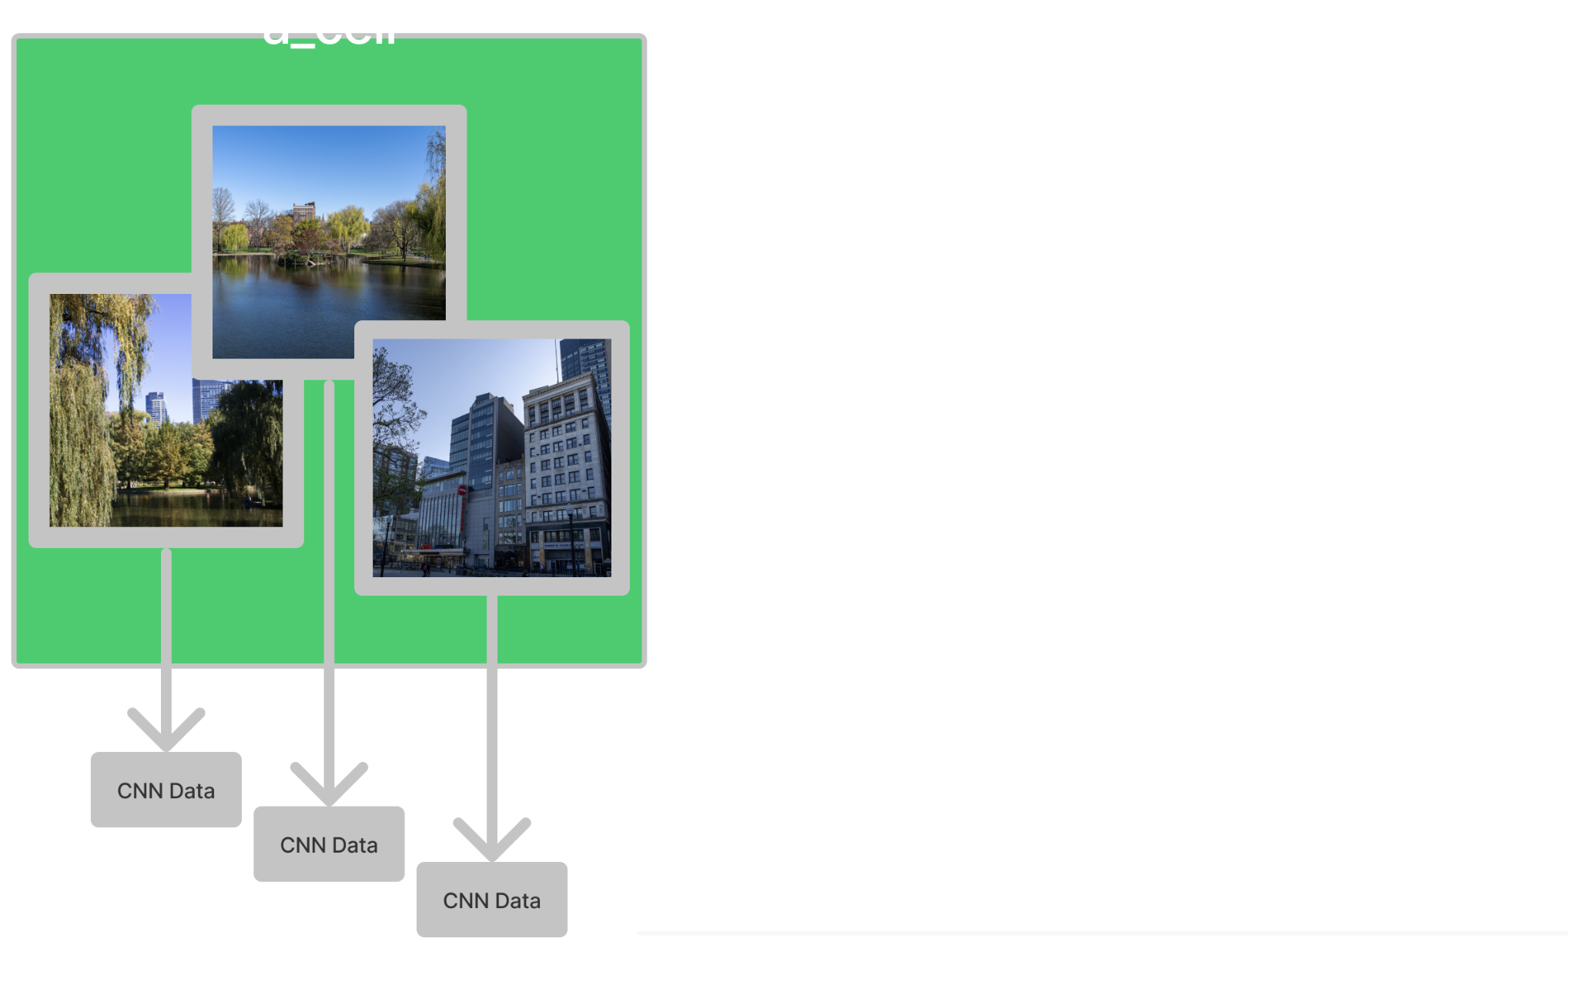
Additive Process for Generating Scenic Values
CNN Output
CNN Output
CNN Output
Notes:
Bigger.

Slide 29
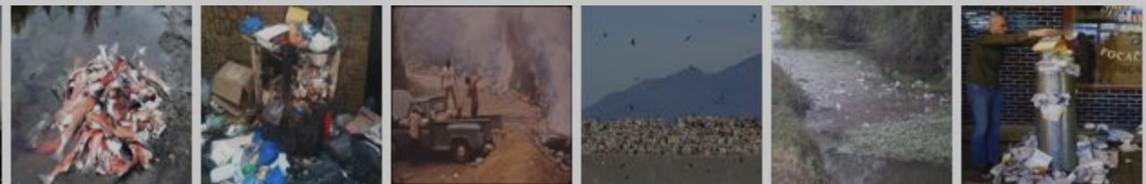
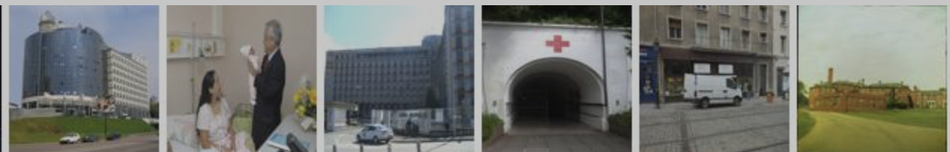
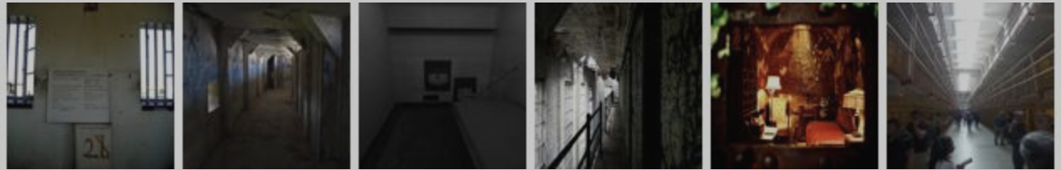
Non-Scenic Category Examples
dump
hospital
jail cell

Slide 30

Additive Process for Generating Scenic Values
Don’t store non-scenic information
CNN Output
CNN Output
CNN Output
Notes:
Bigger.

Slide 31
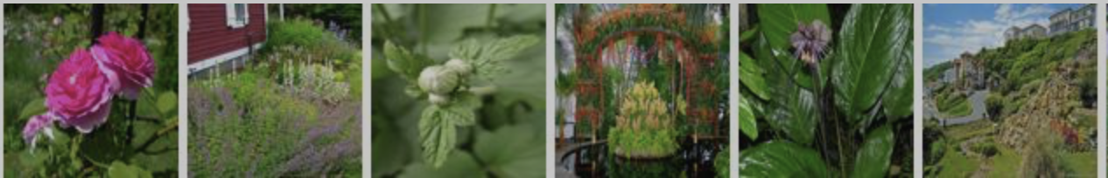
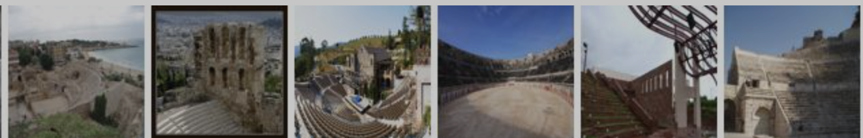
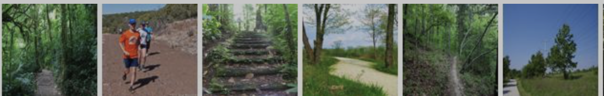
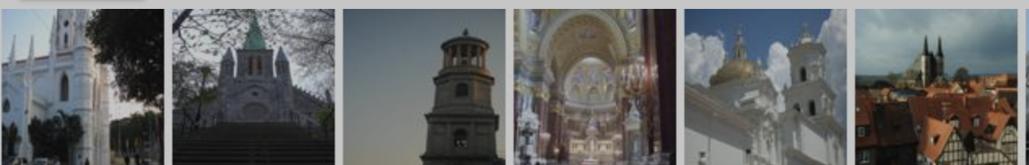
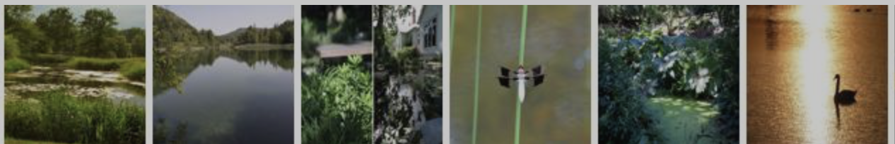
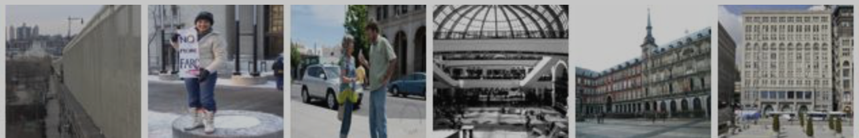
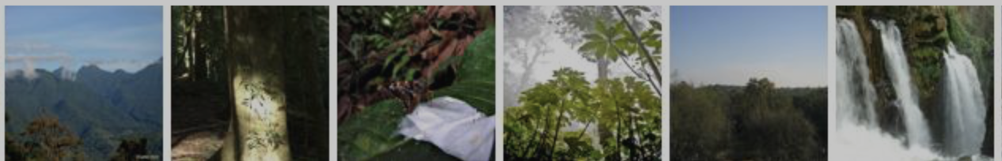
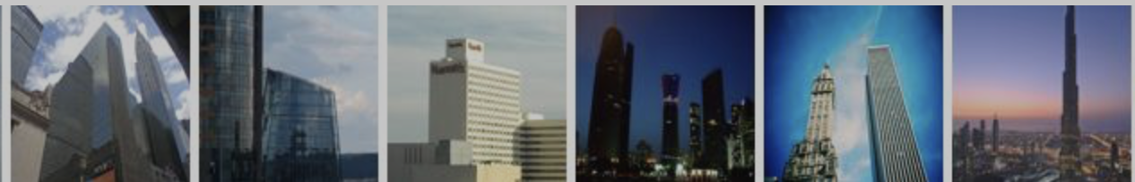
Natural Category
Examples
Urban Category
Examples
botanical garden
amphitheater
forest path
basilica
pond
plaza
rainforest
skyscraper
Notes:
??? where does this slide go?

Slide 32
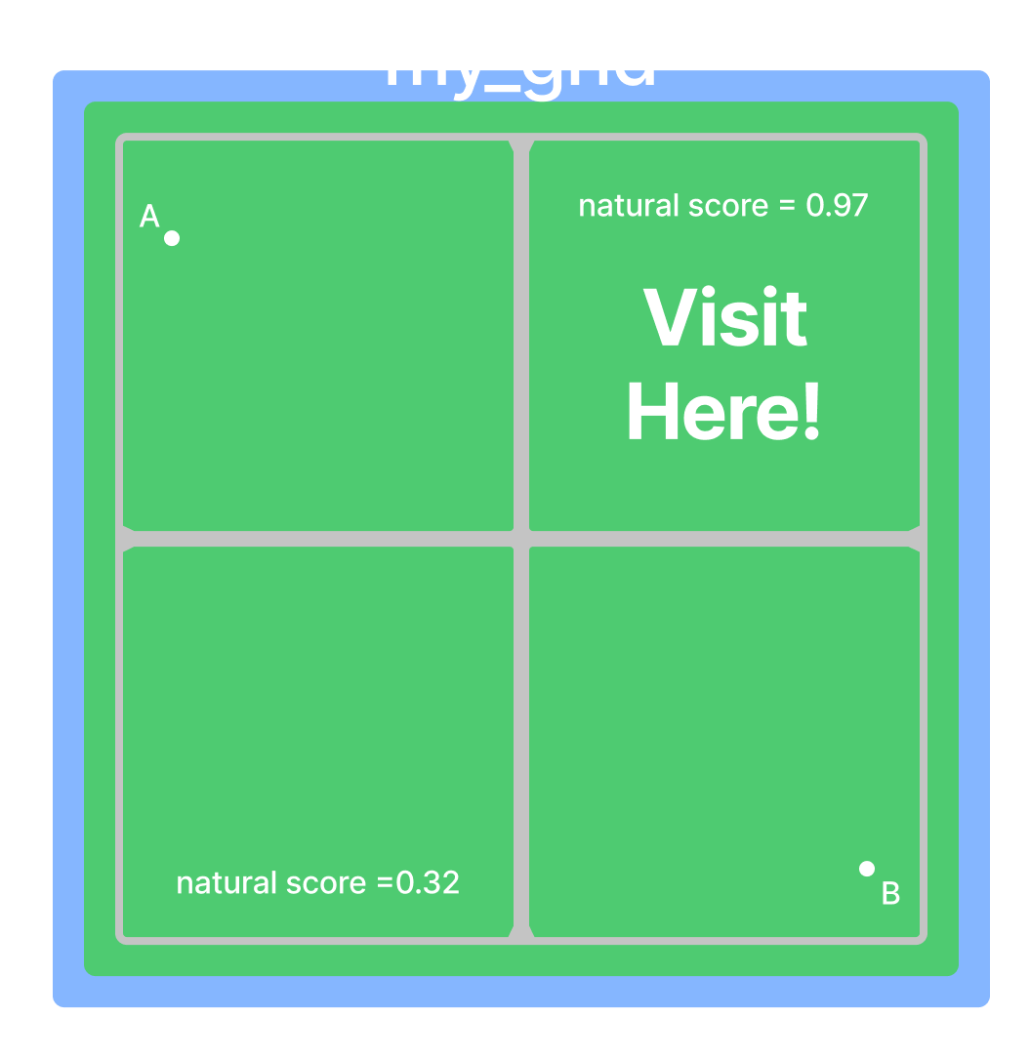
Accounting for our User’s Preferences
scenery preference
# of stops
category sums:
manually tagged categories as urban, natural, or nonscenic
natural scenic value: 0.97
urban scenic value: 0.0
sort cells
Notes:
bigger

Slide 33
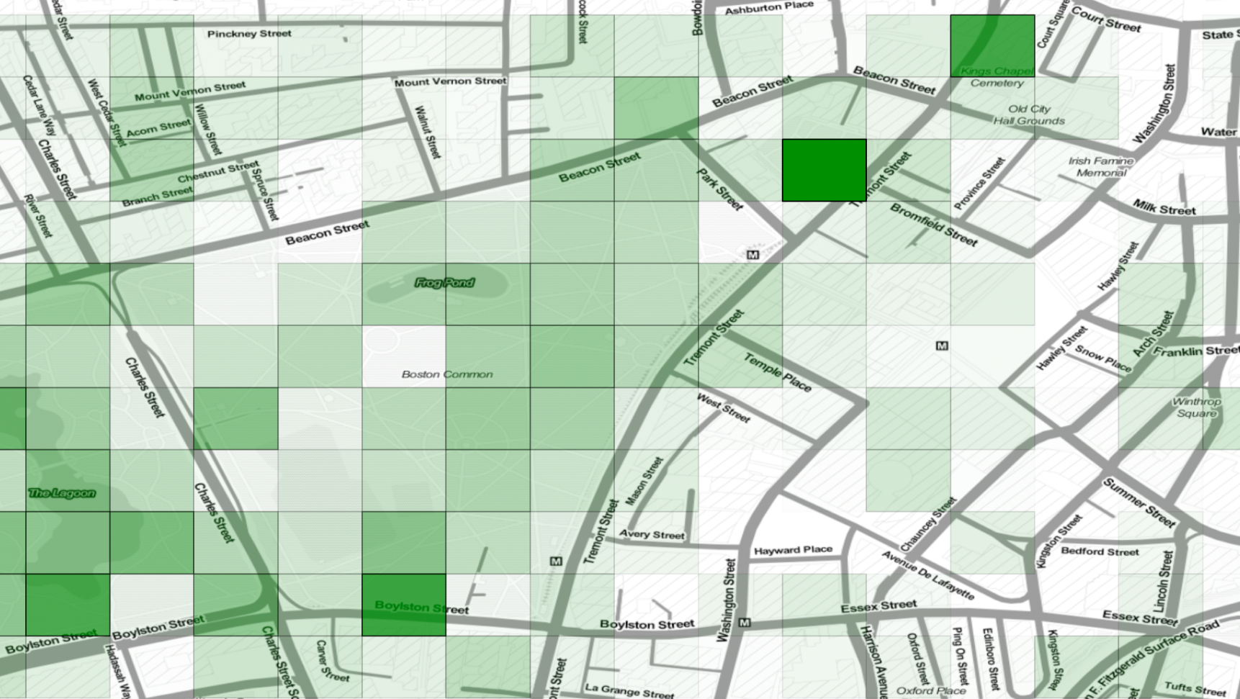
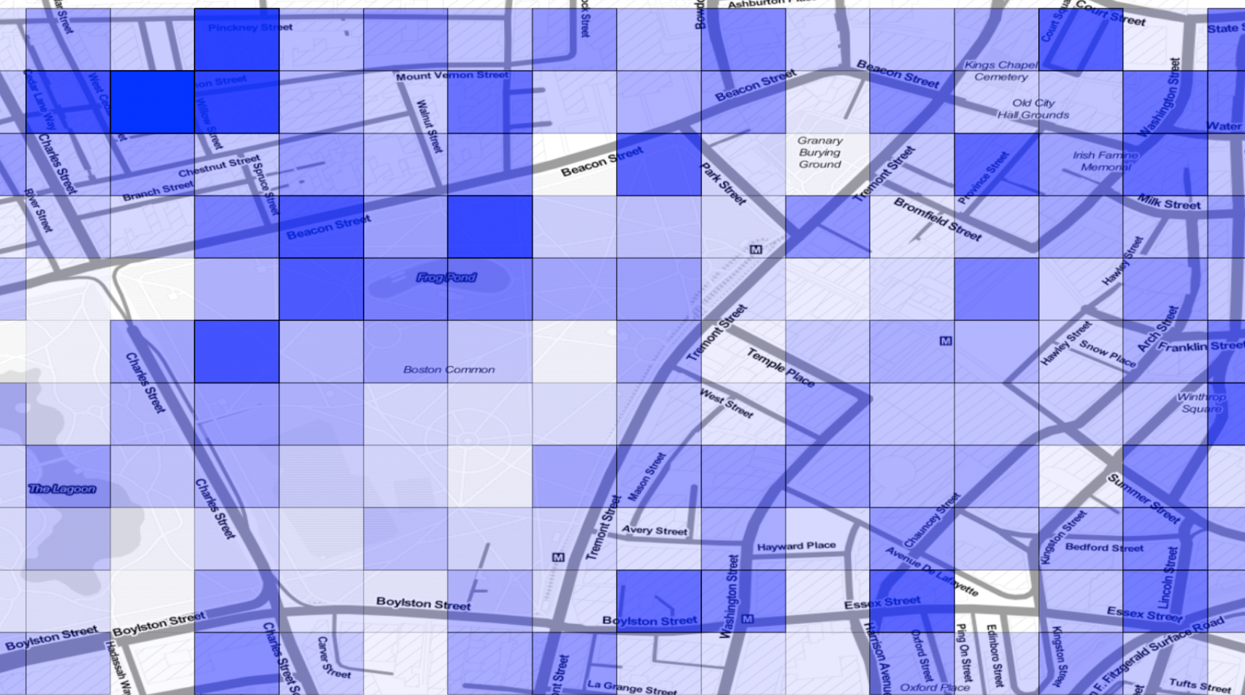
Scenic Value Heat Maps
Natural Scenic Values
Urban Scenic Values
(note, maps use different shading scales)
Notes:
informed by density too

Slide 34

A list of places to visit
lat/long pairs
Google Roads API
Snap to road
Notes:
Natural route

Slide 35
Google
Directions API
Google
Maps Embed API
Notes:
Natural route

Slide 36
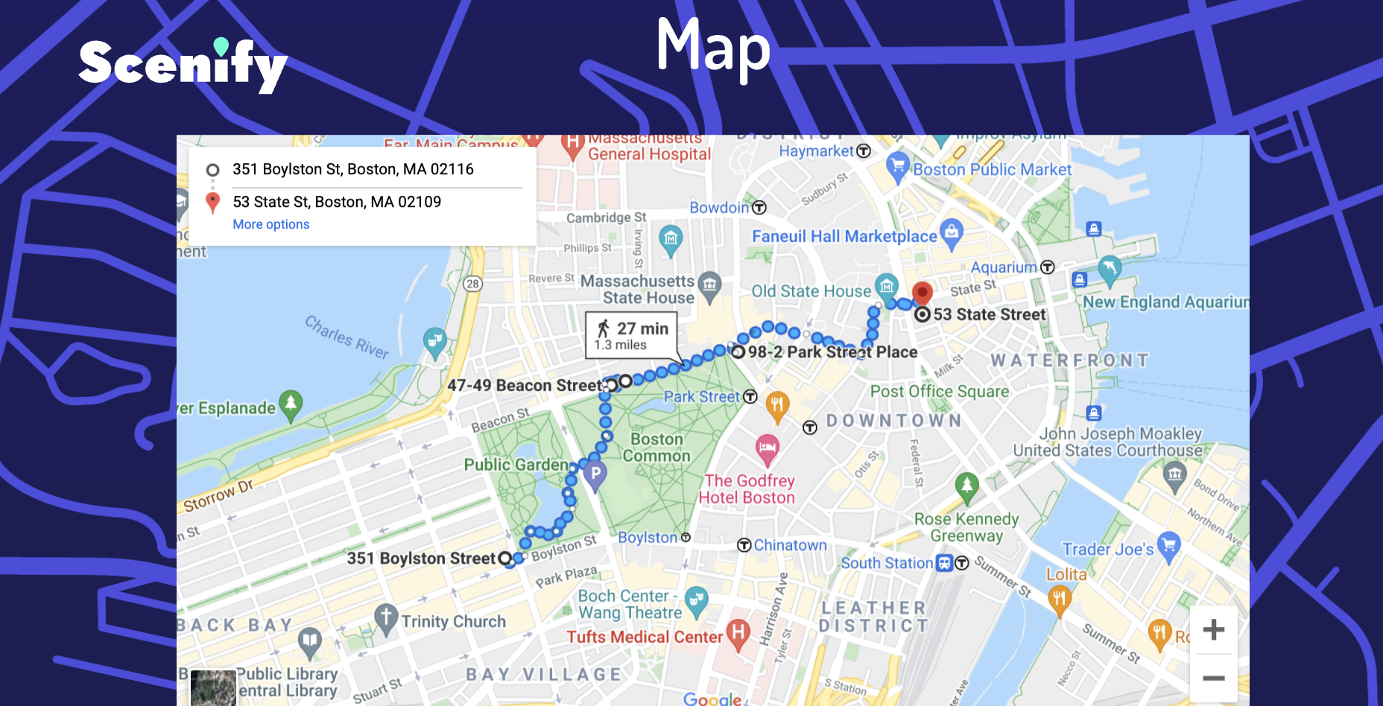
Google Maps Embed API

Slide 37
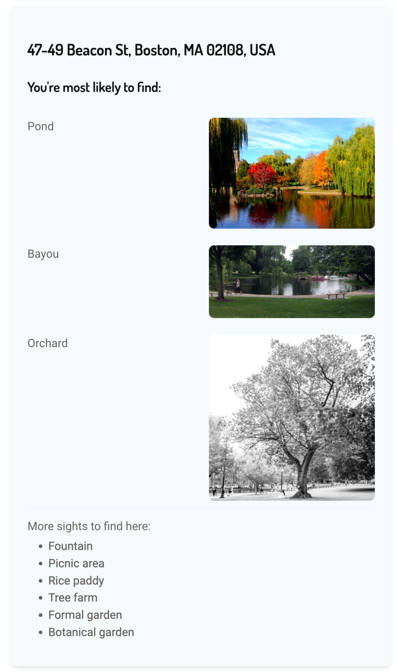
Display for User
Locations in order of route
Display three images the CNN was most confident about
List other categories that CNN has less confidence about
Notes:
larger / zoom in

Slide 38
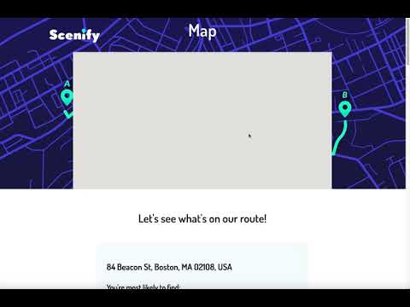
Demo
Notes:
https://youtu.be/5fRd9ifa3pE

Slide 39
In the future…
Add descriptions of the route
Give simultaneous recommendation on user’s input
Improve the calculation of the scenic values
Train our own CNN
Generate the route with our own traversal algo!
…
Notes:
training a model

Slide 40
Thanks!
Run CNN
CNN Output
Database
Scenic Route
Notes:
where will citations go? website? final slide?

