Slide 1
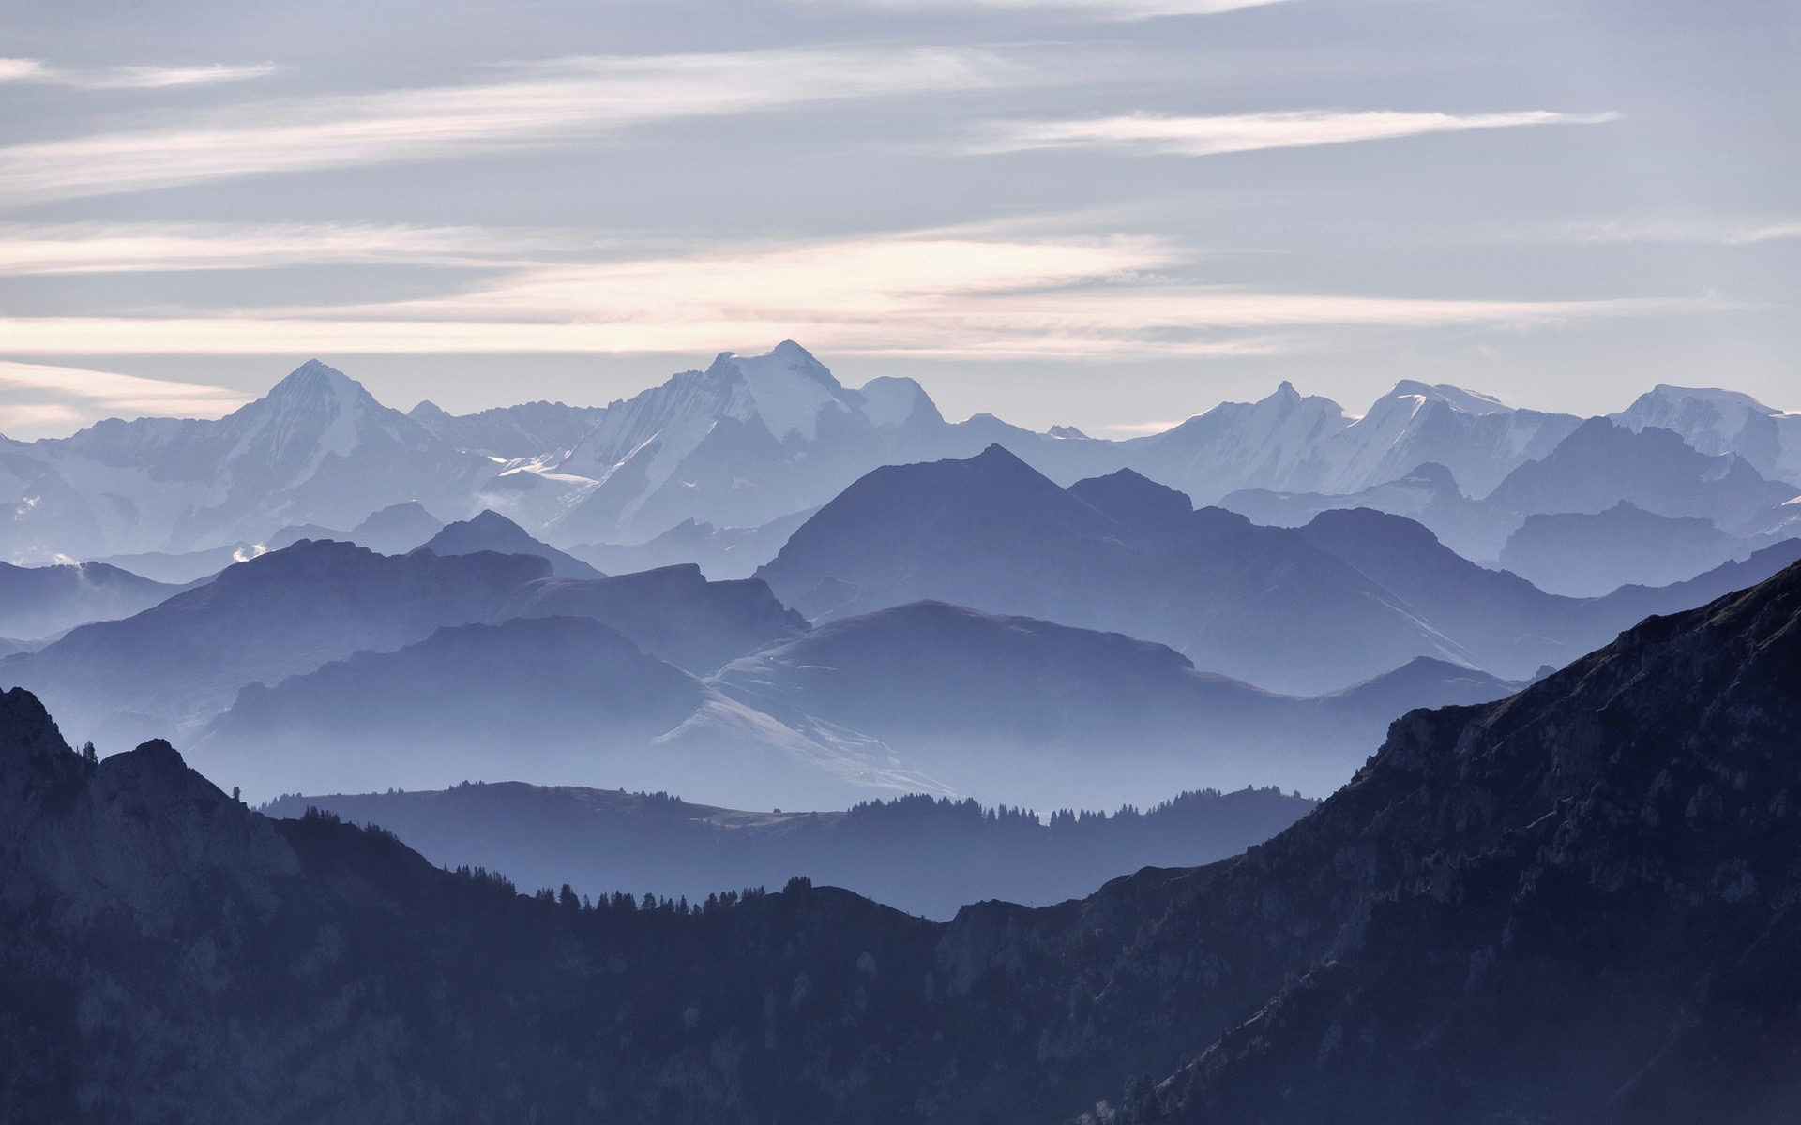
GoScenic
Emily Kampa, Evie Rosenberg, Allie Warren, Phoebe Wooldridge
Notes:
Everyone! (introduce ourselves)

Slide 2

Notes:
Evie

Slide 3
START
END

Slide 4


START
END

Slide 5
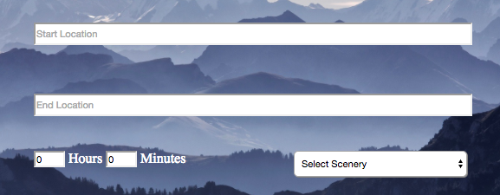

Slide 6

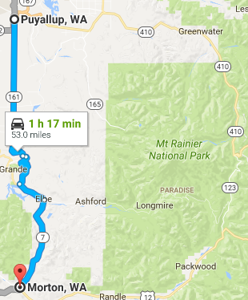
1 hour, 17 minutes

Slide 7

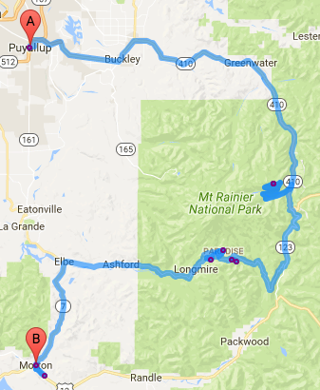
1 hour, 17 minutes
4 hours, 22 minutes
9 scenic points
Notes:
Evie

Slide 8
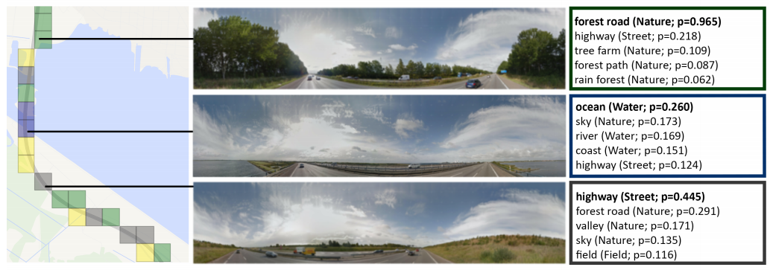
No more Autobahn! Scenic Route Generation Using Googles Street View
Notes:
Evie and Allie

Slide 9
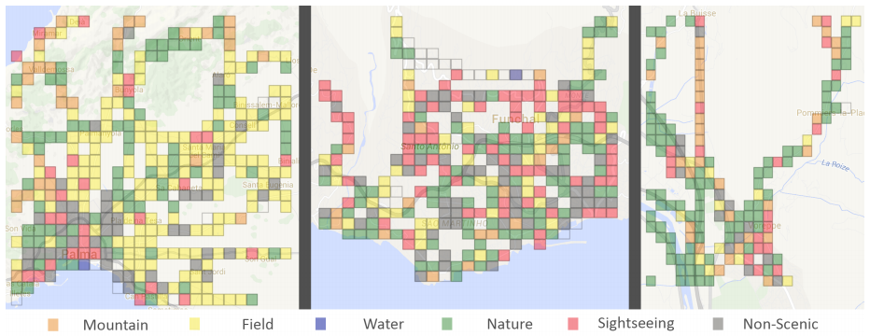
Notes:
Evie and Allie

Slide 10
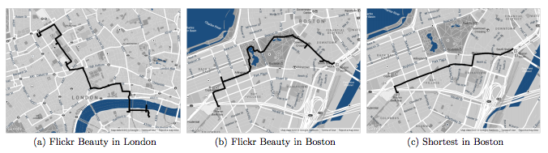
The Shortest Path to Happiness: Recommending Beautiful, Quiet, and Happy Routes in the City
Notes:
Evie

Slide 11
GoScenic “Roadmap”
Classify the scenic area.
2. Build the best route between our scenic points.
3. Output route to user.
4. Explore!

Slide 12
GoScenic “Roadmap”
Classify the scenic area.
2. Build the best route between our scenic points.
3. Output route to user.
4. Explore!

Slide 13
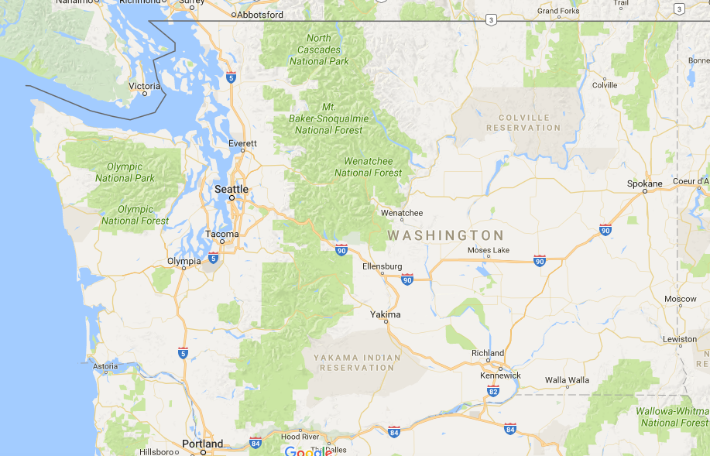
Notes:
Emily

Slide 14
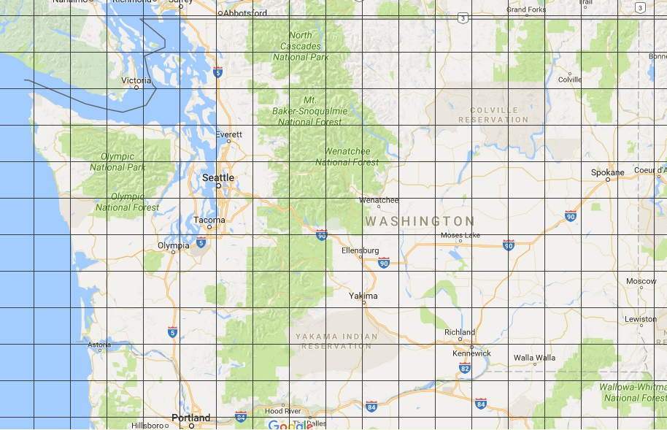
(Not to scale)
Notes:
Emily
It might be funny if we had a text come up after Emily introduced the fact that we did a grid of km square boxes that said “Not to Scale” or something like that (<-- yes, love it)

Slide 15
Notes:
Emily
It might be funny if we had a text come up after Emily introduced the fact that we did a grid of km square boxes that said “Not to Scale” or something like that (<-- yes, love it)

Slide 16
Notes:
Emily
It might be funny if we had a text come up after Emily introduced the fact that we did a grid of km square boxes that said “Not to Scale” or something like that (<-- yes, love it)

Slide 17
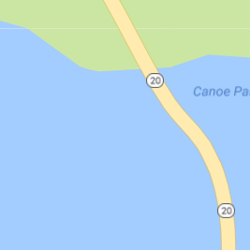
Latitude: 48.408584, Longitude: -122.645638
Notes:
Emily

Slide 18
Latitude: 48.408584, Longitude: -122.645638
Notes:
Emily

Slide 19
Latitude: 48.408641, Longitude: -122.645220
Notes:
Emily
Yoooo these look great

Slide 20
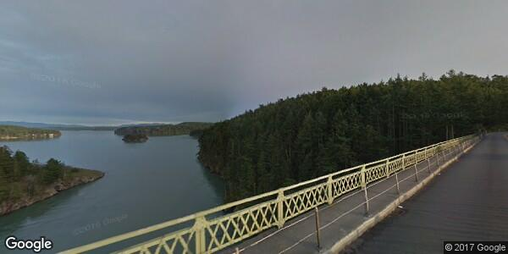
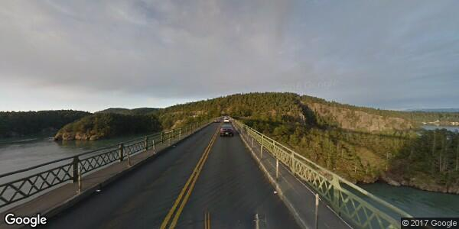
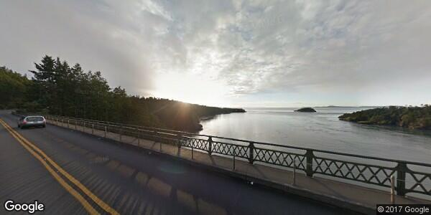
Latitude: 48.408641, Longitude: -122.645220
Notes:
Emily

Slide 21
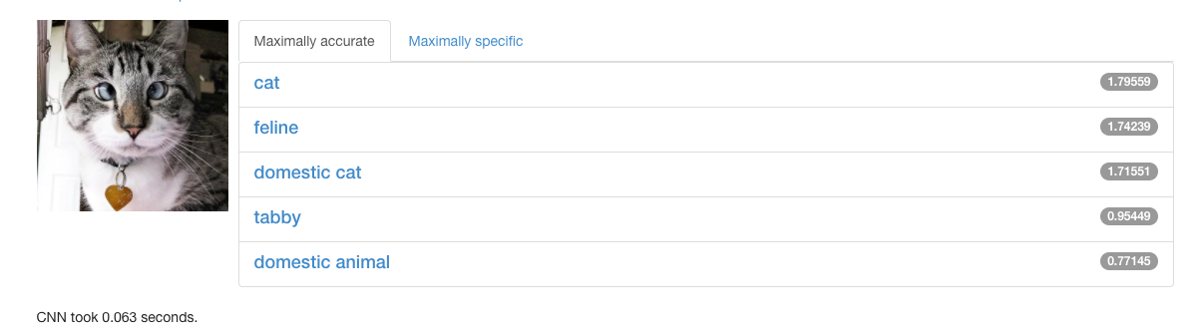
Notes:
Allie/Evie
Were we going to change this to a scenery image? jw

Slide 22
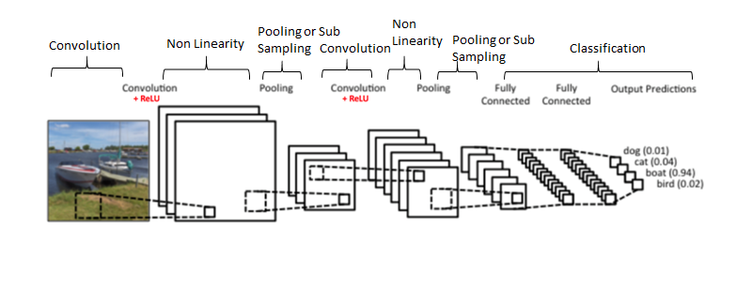
Convolutional Neural Network

Slide 23
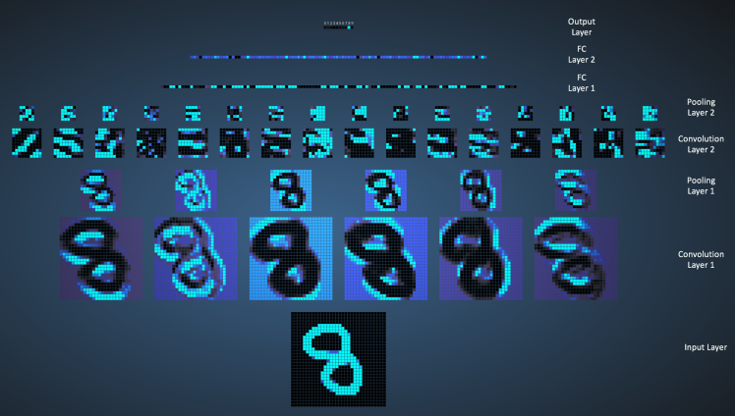
Notes:
Allie/Evie

Slide 24
Notes:
Allie/Evie

Slide 25
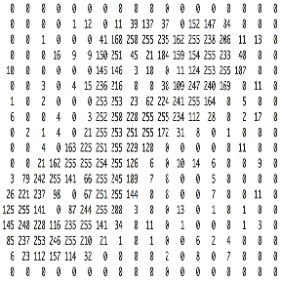
Convert to Matrix of Pixel Values

Slide 26
Convert to Matrix of Pixel Values
255 238 206
154 255 233
124 253 255

Slide 27
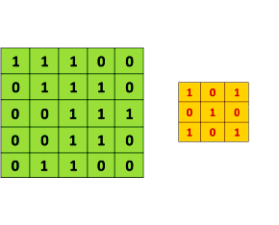
Convolution
Filter or Feature Detector Matrix
Original Image

Slide 28
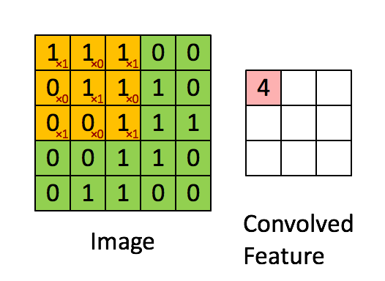
Convolution

Slide 29
Notes:
Allie/Evie

Slide 30
Pooling
Max(255, 238, 154, 22) = 255
255 238 206 11
154 255 233 48
124 253 255 107
247 240 169 8
Max pooling with 2x2 filters and a stride of 2
255 233
253 255

Slide 31
Notes:
Allie/Evie

Slide 32
Notes:
Allie/Evie

Slide 33
Notes:
Allie/Evie

Slide 34
Notes:
Allie/Evie

Slide 35
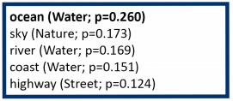
Latitude: 48.408641, Longitude: -122.645220
Notes:
Emily

Slide 36
GoScenic “Roadmap”
Classify the scenic area.
2. Build the best route between our scenic points.
3. Output route to user.
4. Explore!

Slide 37
Start
End
Notes:
Phoebe

Slide 38
Start
End
Notes:
Phoebe

Slide 39
Start
End
Notes:
Phoebe

Slide 40
Determining Relevant Area
Start location
End Location
a
maximum time constraint
a + b =
b
Notes:
Phoebe

Slide 41
Notes:
Phoebe

Slide 42
Notes:
Phoebe

Slide 43
Route-Finding Algorithm
Notes:
Allie/Phoebe

Slide 44
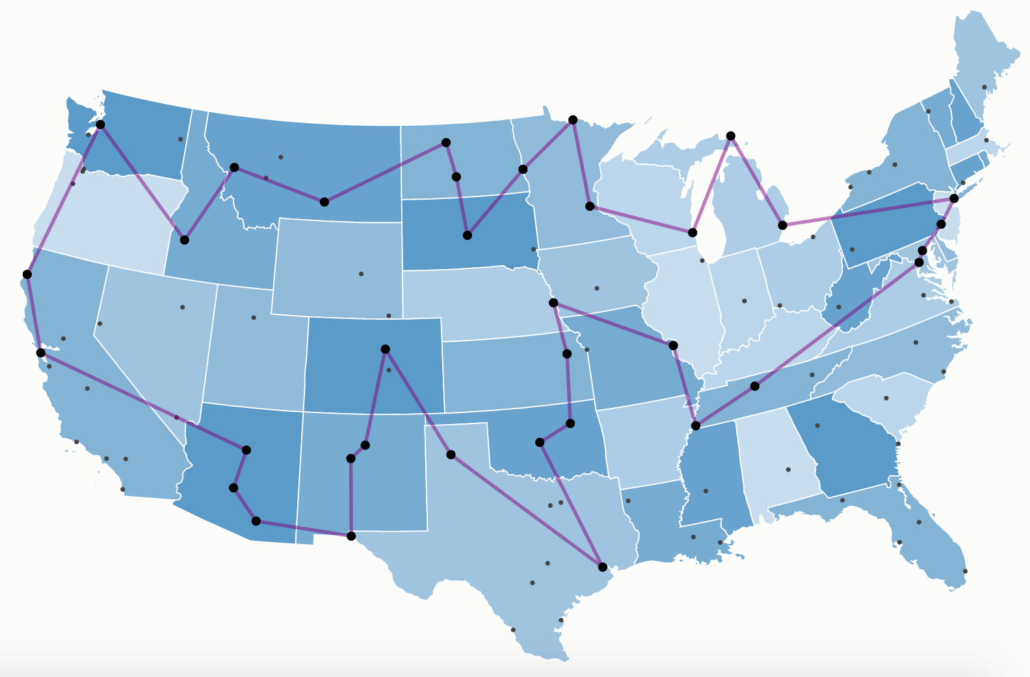
Traveling Salesman Problem
Notes:
Allie/Phoebe
http://examples.gurobi.com/traveling-salesman-problem/

Slide 45
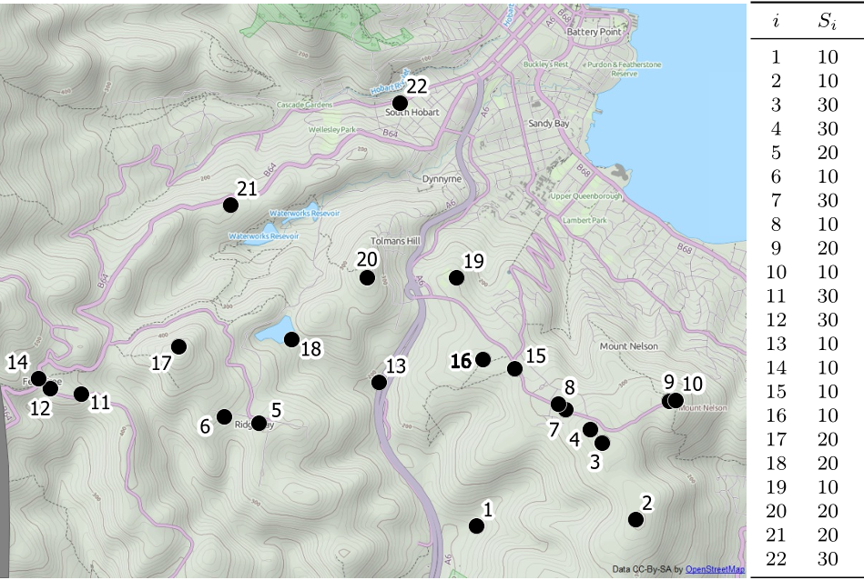
Orienteering Problem
Notes:
Allie/Phoebe
https://www.semanticscholar.org/paper/The-cooperative-orienteering-problem-with-time-Merwea-Minas/9b16244b33f54227a669961bb82856e6edc911a1

Slide 46
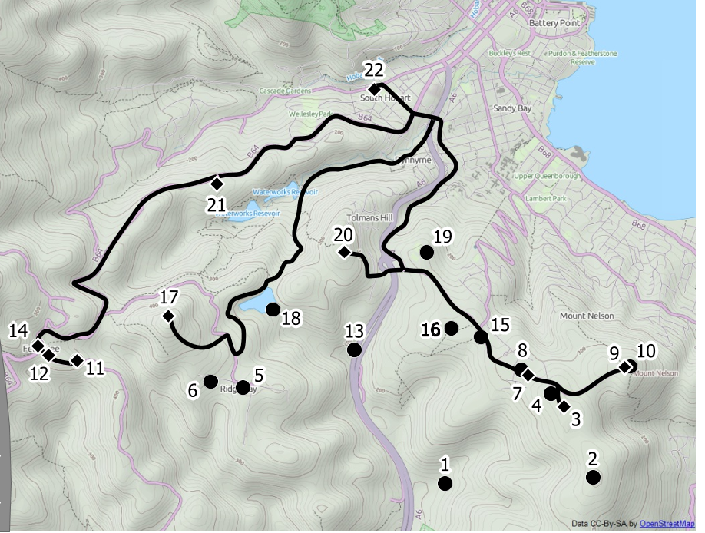
Orienteering Problem

Slide 47
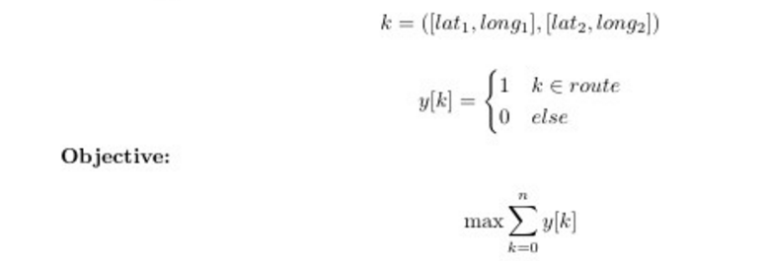
ILP Solution (objective function)

Slide 48
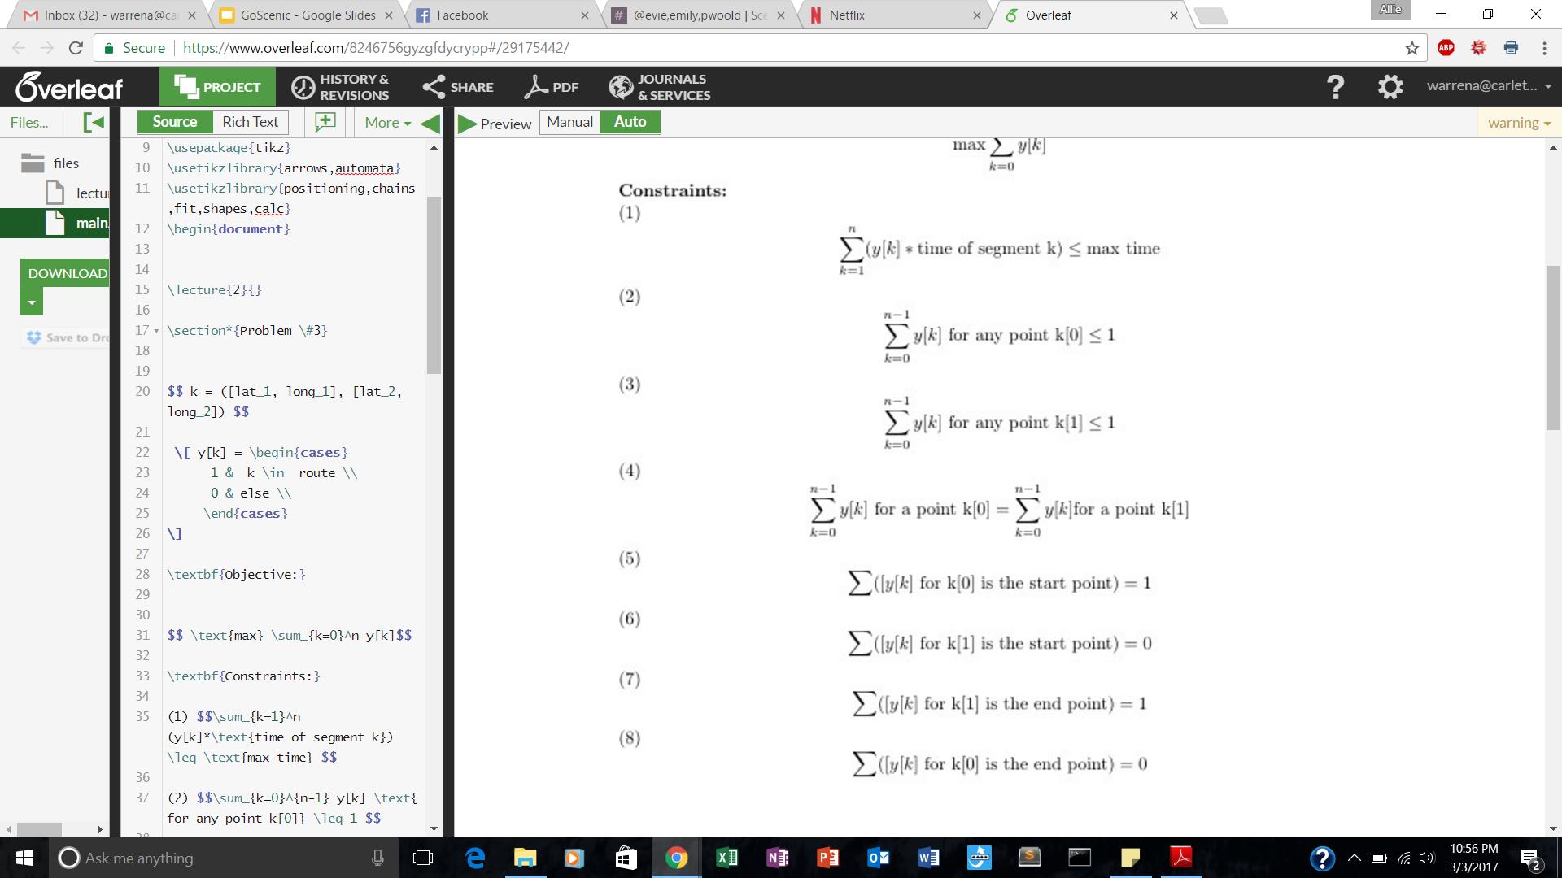
ILP solution (constraints)
Time of route cannot exceed max time
Don’t visit any point more than once
If you visit a point you must also leave that point (except the start and end point)
Notes:
Allie/Phoebe
This probably isn’t a great way to visualize ILP- might want to switch it up?

Slide 49
ILP solution (constraints)
You must leave the start point, but never enter it
You must enter the end point but never leave it
Notes:
Allie/Phoebe
This probably isn’t a great way to visualize ILP- might want to switch it up?

Slide 50
Alternative Heuristic
A fast and effective heuristic for the orienteering problem
I-Ming Chao a, Bruce L. Golden b,. , Edward A. Wasil c

Slide 51
10 points farthest from the start and end point

Slide 54
10 paths through the 10 farthest points

Slide 57
2-Point Exchange

Slide 58
Improved Routes after 2-Point Exchange

Slide 59
1-Point Movement

Slide 60
Improved OPT Route after 1-Point Movement

Slide 61
Final OPT Route:
9 Scenic Points

Slide 62
ILP Optimizations

Slide 63
ILP Optimizations

Slide 64
ILP Optimizations

Slide 65
ILP Optimizations

Slide 66
ILP Optimizations

Slide 67
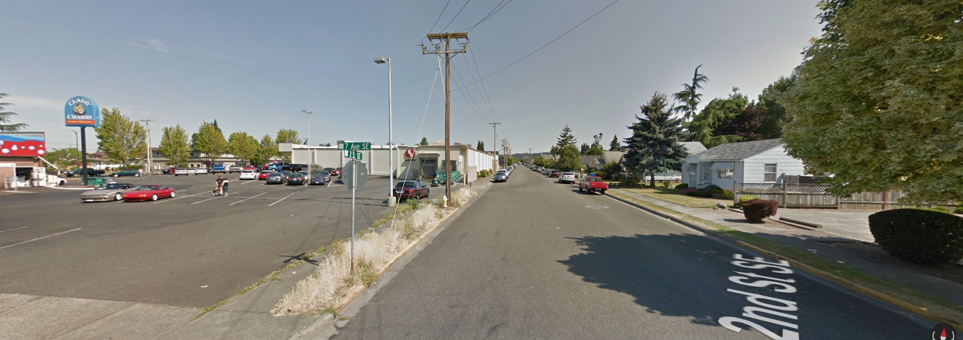
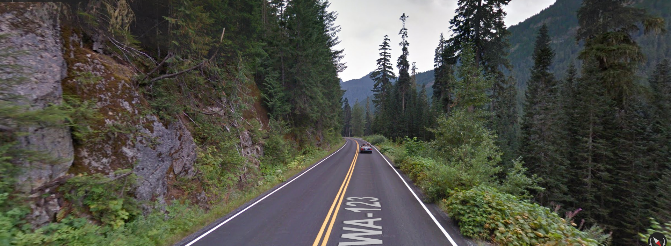
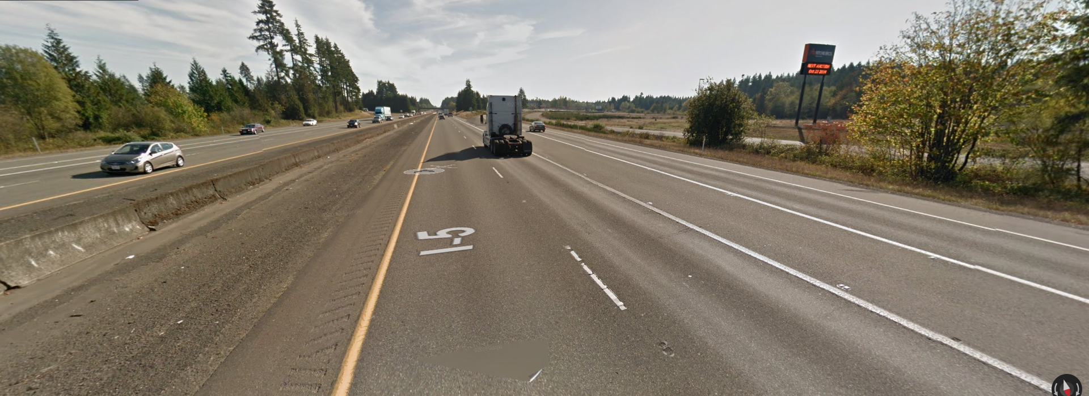
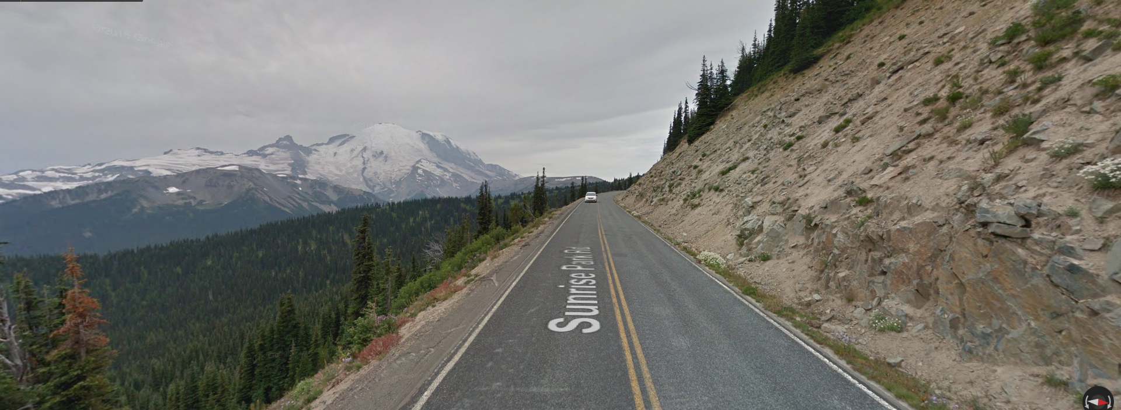
Notes:
Show a demo of what we showed our user-- maybe even scroll through one “scenic route” vs a non scenic? Like a real quick click through? Maybe even do this earlier in the presentation?

Slide 68
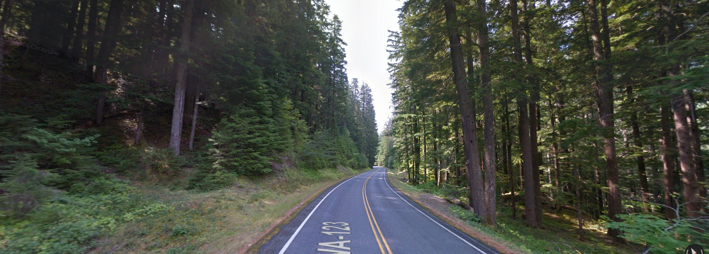
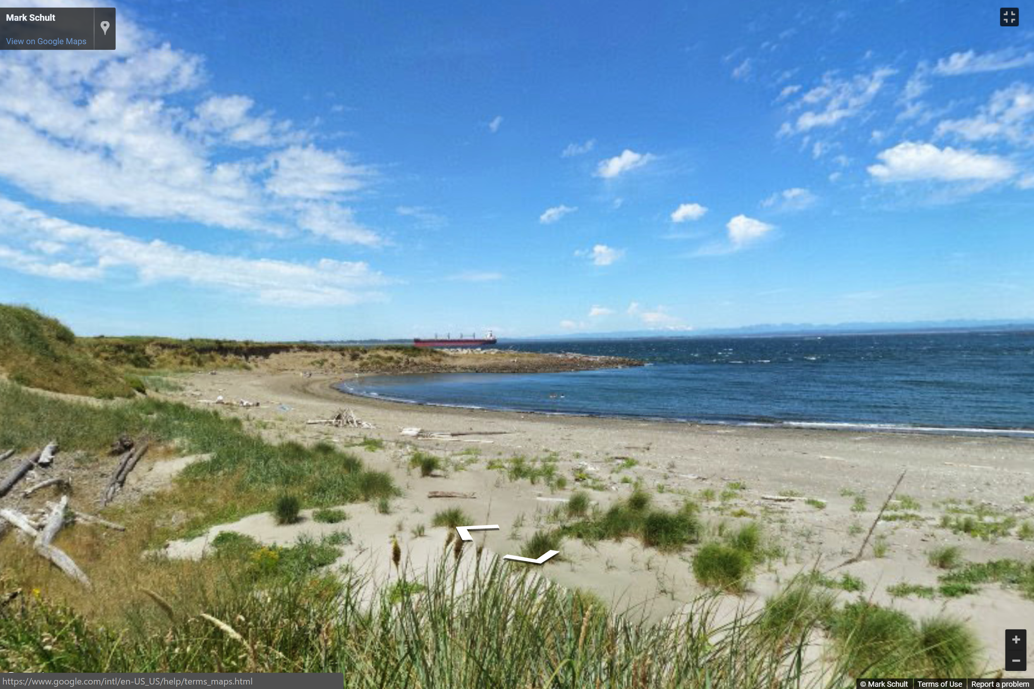
Nature and Woods
Mountains
Water

Slide 69
GoScenic “Roadmap”
Classify the scenic area.
2. Build the best route between our scenic points.
3. Output route to user.
4. Explore!

Slide 70
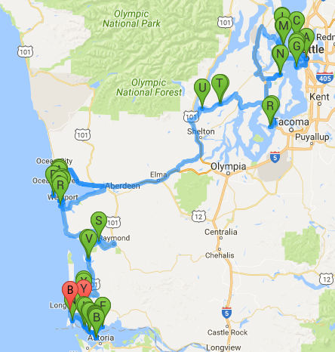
Notes:
Evie/Emily
Mention: distracting, in the way scenic markers; hard to see the start/end point which can finder the user from even using the route; hard for user to see their scenic points as well as hard for us to test our algorithm (was it giving us believable scenic points?; finally, our route had 64 points… and alphabet issue

Slide 71
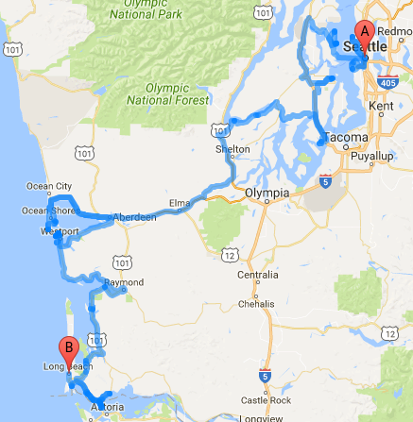
Notes:
Evie/Emily

Slide 72
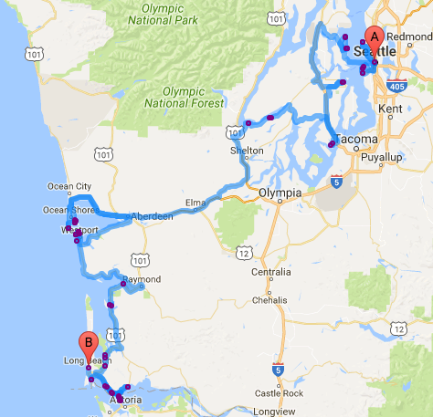
Notes:
Evie/Emily

Slide 73
64 Scenic Points
Notes:
Evie/Emily
Talk about creating multiple directions renderers to fit more than 23 waypoints

Slide 74
START
END

Slide 75
START
END

Slide 76
Notes:
Evie/Emily
Talk about creating multiple directions renderers to fit more than 23 waypoints

Slide 77
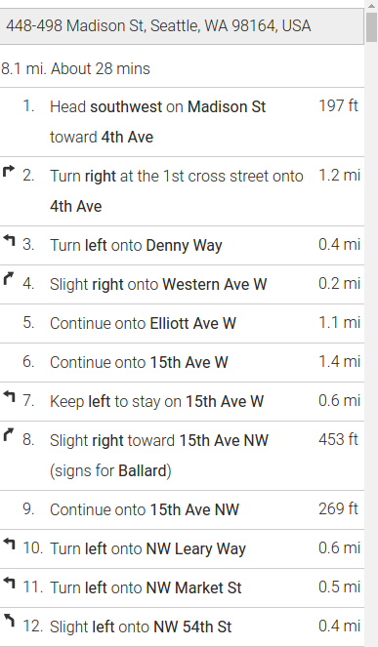
Notes:
Evie/Emily

Slide 78
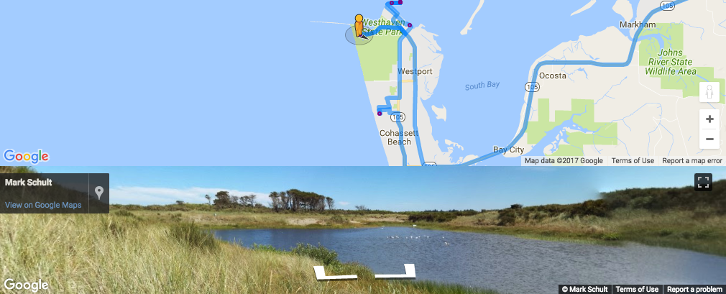
Notes:
Evie/Emily

Slide 79
GoScenic “Roadmap”
Classify the scenic area.
2. Build the best route between our scenic points.
3. Output route to user.
4. Explore!

Slide 80
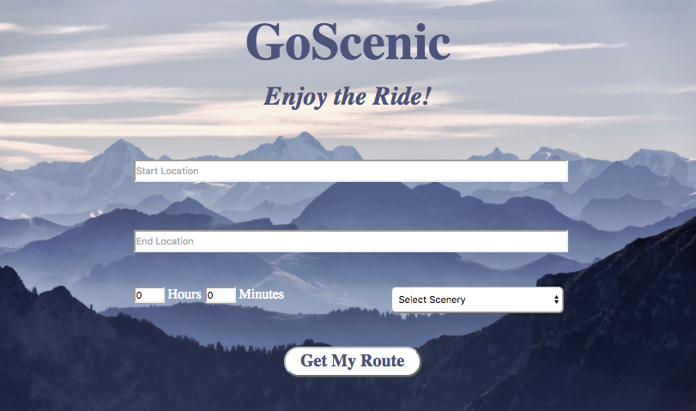
GoScenic: a Demo!
Notes:
??
Should we also demo dragging the person icon to one or two purple scenic dots on our route? We could figure out really scenic google street view ones beforehand?

Slide 81
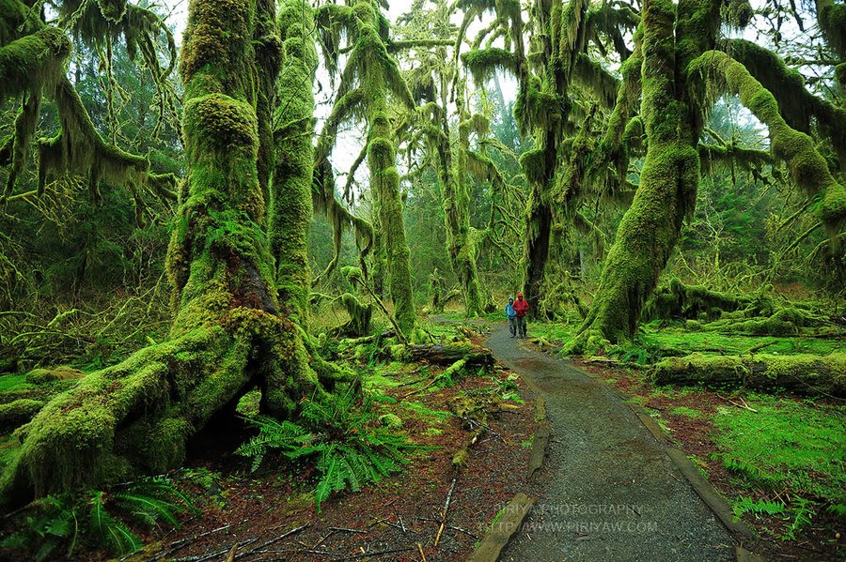
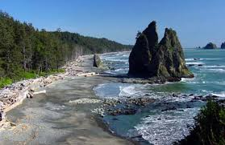
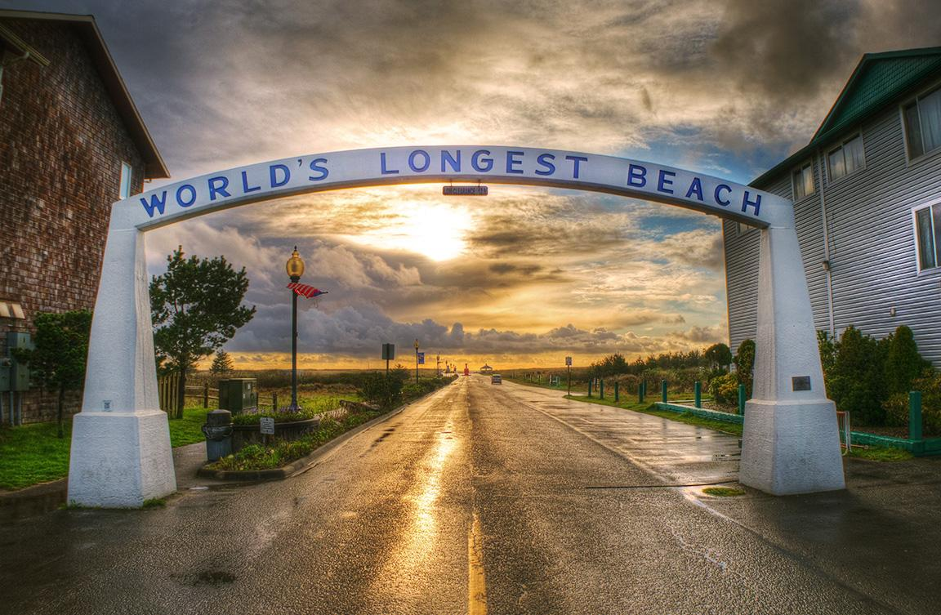
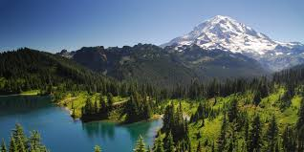
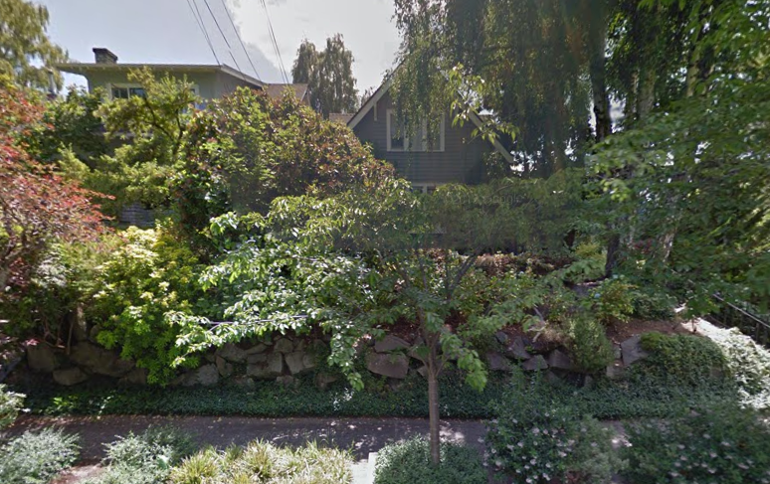
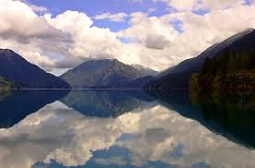
Thank you!
Notes:
Make sure we can credit these photos also lol
(one of these photos should totally be a scenic view of Allie’s house ;)
NOTES (aka Dave’s opinion):
-have images demonstrate better what we are saying
-Tailor what we are talking about to the images maybe → have arrows, things pop up, etc. (get people’s attention)
-the last slide stays up there while you thank people,
-list contributions, summary slide? Screenshot of demo?
-screenshot of demo, maybe before we dive into our interface decisions
-words on screens: we could have short image captions to help direct the audience’s attention; we could do “chapter titles”; we could have captions/titles on slides
Slides:
-Intro slide: give more than just the logo. Maybe show the Google vs GoScenic route slide earlier
-Neuro Net: show kernal gif for a hot sec, then a slide where we build through the layers
-Ellipse side: add another slide or two?
-us VS google maps

Slide 82
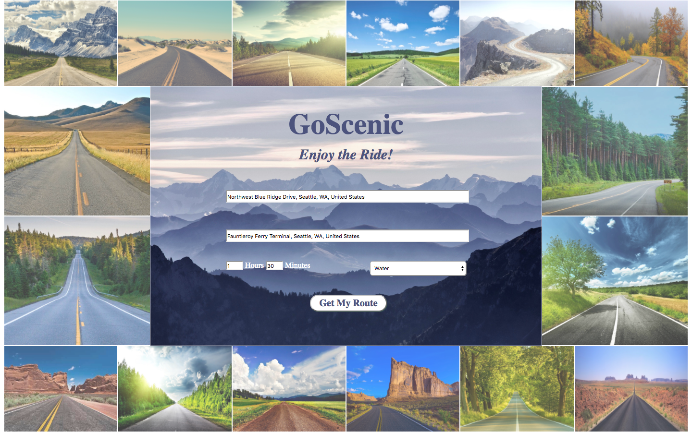
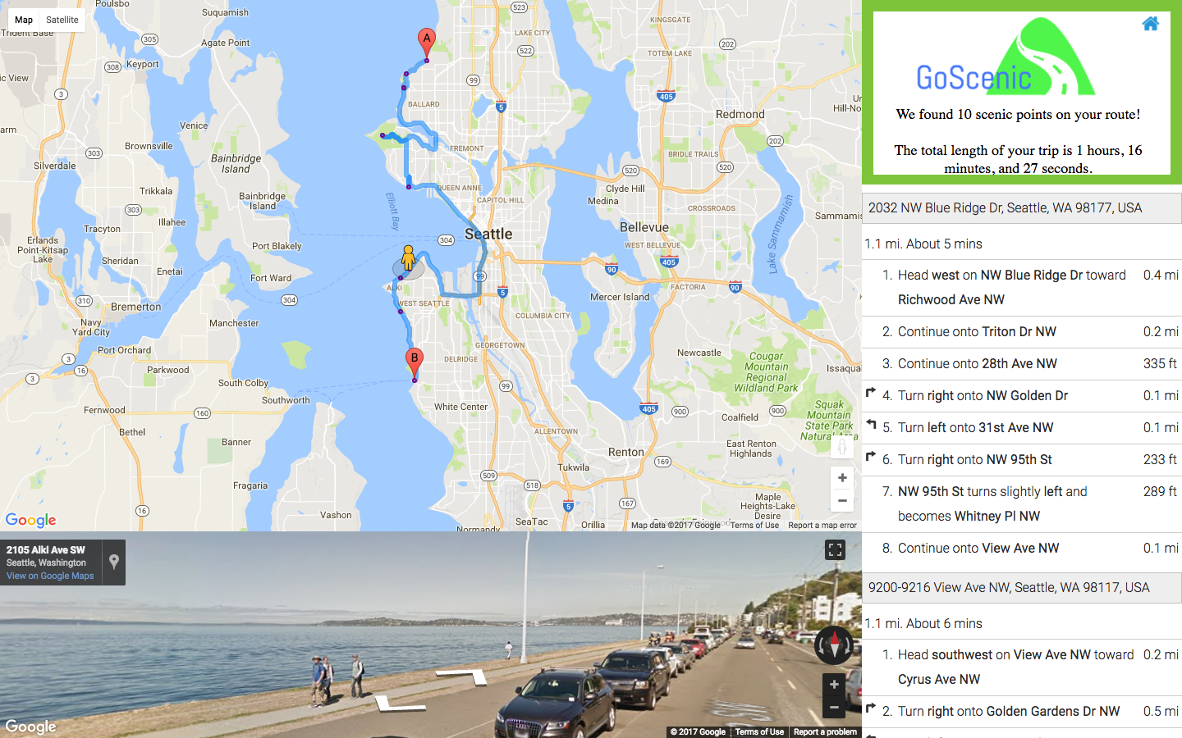
Questions?

