Slide 1
Hoot!: An Optical Character Recognition System
Eric Brenner
Paul Carpenter
Daniel Ehrenberg
Aaron McCarty
Travis Raines
Advised by Jeff Ondich

Slide 2
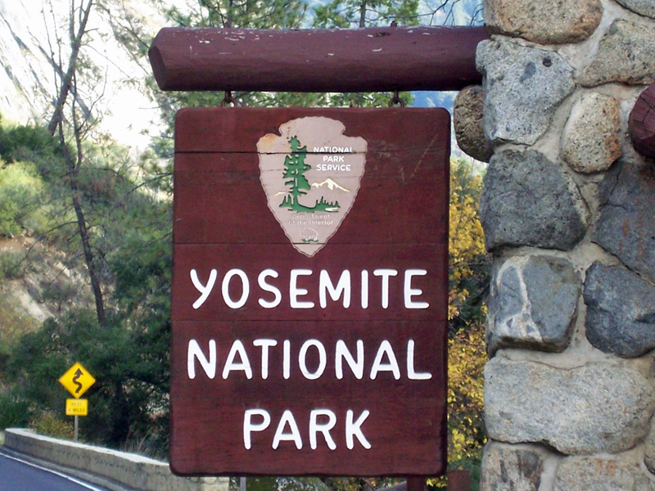
Defining the Problem
What is optical character recognition (OCR)?
Input: an image of some text
Output: corresponding machine-encoded text

Slide 3

Why Should We Give a Hoot!?
Uses and Applications of OCR

Slide 4
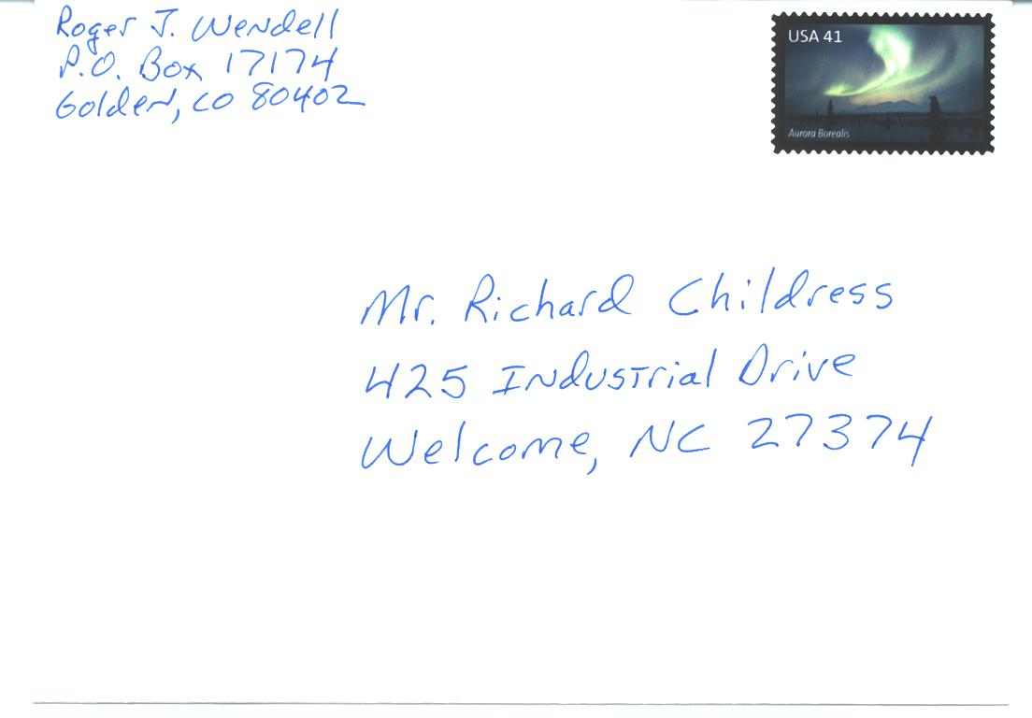
Mail

Slide 5
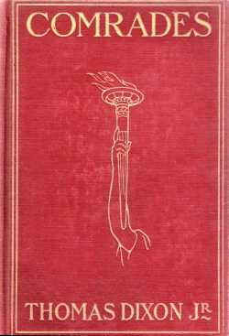
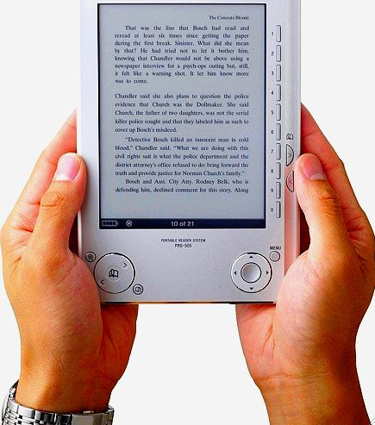
Books

Slide 6
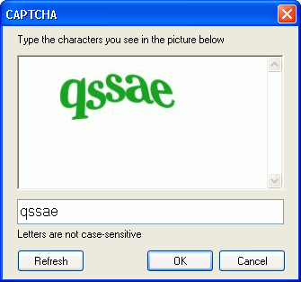
Captcha

Slide 7
What Makes OCR Difficult?

Slide 8
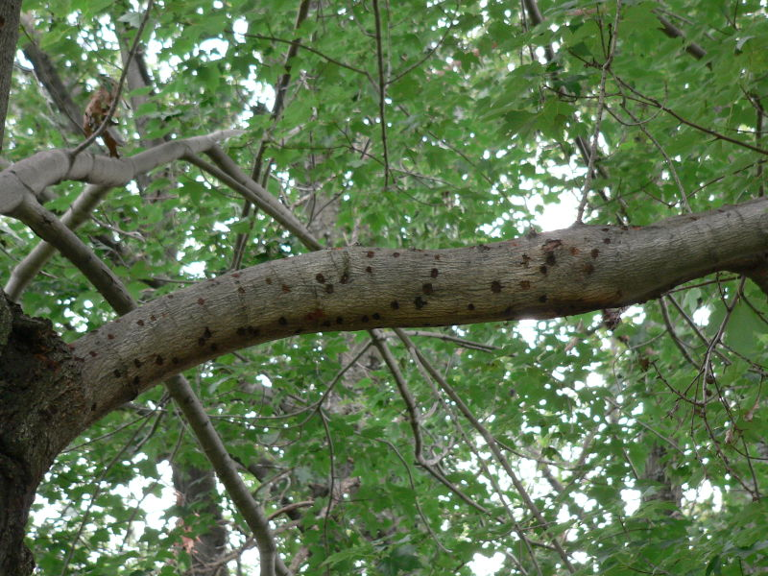

Image contains more than text

Slide 9
Inconsistent coloring

Slide 10


Skew and Rotation
Skewed “l” or forward slash?
/

Slide 11
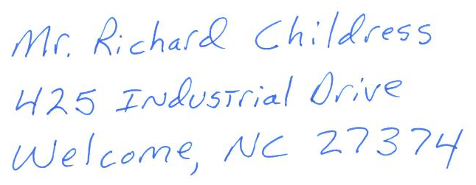
Different Sizes and Different Fonts
A A A A A A A

Slide 12
Our Focus
Conditions similar to those of scanned documents
Consistent coloring within text and within background
Limited but allowed noise, skew and rotation

Slide 13
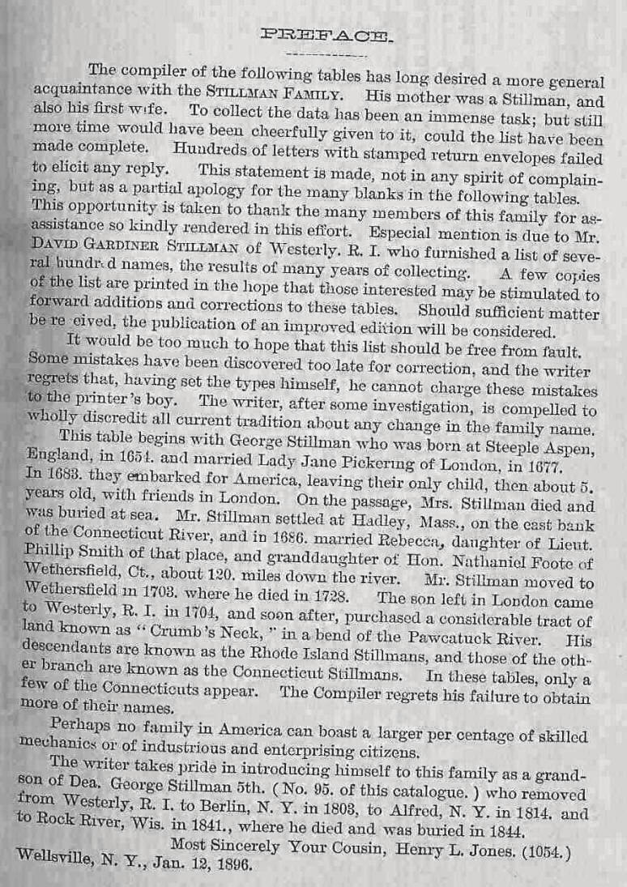
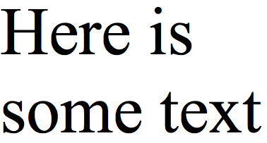
Yes

Slide 14
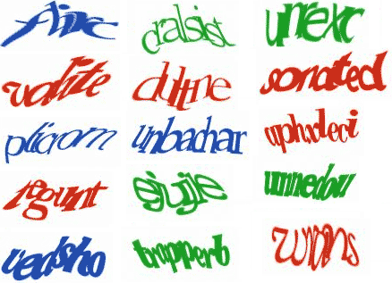
No

Slide 15
Architecture

Slide 16
color image
string
Global
Stream N-gram
Binarizer
Local
Linguist
Word N-gram
b&w image
Dictionary distance
votes
Connected Component
Segmenter
Nearest Neighbor
Bounding Box
Matcher
Processed Library
pieces w/area
feature vectors
Constant
Template
Proportional
Thresholder
Feature Extractor
Histogram
Adaptive
Fourier Descriptors
scaled lines of words
big pieces
Simple
Linear
Typesetter
lines of words
Scaler
Proportional

Slide 17
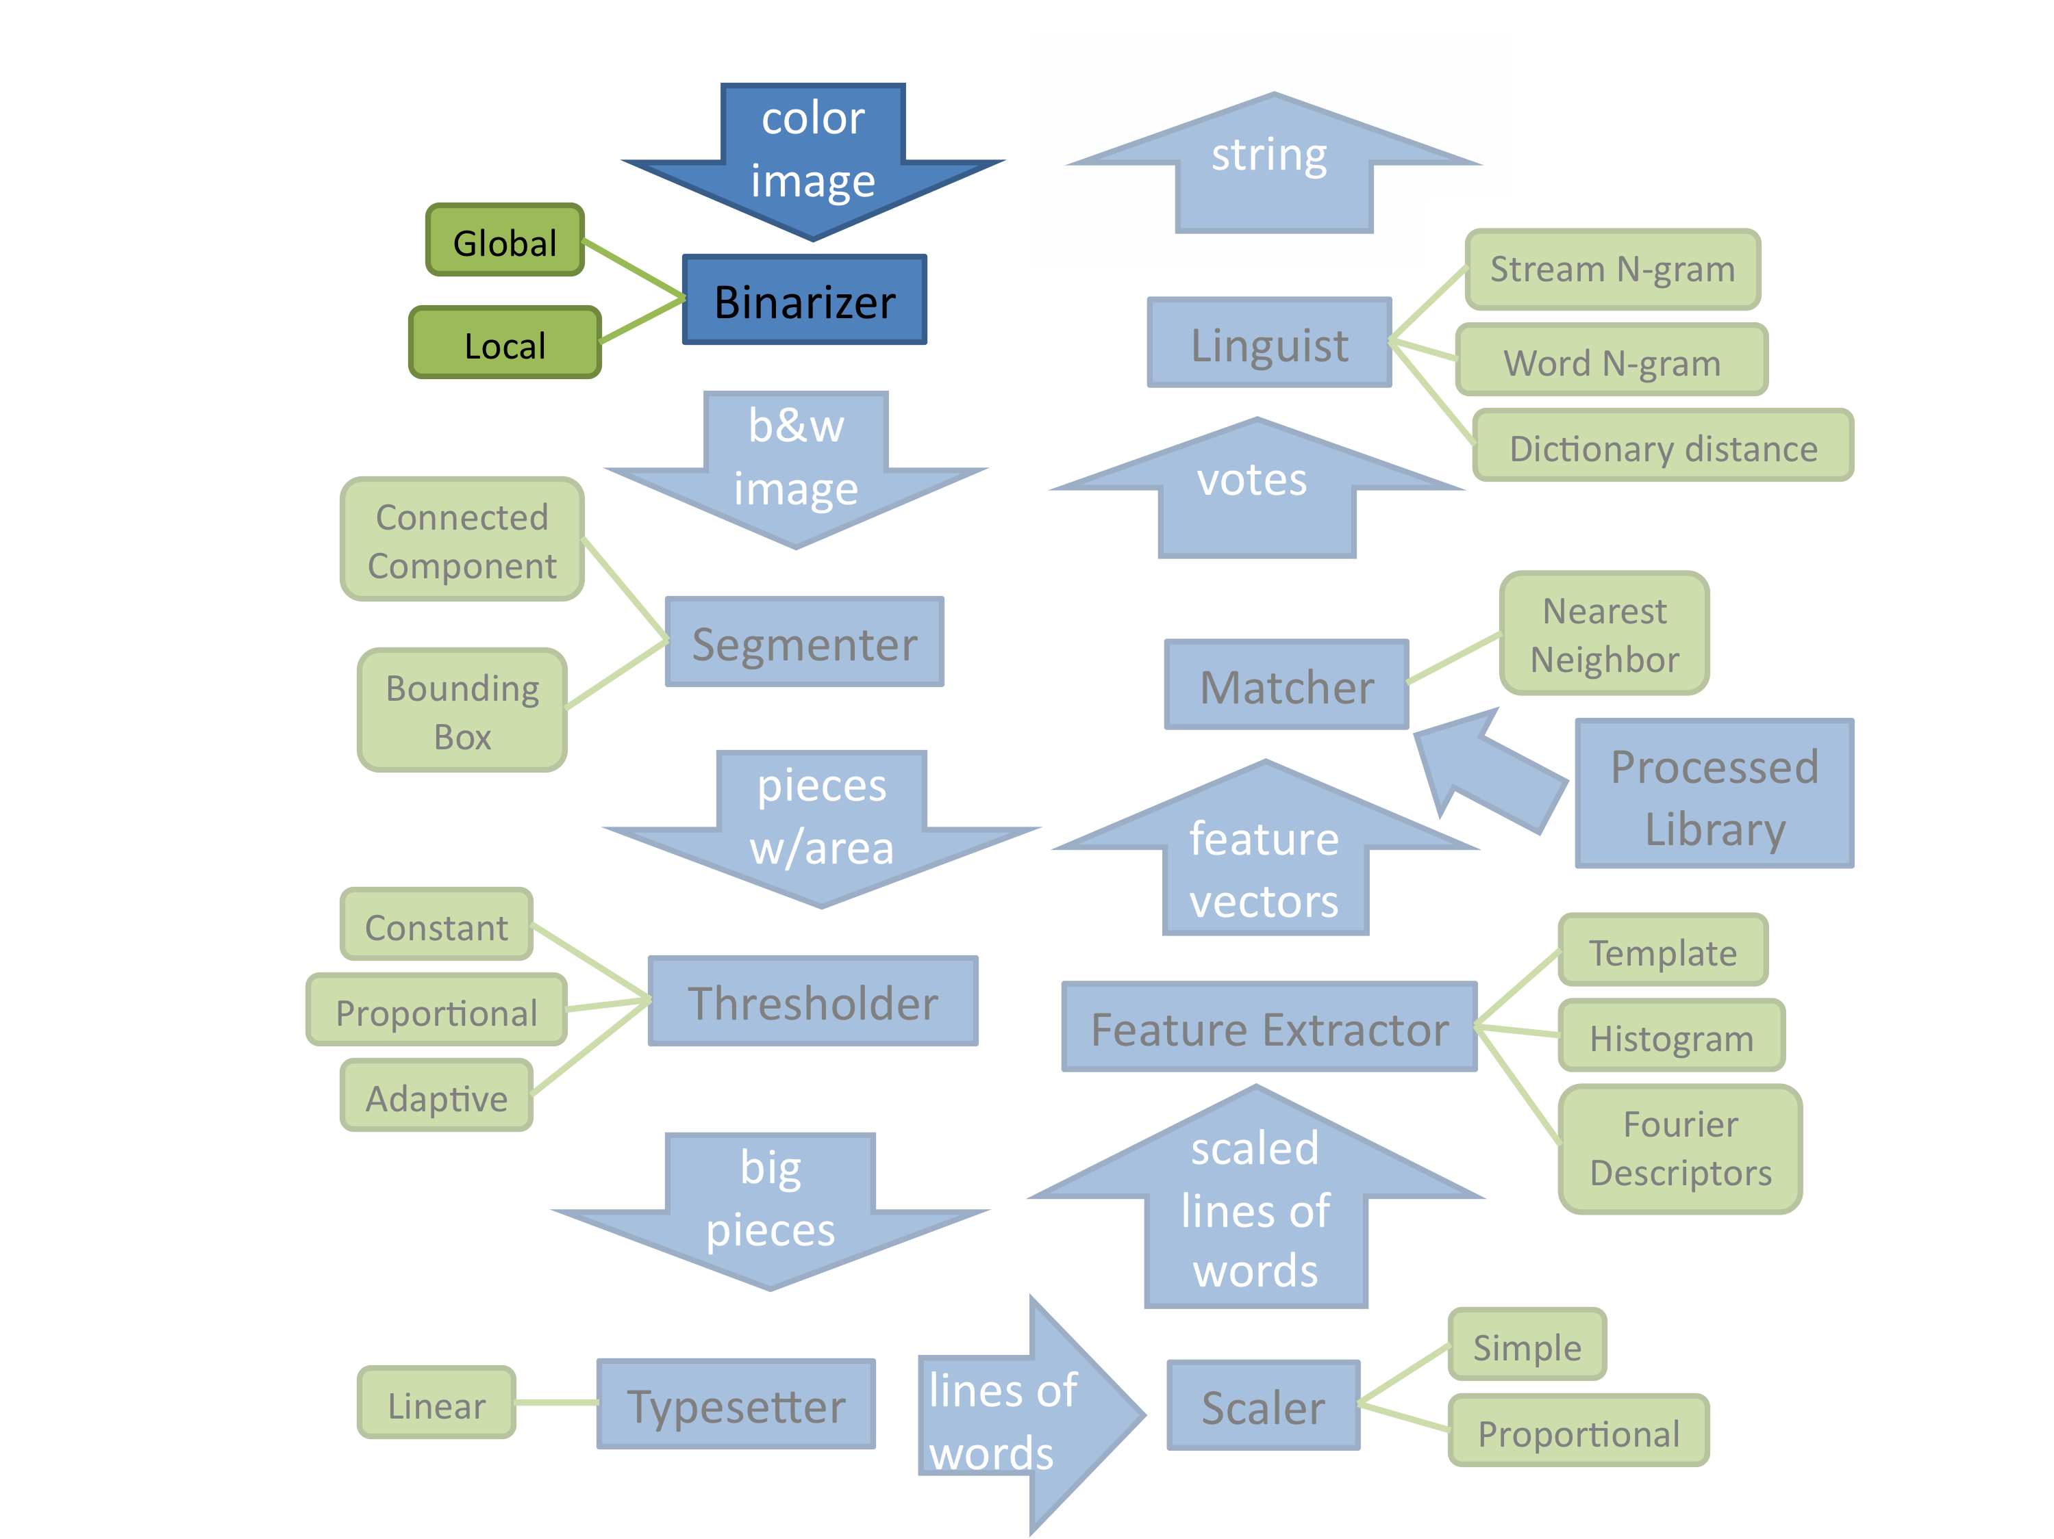

Slide 18


Binarizer

Slide 19
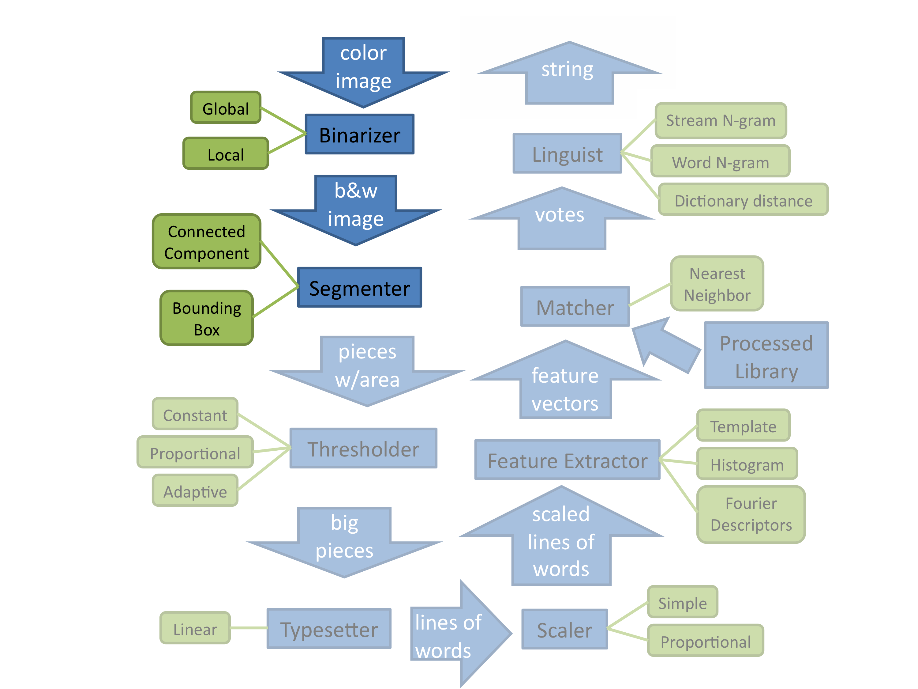

Slide 20
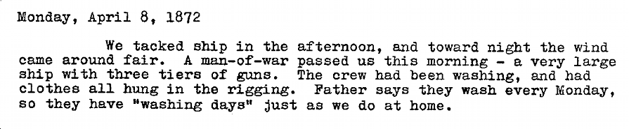
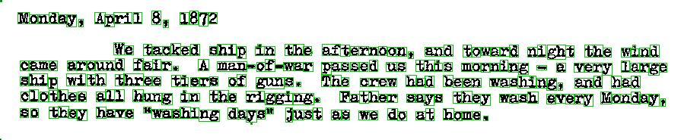
Segmenter

Slide 21
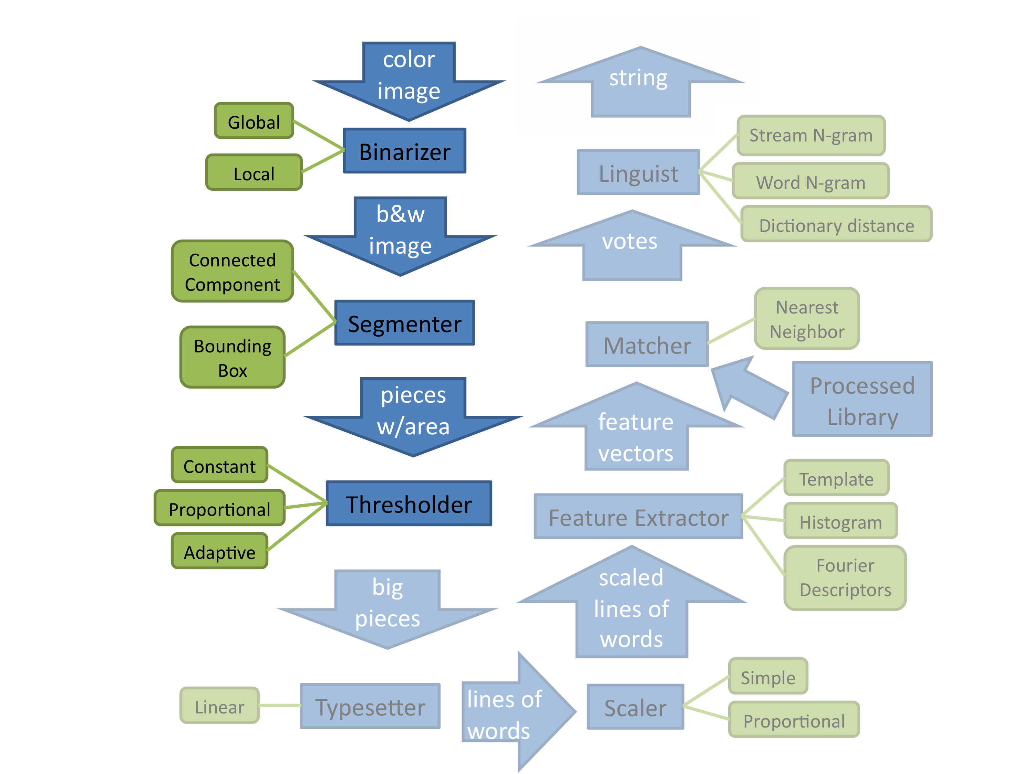

Slide 22
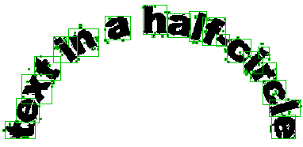
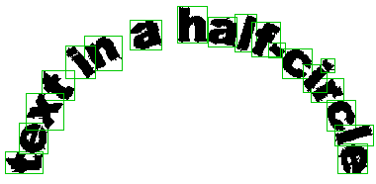
Thresholder

Slide 23
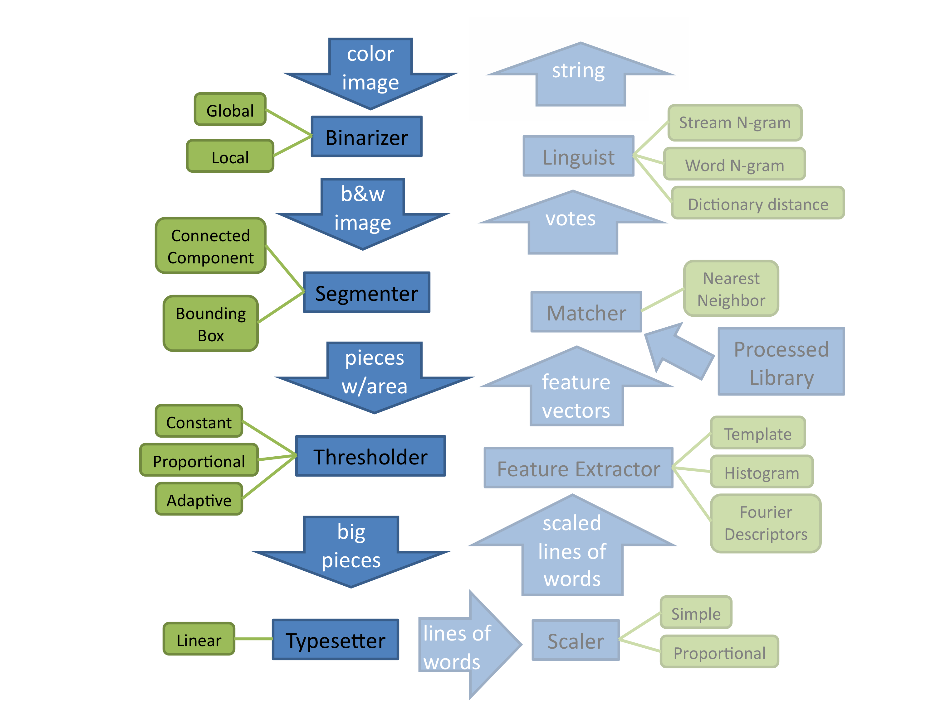

Slide 24
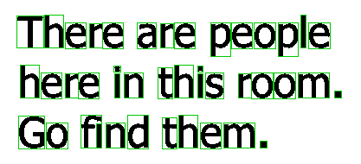
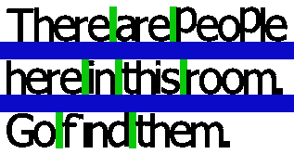
Typesetter

Slide 25
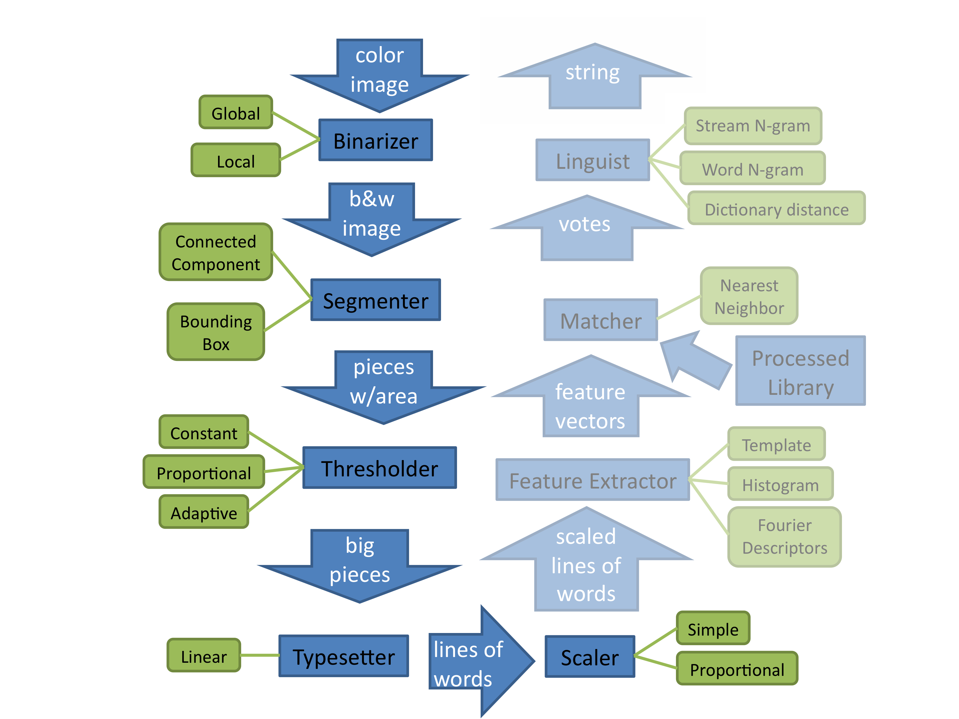

Slide 26

Scaler

Slide 27
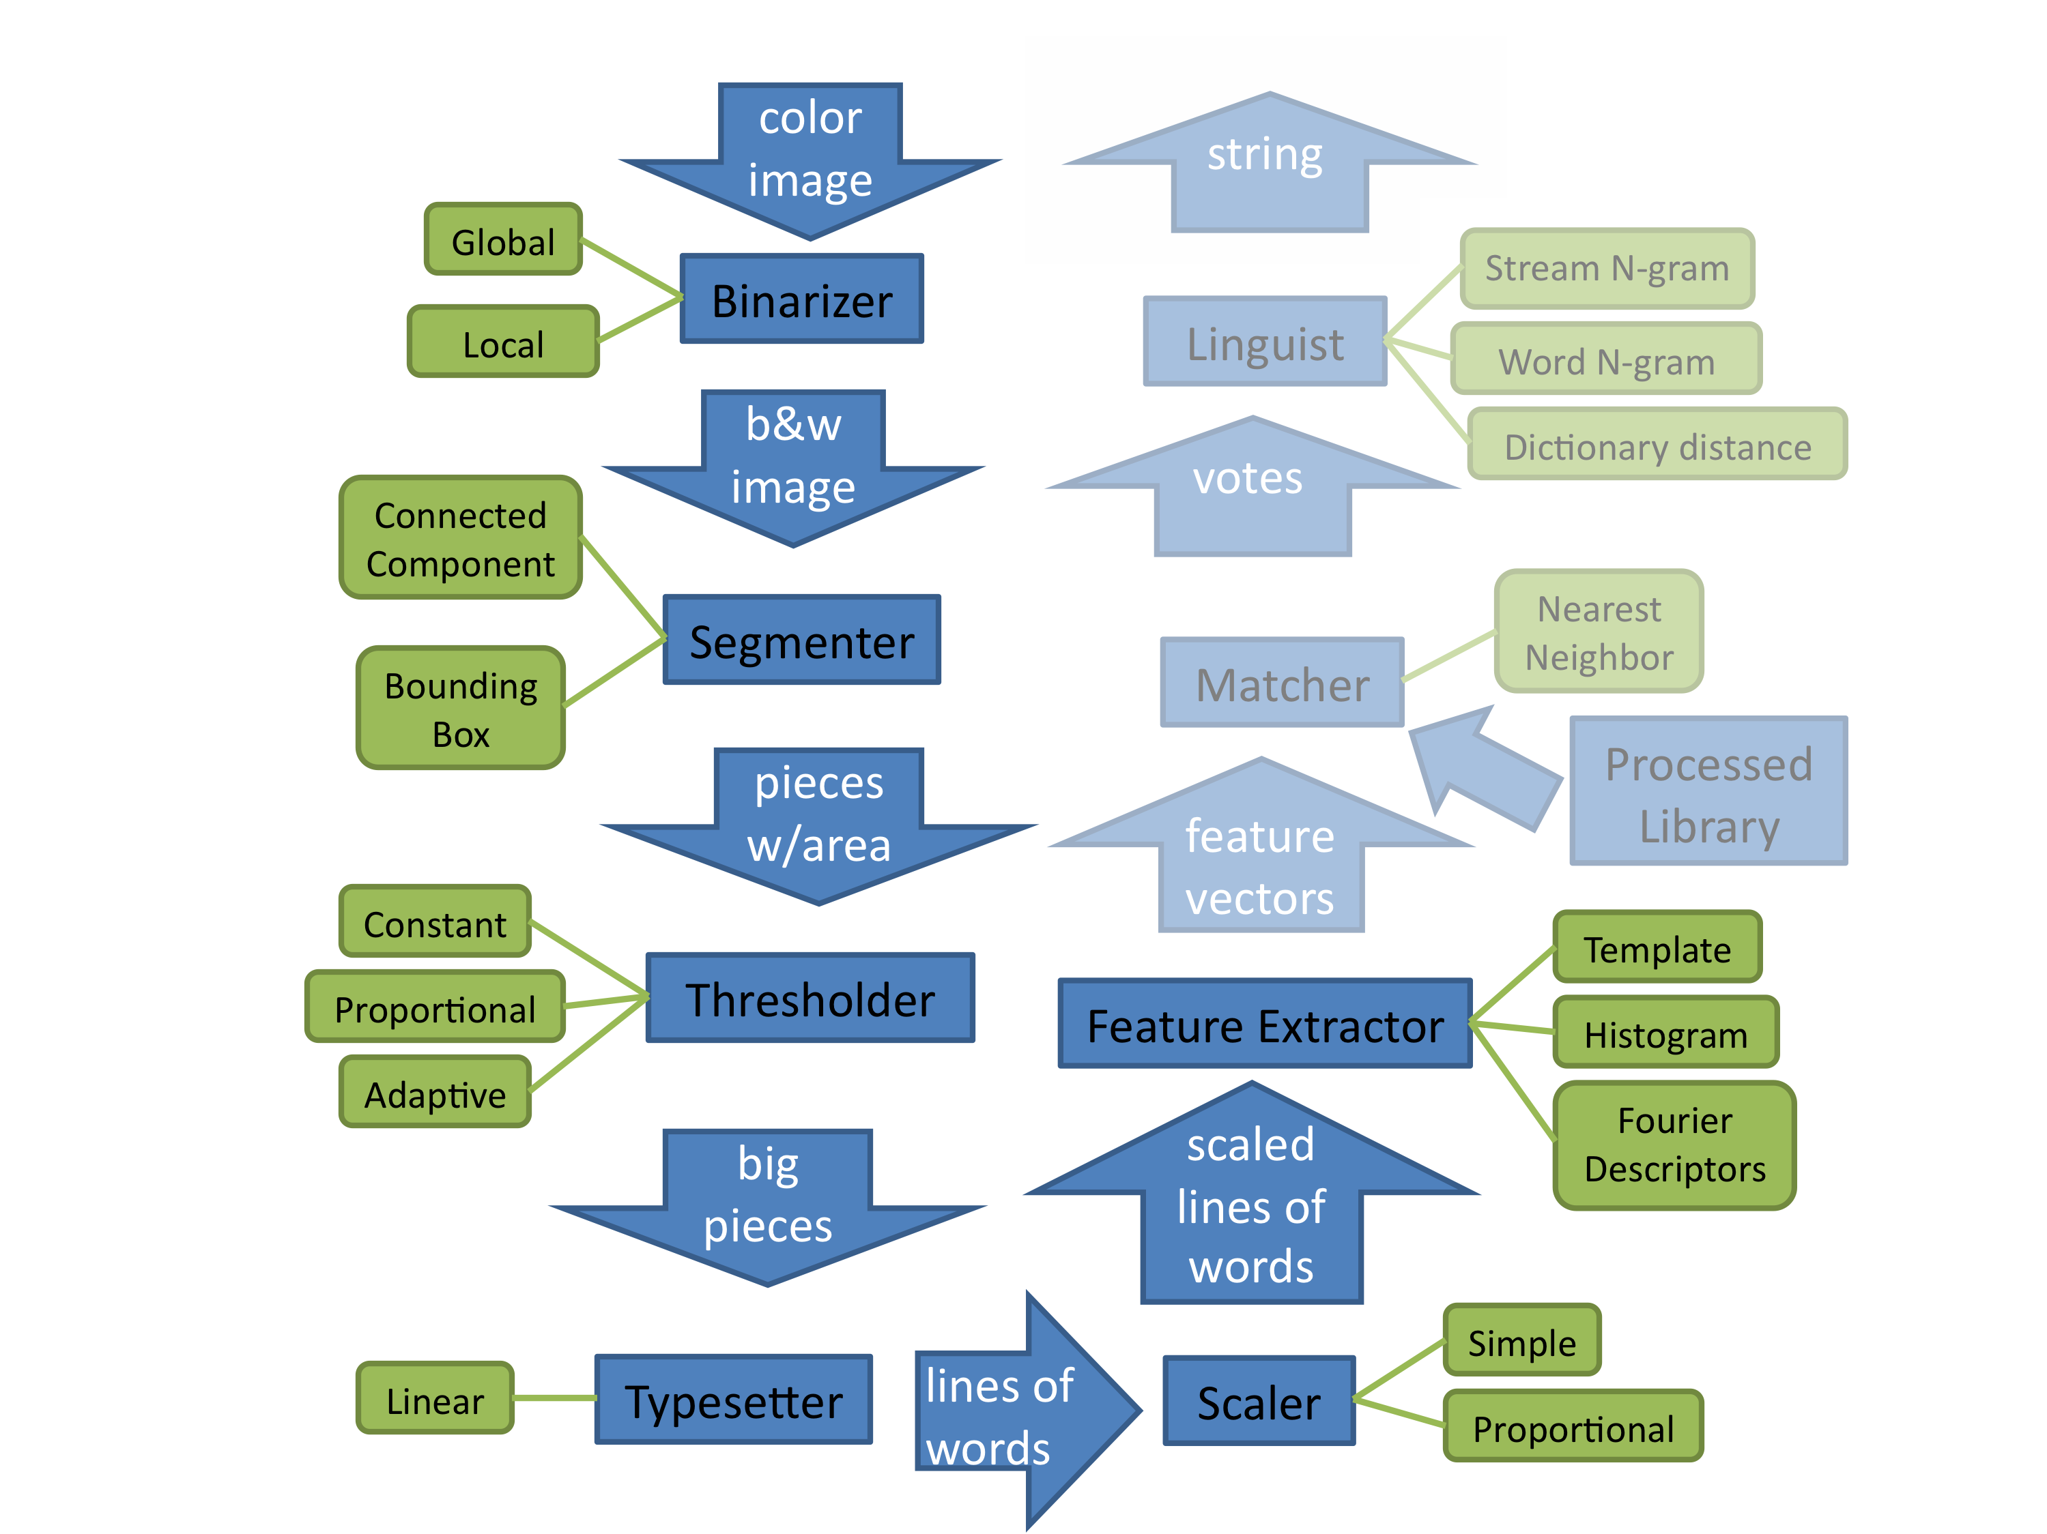

Slide 28


Feature Extractor

Slide 29
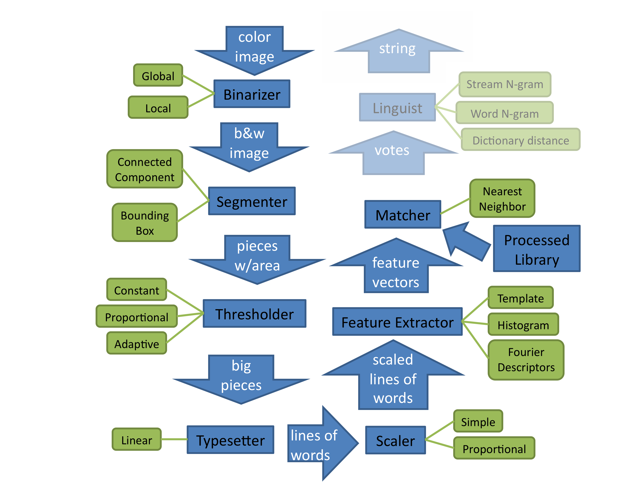

Slide 30

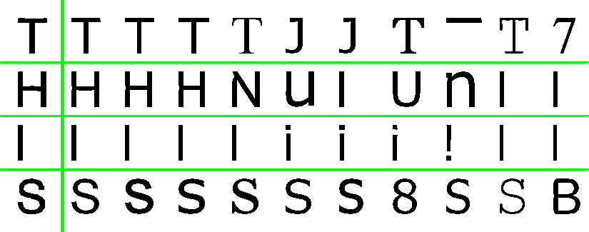
Matcher
Processed Library

Slide 31
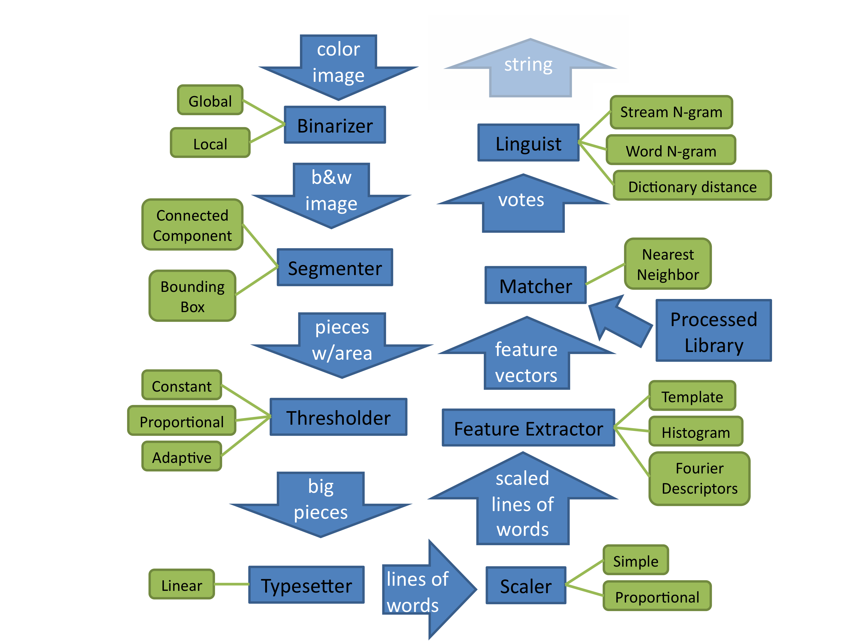

Slide 32
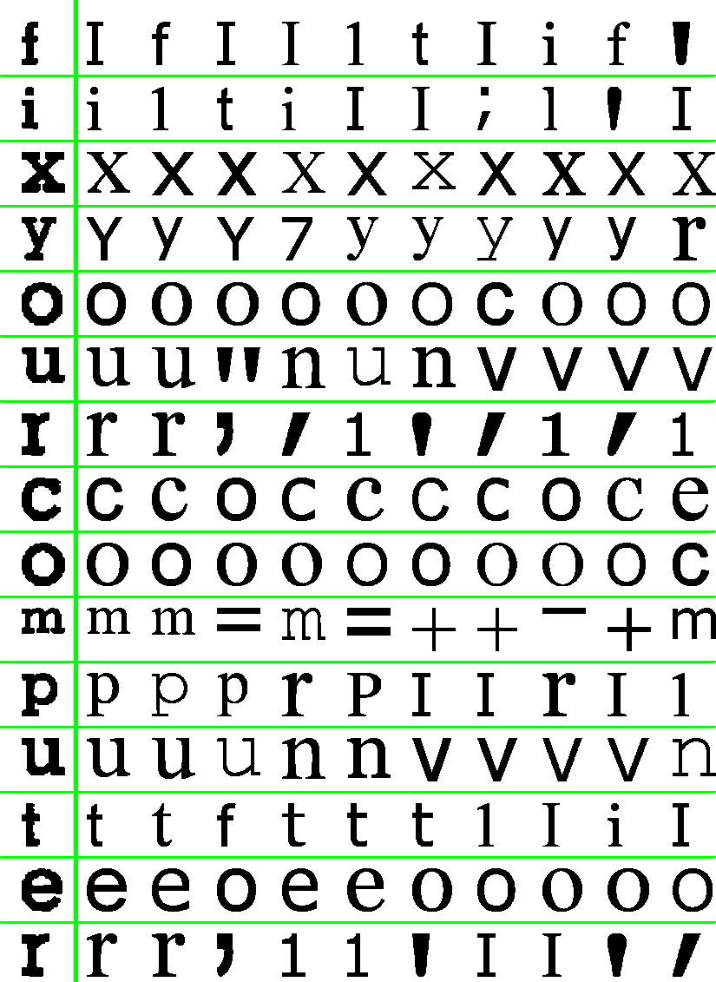
Linguist
Null Linguist
Iix Your computer
Spelling
Linguist
fix your computer

Slide 33
color image
string
Global
Stream N-gram
Binarizer
Local
Linguist
Word N-gram
b&w image
Dictionary distance
votes
Connected Component
Segmenter
Nearest Neighbor
Bounding Box
Matcher
Processed Library
pieces w/area
feature vectors
Constant
Template
Proportional
Thresholder
Feature Extractor
Histogram
Adaptive
Fourier Descriptors
scaled lines of words
big pieces
Simple
Linear
Typesetter
lines of words
Scaler
Proportional

Slide 35
Binarizer
Binarization sends an image’s pixels to either white or black
Simplifies future steps
Methods
  Global
  Local

Slide 36


Global Binarization
Take the average of the brightness of all pixels
For each pixel, send it to black if it is darker than the average and white otherwise
Average: 49.6%

Slide 37


Local Binarization
For each pixel, take the average brightness of the closest surrounding pixels
Helps clean up noise and pixel-level connections between letters
Average: 38.7%
39%

Slide 38

Color
Pixels might have different colors but same brightness
A simple grayscale function that ignores color information can be problematic.
Simple Grayscale

Slide 39
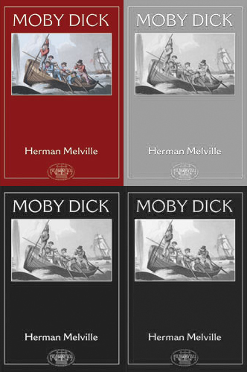
Color
In typical images, color is represented through three channels: red, green, and blue.
We can examine these channels separately.

Slide 40
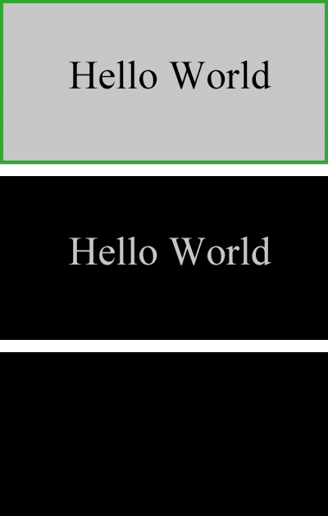
Our solution
Binarize channels separately
Pick the best channel
Red
Green
Blue

Slide 42
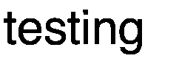
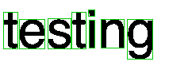
Segmenter
Goal: Find connected components, areas
Techniques
  Naïve set-of-points algorithm
  Bounding box algorithm

Slide 43
Set-of-points algorithm
Create a set of (x, y) coordinates for each black pixel
While the set is not empty:
  Choose a pixel in the set
  Use breadth-first search to find all pixels adjacent to that pixel
  Remove those pixels from the set
  Copy those pixels to another image on the side
fa
f a

Slide 44


Bounding box algorithm
Initialize an empty list of bounding boxes
For each black coordinate in the image
  If the coordinate is not in any bounding box
    Find the bounding box around all pixels adjacent to this
    Append that bounding box to the list
fa

Slide 46
Area threshold
Goal: Eliminate noise left by the binarizer
Idea: filter out segments of area ≤ threshold
To get the threshold:
  Fixed constant
  Proportion of maximum segment
  Statistical analysis

Slide 47


Fixed Constant
Discards any segments with area below a constant number of pixels
This encounters problems for images of different resolutions

Slide 48
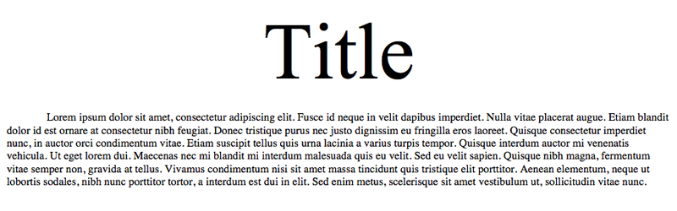
Proportion of Maximum Segment
Discards all segments with area a certain number of times lower than the largest segment
Problematic with multi-size text

Slide 49
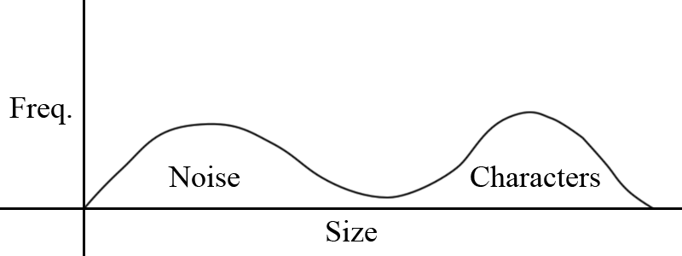
Statistical Analysis
Analyzes the average and standard deviation of the areas of segments
Encounters problems when the quantity of noise gets very large

Slide 51
Typesetter
Goal: To align and join the remaining segments into distinct lines, words, and individual characters
Three distinct subproblems:
  Lines
  Words
  Character Joining

Slide 52
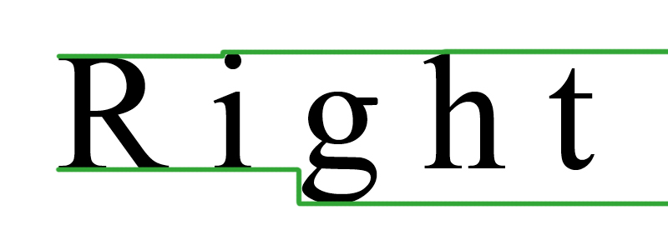
Lines
Find the first segment of a line
Search for following segments to the right until none are found
Adjust the search based on found characters

Slide 53
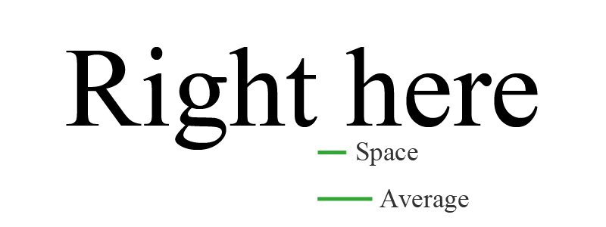
Words
Find the average width of the preceding segments
If the distance between the segments is more than 40% of the average, place a space between them

Slide 54

Characters
For each segment, check for vertically stacked segments on the same line.
If they are found, join them.

Slide 55
Limitations to our approach
Indentation
Lines
Lookback
Character joining

Slide 57
Scaling
Goal: Make all characters the same size
Techniques:
  Absolute
  Proportional

Slide 58
Absolute scaling
Scale the width and height to n

Slide 59
Proportional scaling
Scale image proportional to old image
Add whitespace on right or bottom if needed

Slide 61


Templates
Segments are scaled to a set size.
Unknown segments are compared to each character (the template) in the library pixel-by-pixel.
Doesn’t deal well with unknown fonts?
>
Notes:
The first, and simplest, of these transforms is to perform no transform at all. We scale images to a set size, a preprocessing step we run for all feature extractors, but from there we just leave it be. An unknown image and a template from the library can then be compared to see how many black pixels they have in common. This is good because it is simple—though we still managed to screw it up horribly, and very accurate when our test image is close to the original library image. However, it does not perform well with unknown fonts (maybe, get test data to be sure) and more importantly, it is slow: before we optimized it, it could take around ten minutes (?) to run. This is because we’re comparing ten thousand pixels to ten thousand other pixels just for one template-target comparison, and we do several hundred of those. So, we need some better solution if we want to be running this on pages with hundreds of characters.

Slide 62
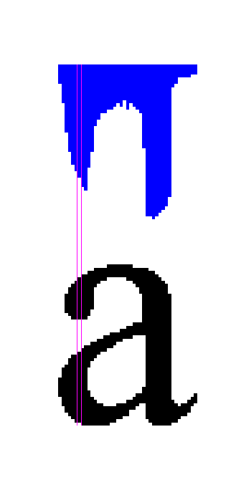
Histograms
Use the sum of black pixels in a given region
Reduces comparisons by an order of magnitude
Notes:
Histograms, our next method, solve this problem nicely. We take advantage of the fact that all our pixels are black or white, and don’t need to be compared by value; we can just count them. An area is cut out of the image, we count the number of black pixels in it, and save that sum for later. This loses some precision, but in a way that’s not particularly bad—we expect that pixels in a given row are likely to be adjacent for the most part, rather than randomly distributed, so their precise location isn’t particularly important.

Slide 63


Histograms
We sum by both rows and columns
Alternatives: grids, diagonals
Notes:
For our particular implementation, we used each row and each column as our areas.
This has the added bonus of being translation-invariant, that is, a letter that is shifted to the right or up will still match, though our scaling should already take care of this.
More importantly, this reduces the number of comparisons radically—we’ve reduced each of n areas to a single number, thus reducing our comparisons by a factor of n: comparing two 100^2 images now requires only 100 or 200 comparisons.

Slide 64
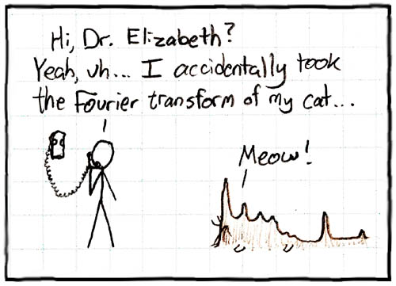
Fourier Descriptors
Notes:
Moving on to our third feature extractor… Well, this was sort of relevant and I figured every presentation needs some comics thrown in.

Slide 65

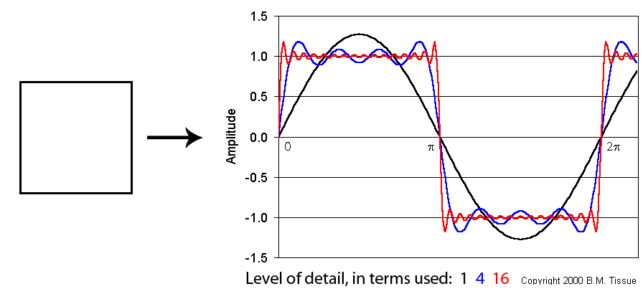
Fourier Descriptors
Use the power of math:
Transform a contour into a series of sine functions
Removing the later functions gives us a smoothed, noise-free image.
Source: http://www.files.chem.vt.edu/chem-ed/data/fourier.html
Notes:
Right, here’s the less fun version of that extractor, a sum. If you’ve had linear algebra, you probably have a better grasp of the actual math than I do, and if not, I don’t claim to know the specifics well enough to be able to give a spot-on explanation. In a nutshell, we’re representing the image as a series of sine functions, from low to high frequency—or more generally, low to high detail. And, since we have these levels of detail separated from one another, we can discard some of them very easily, giving us a basic idea of what the character looks like, with less important, font-specific details, such as serifs, left out.

Slide 66
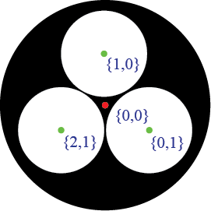
Fourier Descriptors
Faster than the other two: only a few comparisons per curve.
Cost further reduced by only comparing similar collections of curves.
Notes:
So this is even faster than our other two methods—we’re comparing very few points together at most, and we’re only doing that if we can meet several other conditions that require five or so comparisons. Specifically, what we want to compare are letters that have the same number of positive (black-bounding) and negative (white-bounding) curves in the same spatial relations based on their ordinal: the curve on the far right has nothing to its right, and only one above because the curve on the far left is within its vertical tolerance. The one positive curve has no spatial relationships.

Slide 67
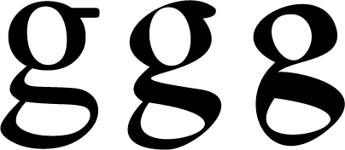
Fourier Descriptor
Ideally, this gives us representations of characters that are free of extraneous details, instead giving us a generic idea of what a “g” or “A” looks like.
Our implementation isn’t quite at this point.

Slide 68






Fourier Descriptors
8
16
32
64
128
256
Notes:
As you can see, we can have various degrees of fuzziness—we can try the lower levels if we’re dealing with, say, unfamiliar and unusual fonts.

Slide 70

K-Nearest Neighbors
Instead of using the best match as the result, use the k best matches.
Notes:
Instead of choosing the best match, we choose the best k matches. Since we’re using multiple fonts in our library, we expect to get multiple matches with same letter, especially as our feature extraction methods become less exact.

Slide 71
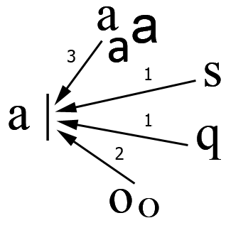
K-Nearest Neighbors
Each of those matches votes for whatever character is associated with it, plurality wins.
Notes:
We can then take these k matches and have them vote, and whoever has the most votes wins.

Slide 72

Weighting
Some characters bear a low resemblance to everything else, their votes are worth less
Votes then passed to the Linguist
Notes:
We’ve additionally added in some weighting to make the closer results worth more, as we found that some characters will simply match most anything, with low similarity, using some feature extractors, making them very common on the lower end. We also don’t determine a result immediately, we pass the vote data onto the Linguist for further evaluation.

Slide 73
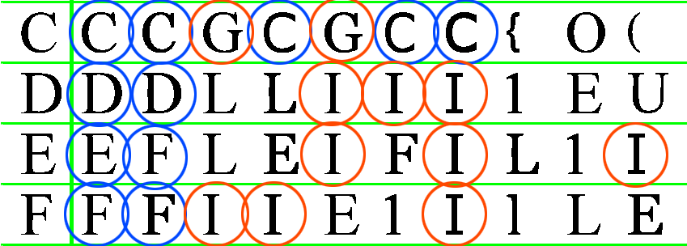
Weighting
I matches the leftmost portion of many letters; this is bad

Slide 75
Linguist
Goal: refine similarity data based on linguistic knowledge
Techniques
  Do nothing
  On-line n-gram-based correction
  Whole-word correction from dictionary
Data: Brown corpus

Slide 76
N-gram model
Language model
  Individual words in the Brown corpus
  Probability of next letter given previous n-1
  Smoothing and backoff by SRILM
Greedy correction algorithm
  For each index in the string, from the start:
    Calculate the probability of each character in the list, given the previous n-1 characters
    Choose the maximum weighted average of LM probability and feature extractor probability

Slide 77
Dictionary model
Language model
  Words in the Brown corpus with frequency
Algorithm
  Enumerate all strings within the edit distance
  Find frequency of those strings in the dictionary
  Select word by weighted average of
    Frequency
    Letter probabilities

Slide 78
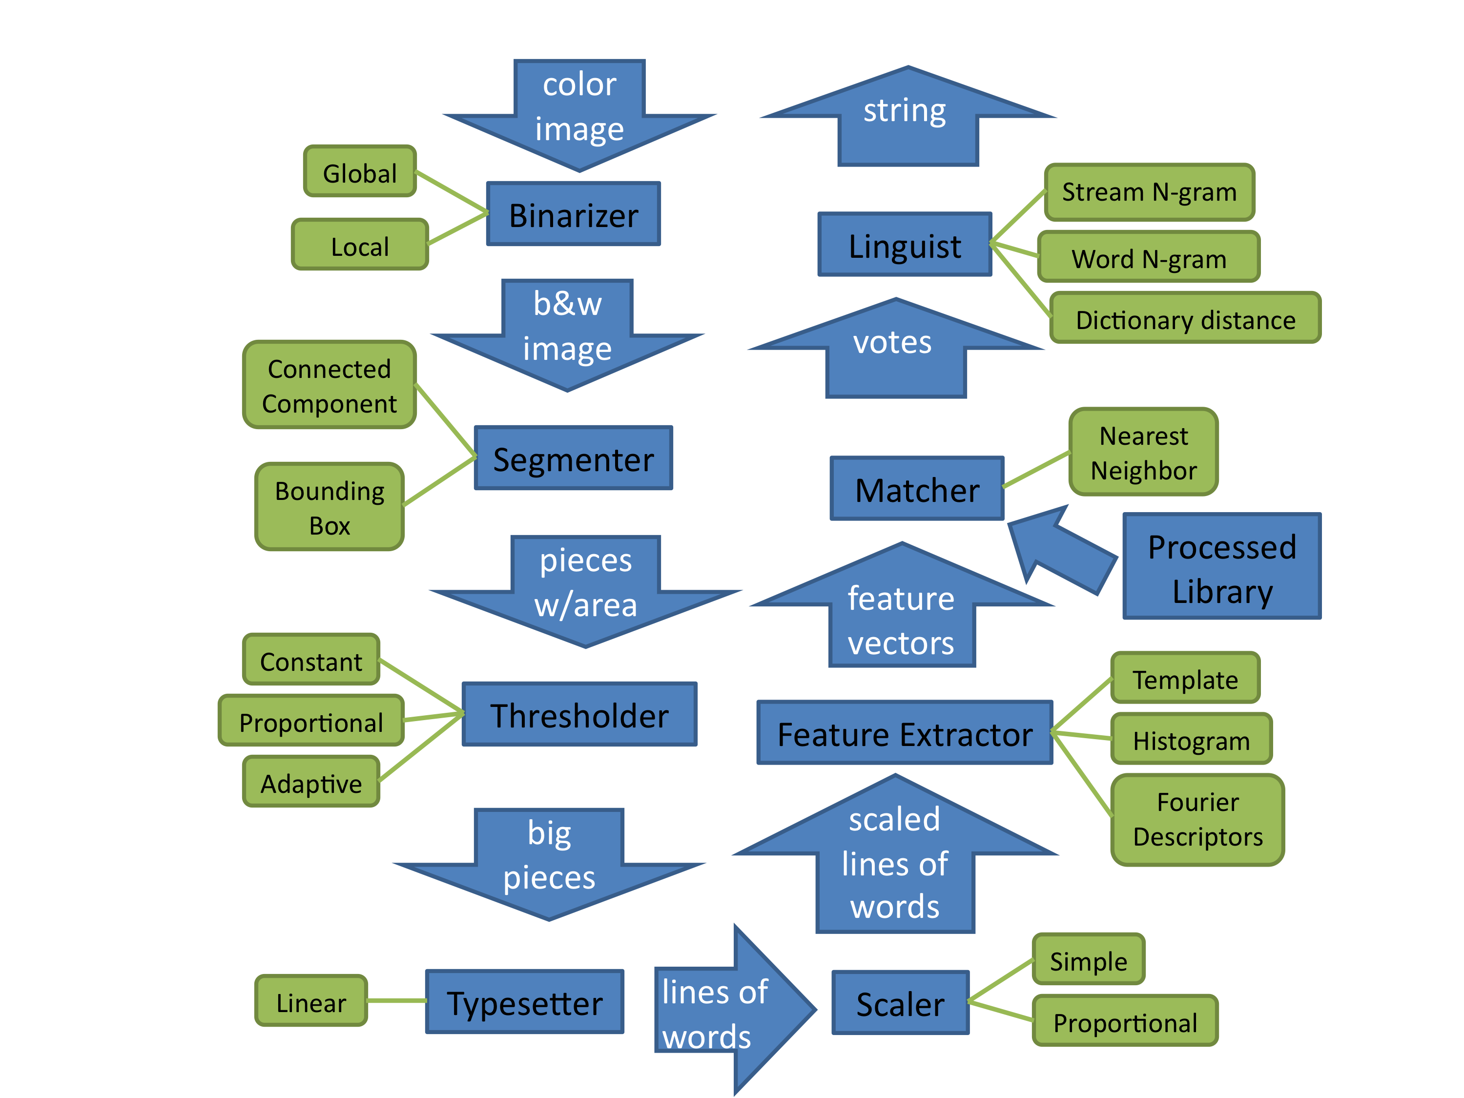

Slide 79
Assisting Libraries

Slide 80
wxWidgets

Slide 81
OpenCV
Local Binarizer Visualization
Histogram Feature Extractor Visualization

Slide 82
Numpy
0
0 1

Slide 83
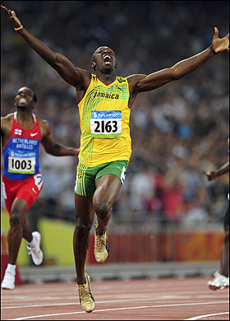
C

Slide 84
Woopsies
A few mistakes and what we learned

Slide 85
Unbinarizing During Scaling
grayscale found here

Slide 86
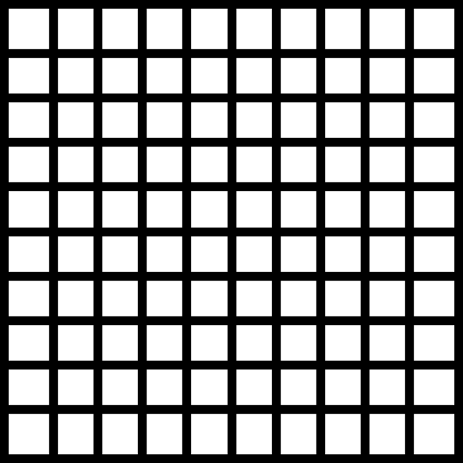
Diagonal Iteration

Slide 87
Performance Analysis
Test cases
  Inside our domain
  Expected failures outside of our domain
How?
  Exhaustive search
  Deep examination of few test cases
  A combination of the above

Slide 88

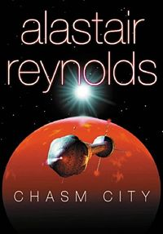
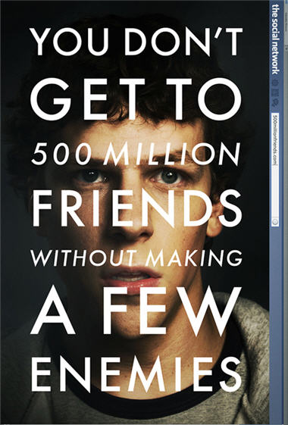

Expected Failures

Slide 89


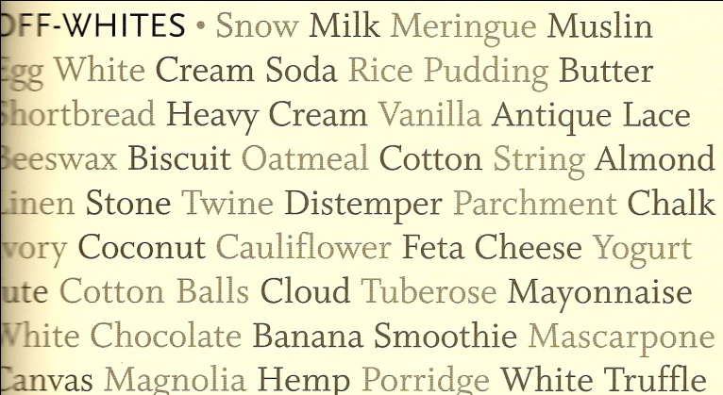
Possible Successes

Slide 90


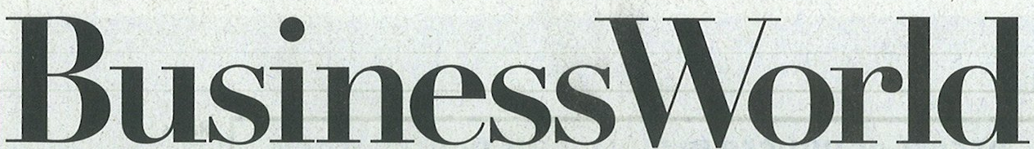
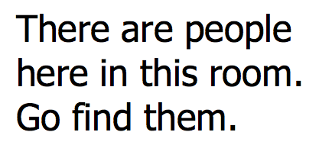

Expected Successes

Slide 91
Methods
Ran all test cases through OCR with different attributes and a null linguist
  Possible Binarizers:
    Global and Local
  Possible Thresholders:
    Constant, Proportional and Adaptive
  Possible Feature Extractors:
    Templates, Histograms and Fourier Descriptors

Slide 92
Methods (cont.)
Results given in terms of letters identified and edit distance with insertions and deletions
Test cases with reasonable results were then put through the linguists
  Possible linguists:
    N-gram, Whole Word N-gram, Spelling

Slide 93
Expected Failures
. K .
' h k !+ &
8 K ' ,
, J
-
. ?
|
` |
* '[
` -. '
~
x !
}
\
`
, ~ x
w~
+
~` ,
`
- 1
_
!~`
k /:| .$:;:/;^'4* */,'`;';`)|;/\v;;:;;::;:|/:;::|:;|:;
,; ' 7
^ ' -
'Y- ' 4
, ~` . I
F
-' 9 }r, $
-, y $ , - - `,
-
, r,4/_`' i1;{, ,`/$;
,
,
`;\-(| Q ,,:,'* |:,J,~,/}) ` ' 7` ` '` < 4
Y ?;\` ;`
- ` `
' 'm>,)\^~' s ,,{ , -
- ~
'
'.
,
] ^ \ -
.
Mjr84 f -.`j;:;;(::,,':-`;\{::'
`{ \q-/ f':- ' ;
l
<~.
,,. ' > .
, ^ - '{V4 v
w/,v^:,' ` ,
rflr8IJY,\-
` 4r * ^ , -j
' ,,; -
'' '
, k -
|
w ~ w
= * o
-' *''' W
(
_ s ' ~ y
=
E
!1 !A. ! $. + !Y +|T_ ~ :` -!_``J~-;!-|!!~
.
~
-

Slide 94
Possible Successes
!t+
!
" ~" " e :* ;
" "
_ w'~
*
~
^N:8\r5!

Slide 95
Possible Successes (cont.)
'F-Wl lTES . Snow Milk Meringue Muslin
White Cream Soda Rice Pudding Butter
orthI-ead Heaw Cream vanilla Autique Iace
eswax Biscuit oatmeal Cottou String /moud
- Stone Twine Distemper Parchment Chalk
en
oj Cocount Caulihower Feta Cheese Yojrt
te Cottou Balls Cloud Tuber-ose Mayonnaise
hite Chocolate Banaua Smoothie Mascarloue
vas Majuolia Heml Porridje White Trufle
;
Global Binarizer
Adaptive or Constant Threshold
Template Matcher
N-gram Linguist

Slide 96
Expected Successes
Global Binarizer
Any Thresholder
Template Matcher
Spelling Linguist
fix your computer
I will Nor
No
for free
Any Binarizer
Any Thresholder
Any Matcher
Any Linguist (not null)
This
Any Binarizer
Any Thresholder
Histogram or Template Matcher
Any Linguist (not null)
THIS

Slide 97
Expected Success (cont.)
Any Binarizer
Any Thresholder
Template Matcher
Spelling Linguist
xondpy, Ap)1 8, 1872
c-e aro-d 1a'-. A --or-wpr PQaoed Pa 1j. a mo-,= -ilv:;; :;n:e
ujp /1b 1)oo 11.ra or -o. The o-ow I! beep waulw-, -d }d
cloihos all b-8 ,n the )-, -. rp1)or aqYu 1,oy w-b .very Xoudey,
an 11ey have .wasti- daya,, Just as we do e1 home .
be 1Qqked ojp 1n the !1erucou, -d toward ni

Slide 98
Expected Success (cont.)
Any Binarizer
Any Thresholder
Template Matcher
Spelling Linguist
There are people
here in this room.
Go find them.
Any Binarizer
Proportion-Thresholder
Template Matcher
Spelling or N-gram Linguist
Businessworld

Slide 99
Results
Template matcher is best performer
No single set of ideal starting parameters

Slide 100
Conclusions
Collected Culminations and Cessations

Slide 101
Conclusions
Our solution was a sequence of components each performing a specific sub-task
Components are modular
Many possible solutions for each component
Notes:
So, to wrap up, our solution to the OCR problem was to develop a modular sequence of components for each sub-task.

Slide 102
color image
string
Global
Stream N-gram
Binarizer
Local
Linguist
Word N-gram
b&w image
Dictionary distance
votes
Connected Component
Segmenter
Nearest Neighbor
Bounding Box
Matcher
Processed Library
pieces w/area
feature vectors
Constant
Template
Proportional
Thresholder
Feature Extractor
Histogram
Adaptive
Fourier Descriptors
scaled lines of words
big pieces
Simple
Linear
Typesetter
lines of words
Scaler
Proportional

Slide 103
Conclusions
Everything has tradeoffs
Gotchas and stupid mistakes abound
OCR is hard
Notes:
Some things that we’ve learned:
Everything has tradeoffs: a solution like Fourier descriptors may be faster than template matching, but it’s also often less accurate.
It’s easy to make stupid mistakes and hard to find them—something that is wrong might work well enough to imply that it’s not completely wrong, such as the LineIterator fiasco, or it might go away seemingly at random, like the Fourier descriptor interpolation problem.
OCR is hard: it’s a significant task just to figure out which of the umpteen-hundred possible solutions you’d implement, implementing it never goes completely as planned, and even once you do get everything working, results may not be as expected.

Slide 104

Conclusions
OCR is AWESOME
So are owls

Slide 105
Future Work
Binarizer: make use of local and global data both.
Segmenter and Typesetter: seam carving for edge cases.
Feature Extractor: generalizing, invariance to skewing, occlusion, rotation.
Linguist: HMMs for n-grams, multiple passes
General: optimization, better use of libraries
Notes:
The blessing, or curse, of comps is that the time we have to do it is far shorter in practice than it would seem at the outset. However, if we had infinite time available, there are some additional ideas we would have liked to implement.
The binarizer currently uses either only local or only global knowledge to make its decision: it would be nice to use both.
The segmenter and typesetter encounter cases where they can’t find a perfect line of demarcation, for these, something like seam carving would work.
The feature extractor could be better at generalizing letter shapes, and could also deal with letters that are skewed, partially covered, or rotated slightly.

